Slide 1

Anatomy Of The Male Reproductive System (1)
Dr: Amer H. Saleem
MRCS, London
FEBU, Egypt
Arab board, Jordan
Consultant, Shifa hospital

Slide 2
The male reproductive system is mostly located outside of the body.
These external organs include :
Distal urethra
penis,
scrotum
Internal organs include:
vas deferens
prostate
urethra.
Testis
Epididymis
ejaculatory ducts
Accessory glands : seminal, prostate and bulbourethral glands
The male reproductive system is responsible for sexual function, as well as urination

Slide 3
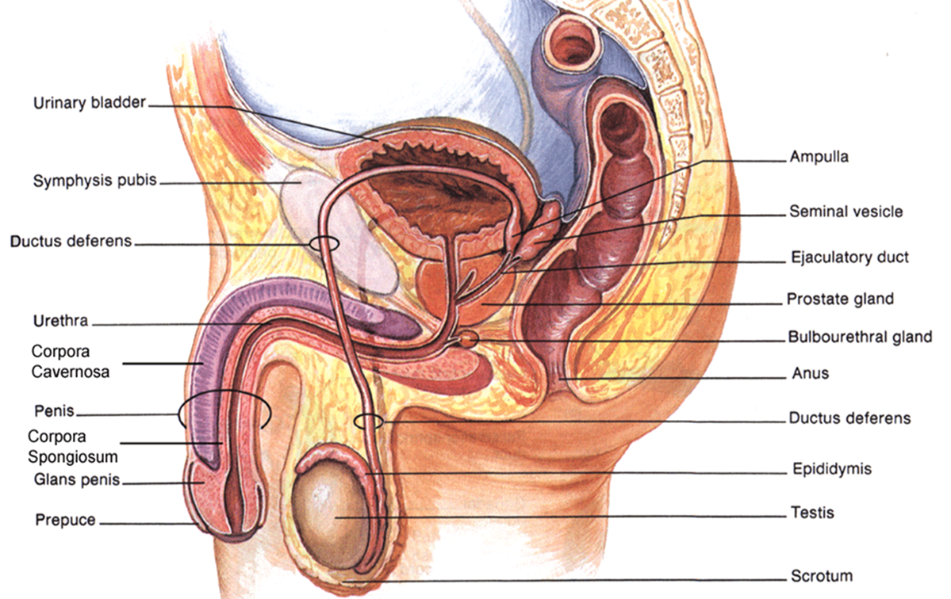
Male reproductive system

Slide 4
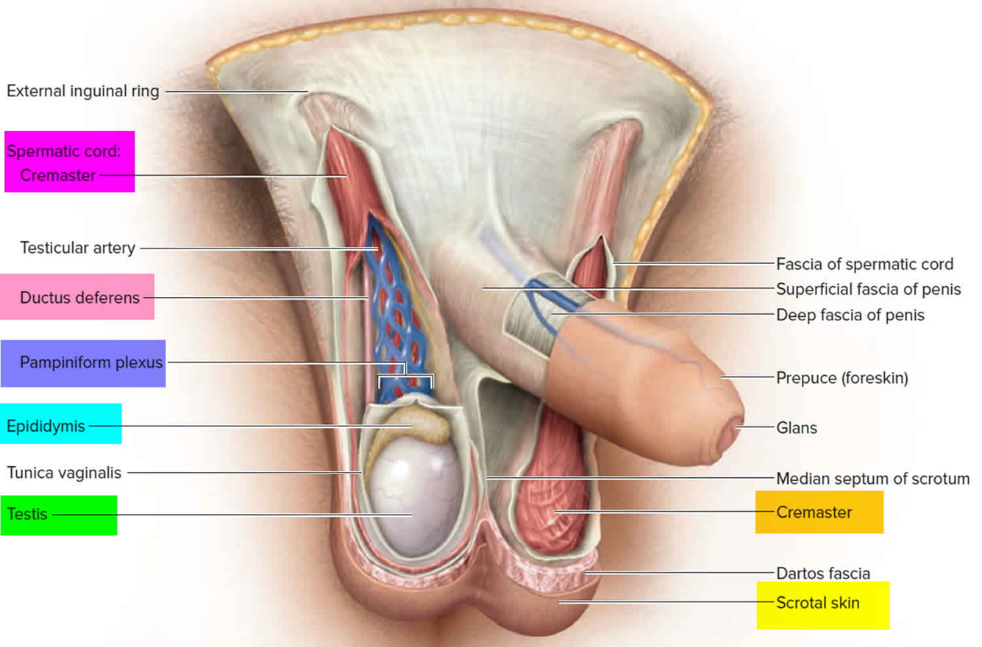

Slide 5
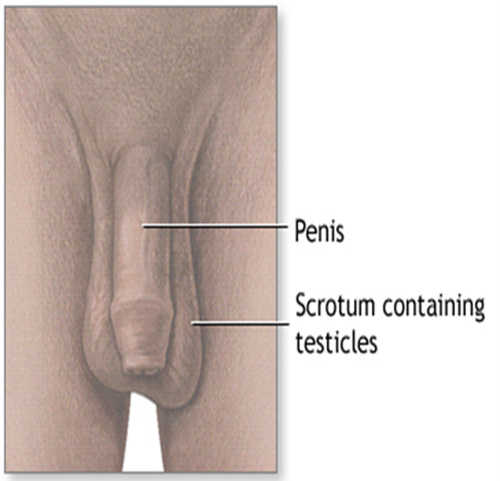
The scrotum
The scrotum is a large pendulous sac of skin below and behind the penis.
it is an out pouching of skin formed from the lower part of the anterior abdominal wall .

Slide 6
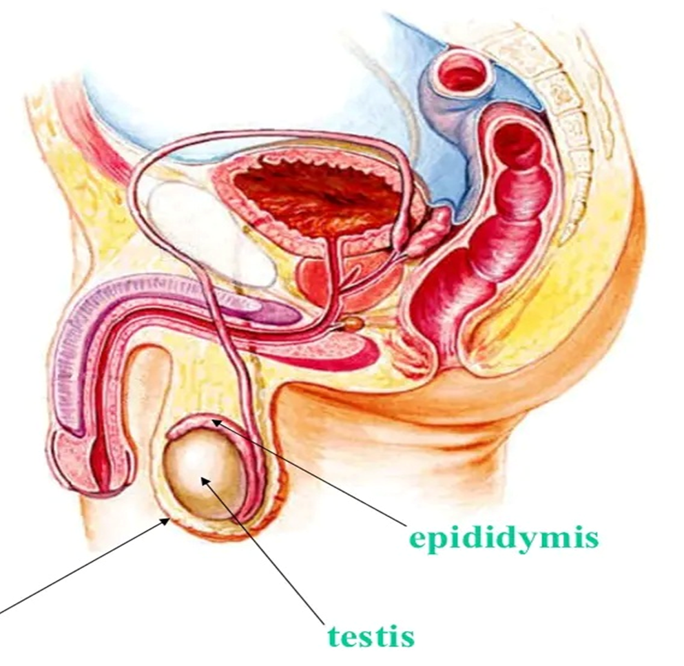
Scrotum

Slide 7
The Scrotum
It is comprised of the following structures:
Testes.
Epididymis.
Lower parts of the spermatic cords

Slide 8
The Scrotum
External features :
The scrotum is split into left and right halves by a median ridge or raphe, which suggests the line of fusion of the 2 halves of the scrotum.
This ridge is continued forwards in the midline to the undersurface of the penis and backwards in the midline of the perineum to the anus

Slide 9
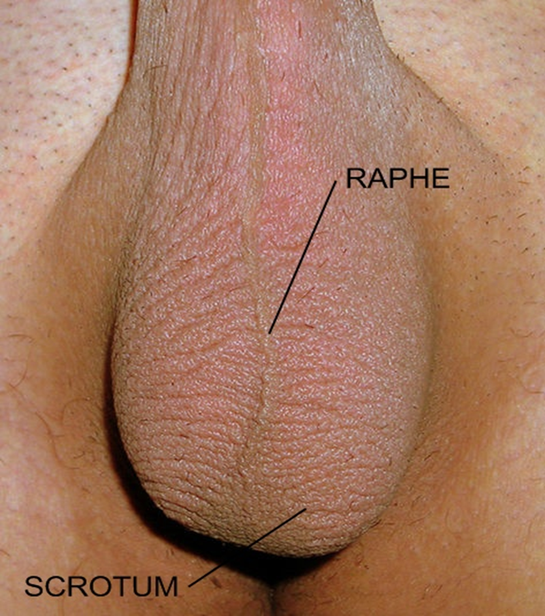
The Scrotum

Slide 10
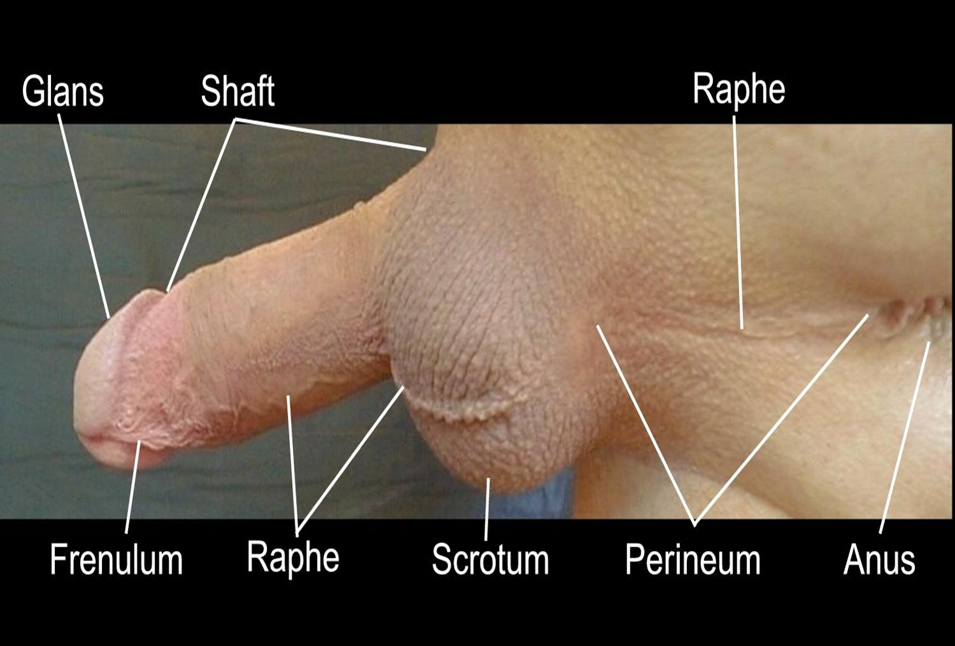

Slide 11
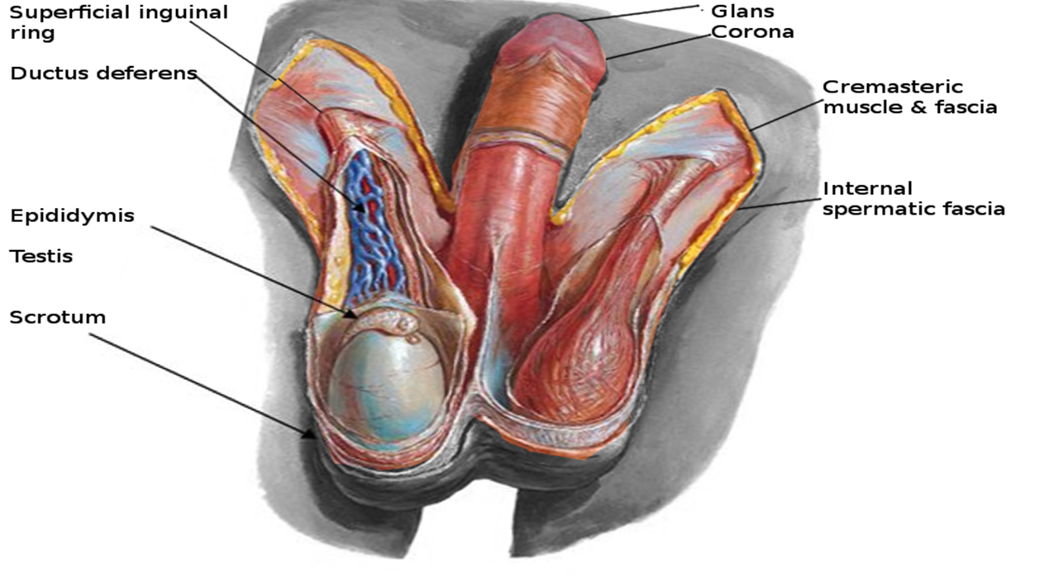
The left half of the scrotum hangs lower compared to the right half as the left spermatic cord is longer in relation to the right spermatic cord

Slide 12
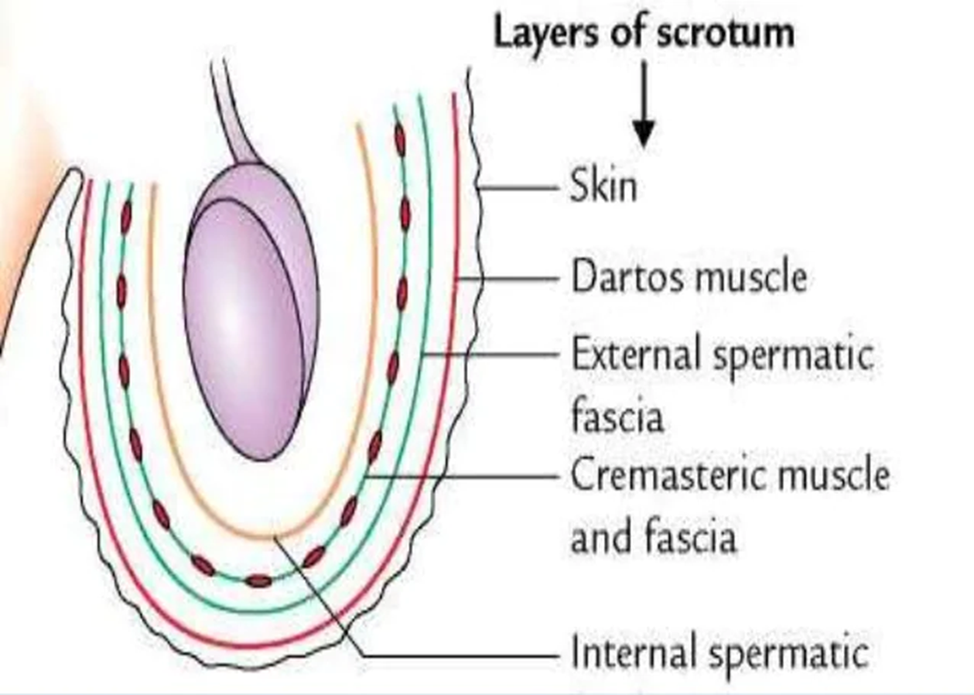
Layers of the scrotum

Slide 13
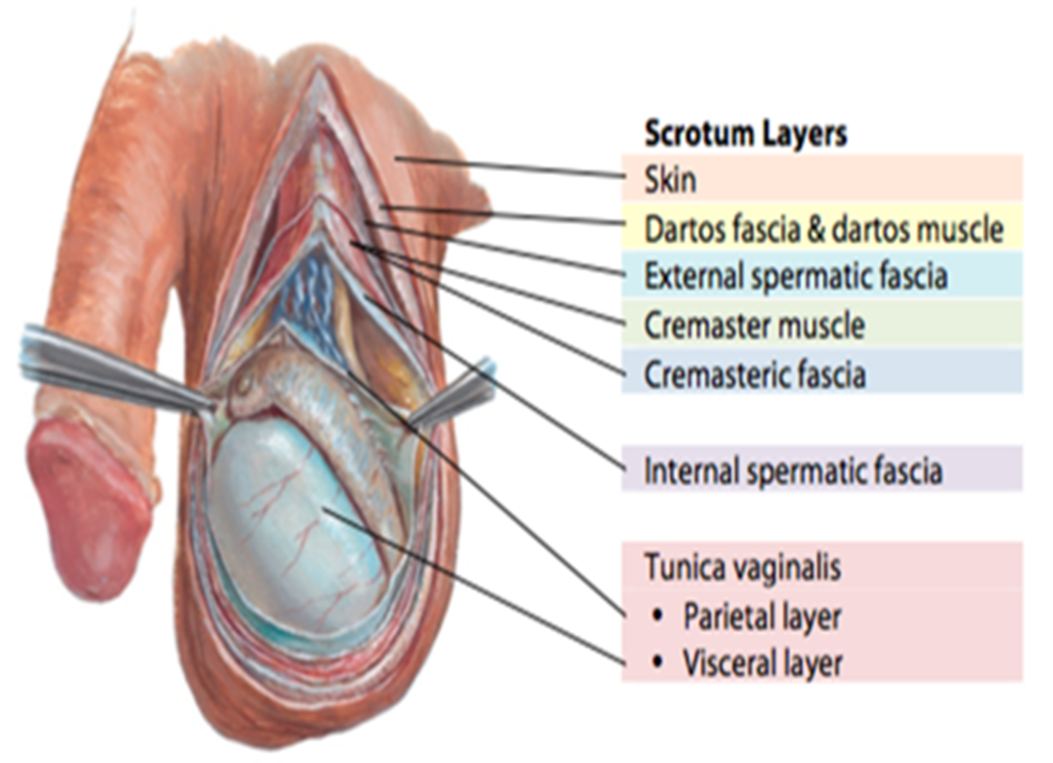

Slide 14
THE SCROTAL SKIN
It is thin, elastic, pigmented and presence of rugose due to adhesion with the underlying dartos muscle.
It bears scatted coarse hairs and numerous sebaceous and sweat glands, pigment cells, nerve endings.
Here the absence of subcutaneous adipose tissue helps in lowering the scrotal temperature

Slide 15
DARTOS MUSCLE
It is the thin layer of subcutaneous involuntary muscle
It is continuous with the fascia of camper and scarps of the anterior abdominal wall and posteriorly with the fascia of colles of the perineum
It extends interiorly at the median raphe as scrotal septum
This layer helps in regulation of temperature within the scrotum.

Slide 16
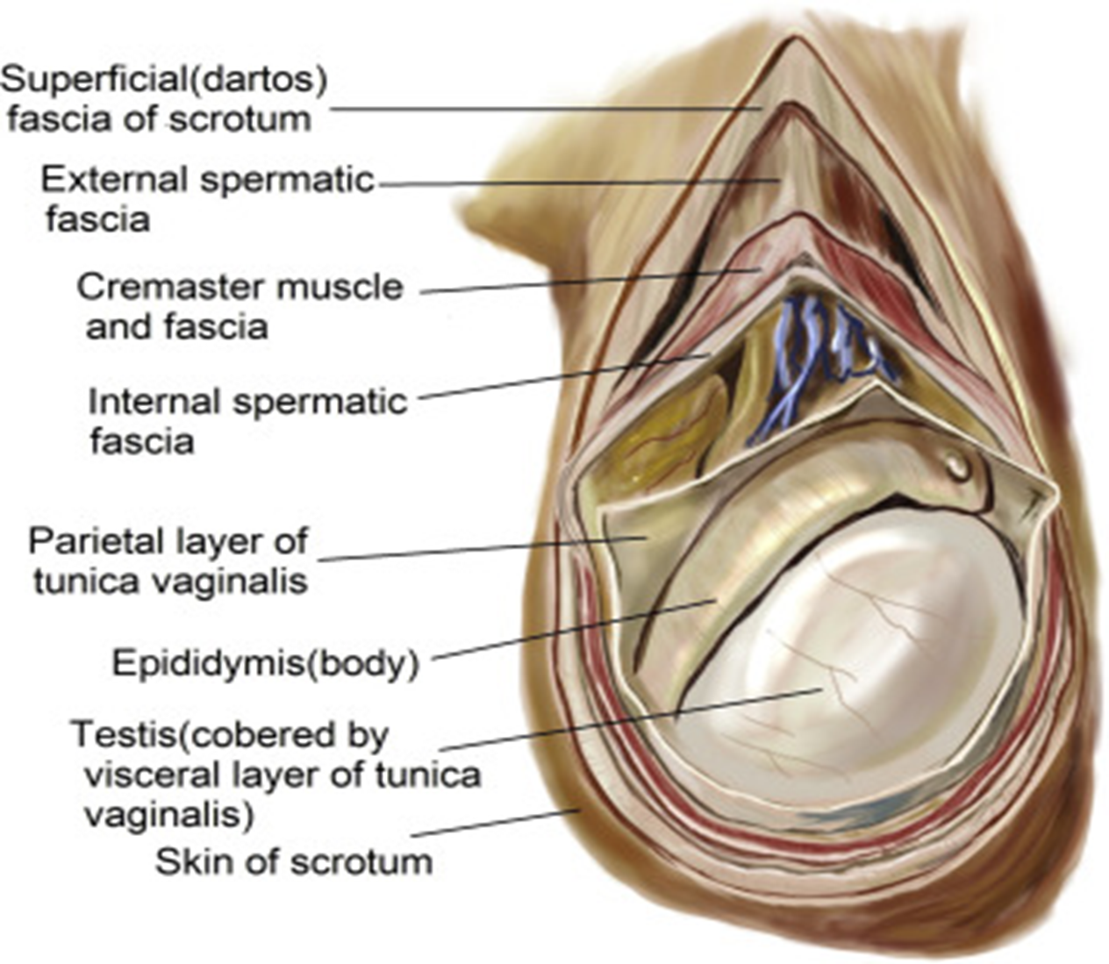

Slide 17
EXTERNAL SPERMATIC FASCIA
It is the tubular prolongation of the fibrous tissue from the margins of the superficial inguinal ring.
It is the continuation of aponeurosis of external oblique abdominis and overlying fascia.

Slide 18
CREMASTERIC MUSCLE AND FASCIA
It is derived from the oblique abdominis and transverses abdominis
It extends from the superficial inguinal ring, and spreads in the scrotum in form of U-shaped loops which are held together by an areolar fascia.
When this muscle contracts, it pulls the testis towards superficial inguinal ring and acting as cremasteric plug

Slide 19
INTERNAL SPERMATIC FASCIA
It is derived from the fascia transversalis from the margins of the deep inguinal ring.
THE PARIETAL LAYER OF TUNICA VAGINALIS
It is developed from the distal part of the processus vaginalis of the peritoneum

Slide 20
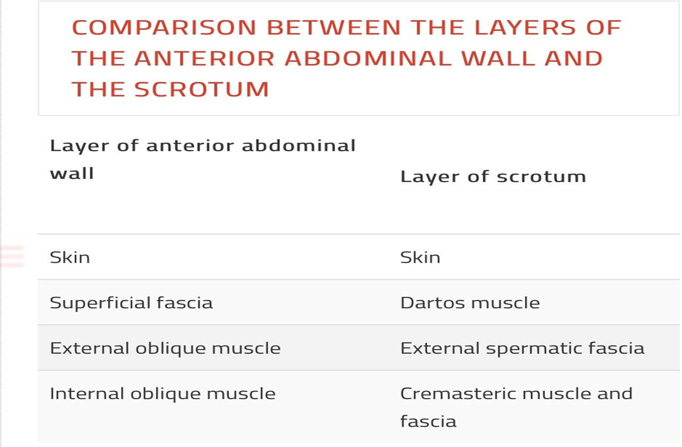

Slide 21
Blood supply
Posterior scrotal branches of the perineal artery: Arise from the internal pudendal artery, which is a branch on the internal iliac artery.
Anterior scrotal branches of the external pudendal artery: The external pudendal artery branches directly from the femoral artery, a continuation of the external iliac artery.
Cremasteric artery: A branch of the inferior epigastric artery, which arises from the external iliac artery

Slide 22
Nerve supply
Anterior one third of the scrotum is provided by ilioinguinal nerve (L1) and genital branch of genitofemoral nerve (L1).
Posterior two third of the scrotum is provided by posterior scrotal branches of the perineal nerve (S3) and perineal branch of the posterior cutaneous nerve of the thigh (S3).
The automatic dartos muscle is provided by the sympathetic fibers via genital branch of the genitofemoral nerve.

Slide 23
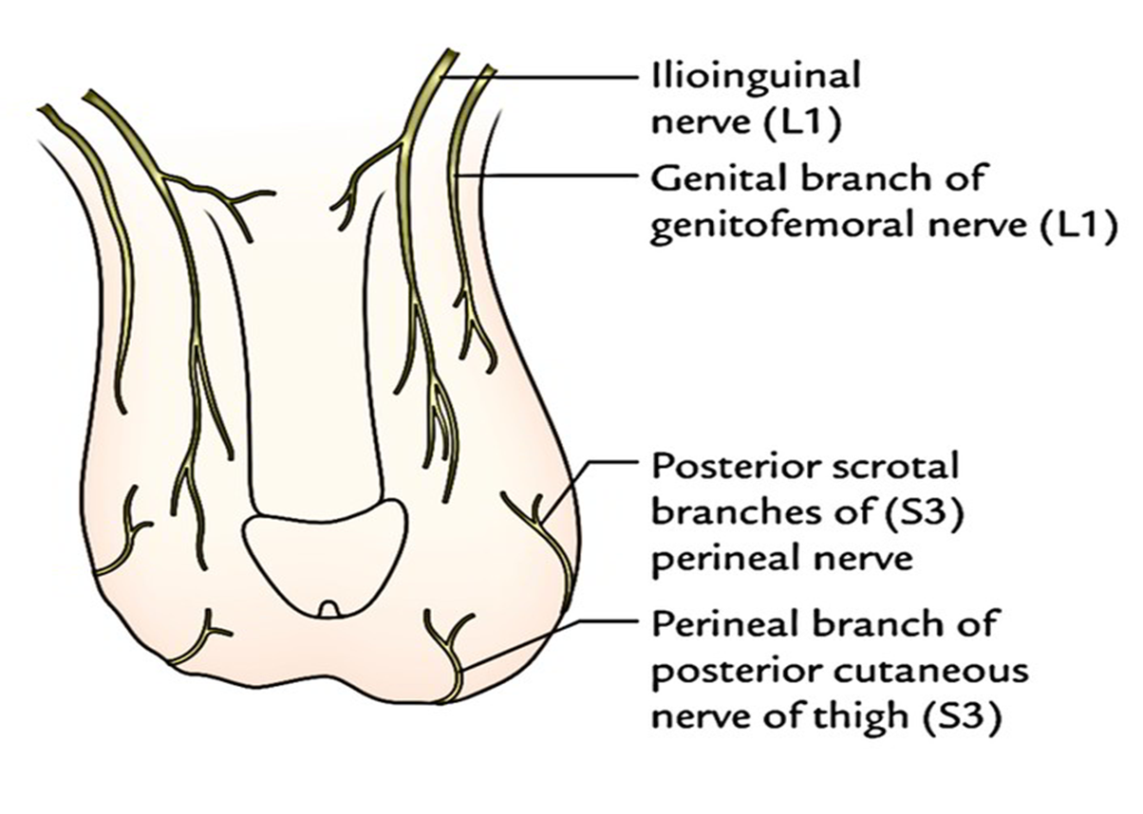
Nerve supply of the scrotum

Slide 24
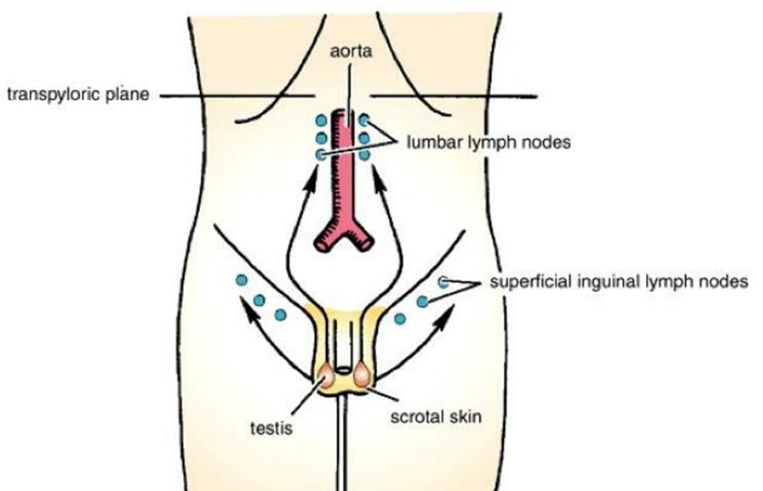
LYMPHATIC DRAINAGE
The lymph vessels from the scrotum drain into the superficial inguinal lymph nodes.

Slide 25
Testicles
The testicles are paired organs within the scrotum that include both reproductive and endocrine functions.
It is a male gonad that is homologous with the ovary in the female.
The testes are oval organs about the size of very large olives that lie in the scrotum, secured at either end by a structure called the spermatic cord.

Slide 26
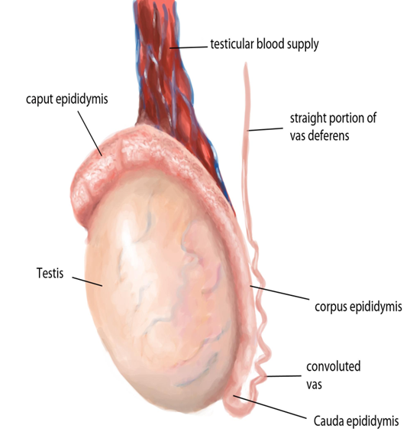
Testicles
The testes are responsible for making testosterone, the primary male sex hormone, and for producing sperm.
Testis is one of the mobile organs of the body.

Slide 27
SHAPE AND MEASUREMENTS
Shape :
It’s oval/ellipsoid in shape (compressed from side to side).
Measurements :
- It measures roughly 4 X 3 X 2.5 cm (length = 4 cm, width = 2.5 cm, anteroposterior diameter = 3 cm) and weight = 10-15 grams.
- The testis normally has a volume of 15 to 25 mL

Slide 28
POSITION IN THE SCROTUM
The testis is suspended in the scrotum by the spermatic cord.
It is located obliquely, so that its upper pole is leaned somewhat forwards and laterally, and lower post backwards and medially.
The left testis is located somewhat at the lower level compared to the right since the left spermatic cord is somewhat longer in relation to the right. This is because descent of left testis starts early

Slide 29
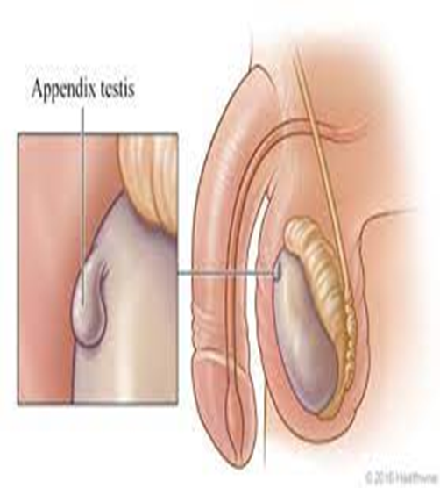
There is a small pedunculated or sessile body at the upper pole of the testis, which is known as the appendix testis

Slide 30
COVERINGS
A tough capsule envelops the testis, composed from external to internal of the visceral :
tunica vaginalis
the tunica albuginea
the tunica vasculosa

Slide 31
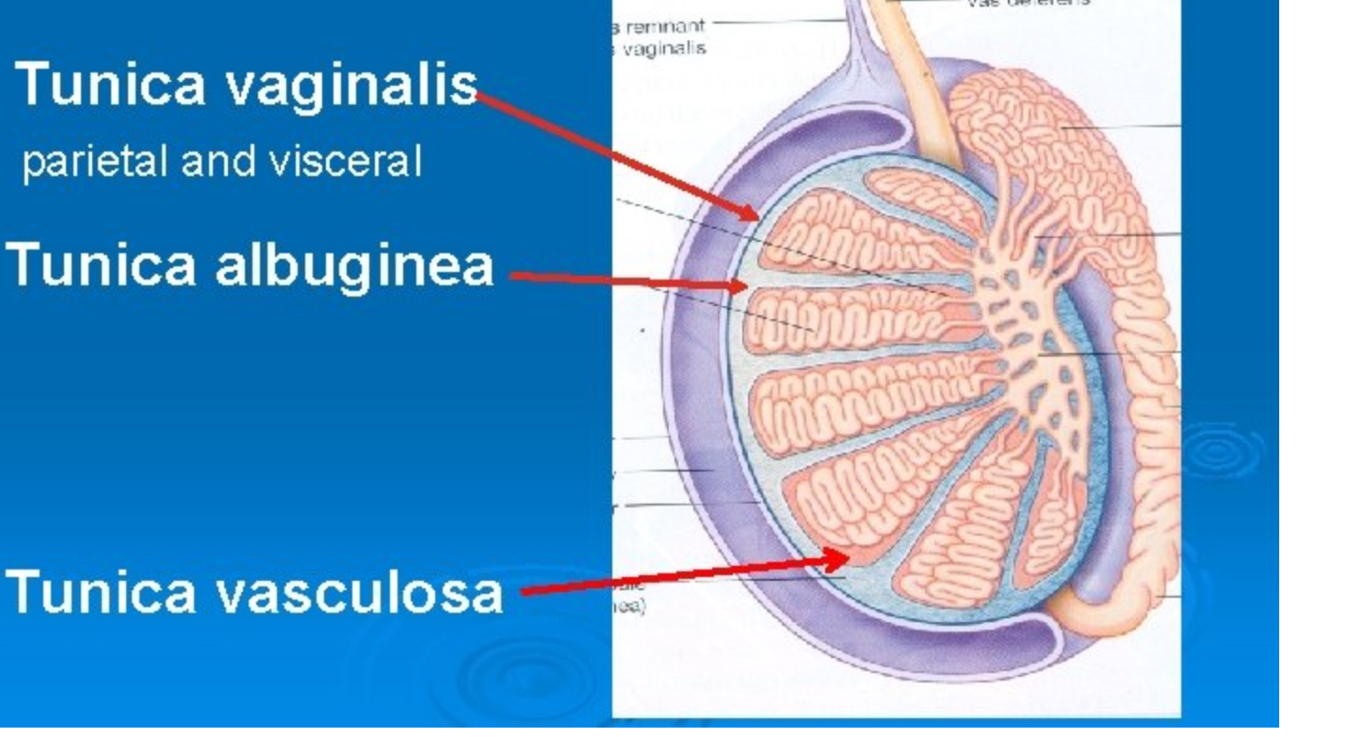
Coverings

Slide 32
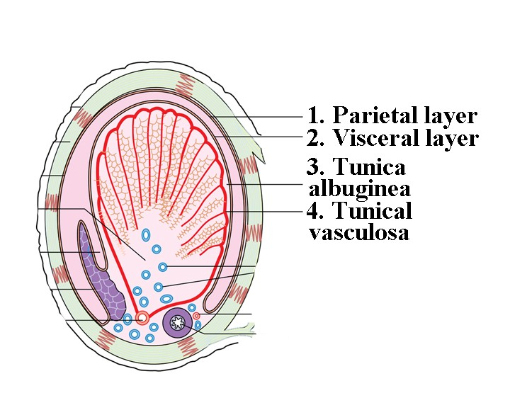

Slide 33
Tunica Vaginalis
It’s a serous sac representing the constant lower portion of the processus vaginalis.
It’s invaginated by the testis from behind. Consequently, it presents parietal and visceral layers using a potential cavity between them.
Therefore, the tunica vaginalis fully encloses the testes on the front and sides

Slide 34
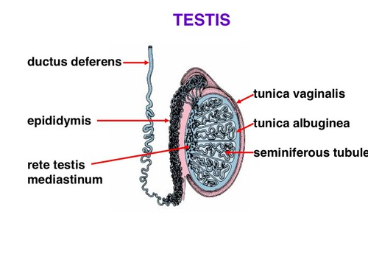
TUNICA ALBUGINEA
It’s a thick, dense layer of fibrous tissue enclosing the testis.
It’s covered by the visceral layer of tunica vaginalis with the exception of where it’s in direct contact together with the epididymis

Slide 35
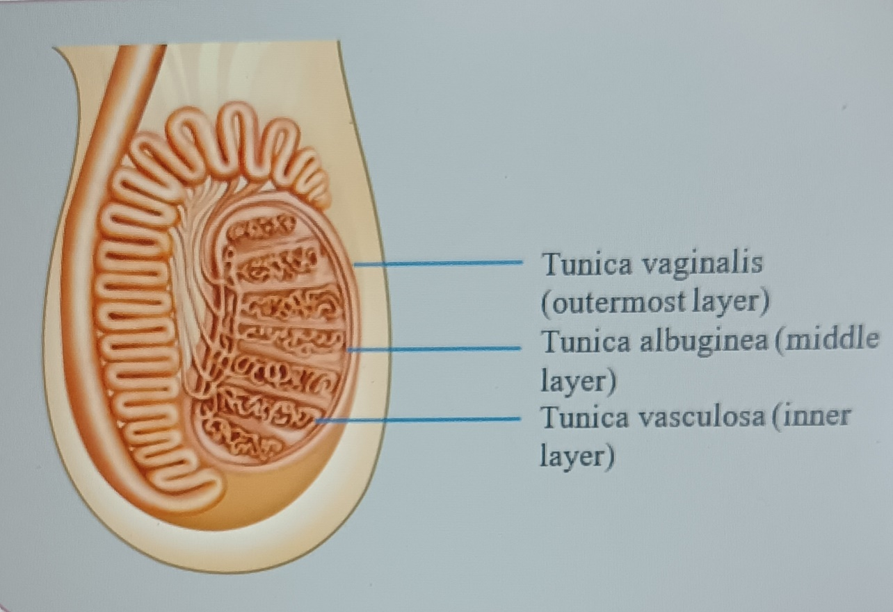
TUNICA VASCULOSA
It’s the innermost vascular layer of the testis, lining the lobules of the testis

Slide 36
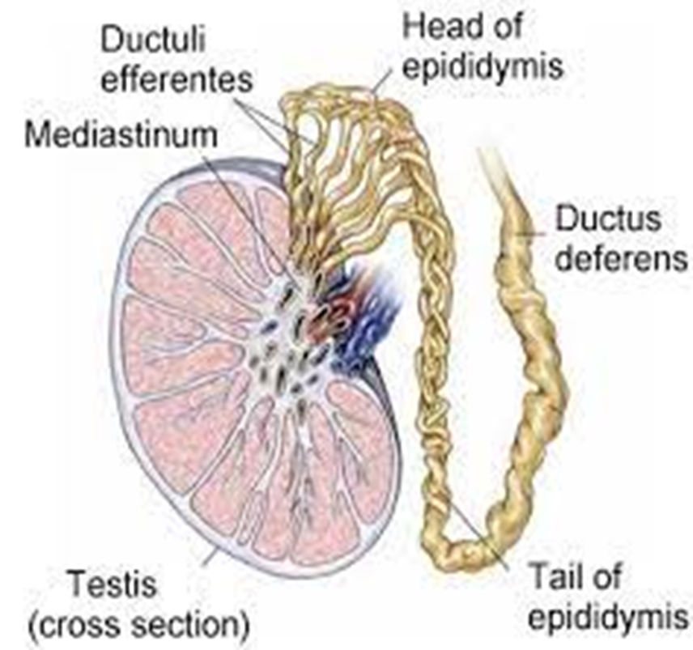
STRUCTURE
The testis is enclosed in a fibrous capsule, the tunica albuginea. Posteriorly, the tunica albuginea is thickened to create an incomplete vertical septum/ridge, the mediastinum testis

Slide 37
STRUCTURE
Numerous incomplete fibrous septa go from the mediastinum to the inner aspect of the tunica albuginea and split the inner part of the testis into 200-300 lobules.
Every lobule includes 2 to 4 coiled seminiferous tubules, lined by thick multilayered germinal epithelium that creates spermatozoa.
The thin, threadlike loops of seminiferous tubules join every other and become straighter as they pass toward the mediastinum creating straight tubules

Slide 38
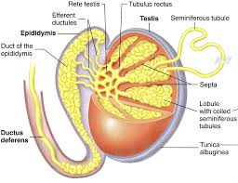

Slide 39
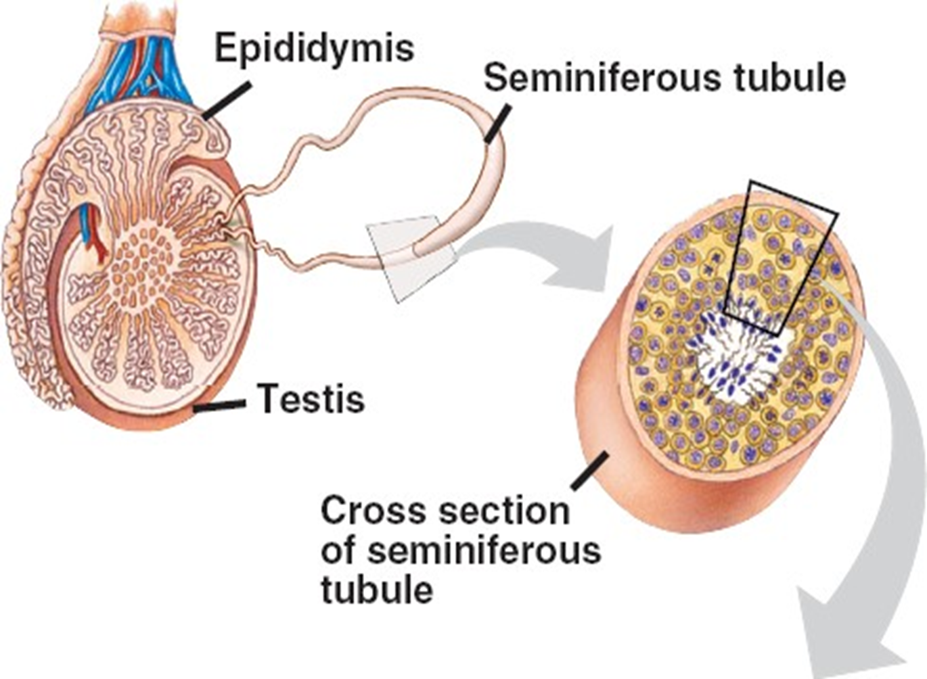

Slide 40
The seminiferous tubules contain germ cells and supporting cells including Sertoli cells, fibrocytes, and myoid cells of the basement membrane
The testosterone-producing Leydig cells are interdispersed in the loose tissue around the seminiferous tubules.
The interstitial tissue includes Leydig cells, mast cells, macrophages, nerves, blood vessels, and lymphatic vessels. This interstitial tissue makes up a total of 20% to 30% of the testicular volume

Slide 41
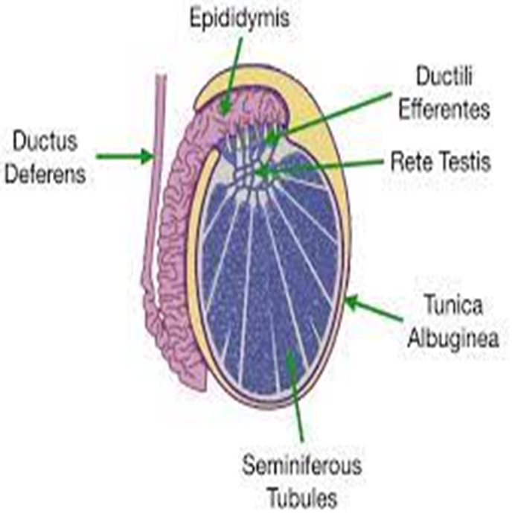
Seminferous tubules are coiled and long, with both ends typically ending in the rete testis.
The seminiferous tubules straighten out and become tubuli recti toward the apex of each lobule,
And anastomoses with rete testis
forms 8 to 12 efferent ductules that anastomose into the caput of the epididymis

Slide 42
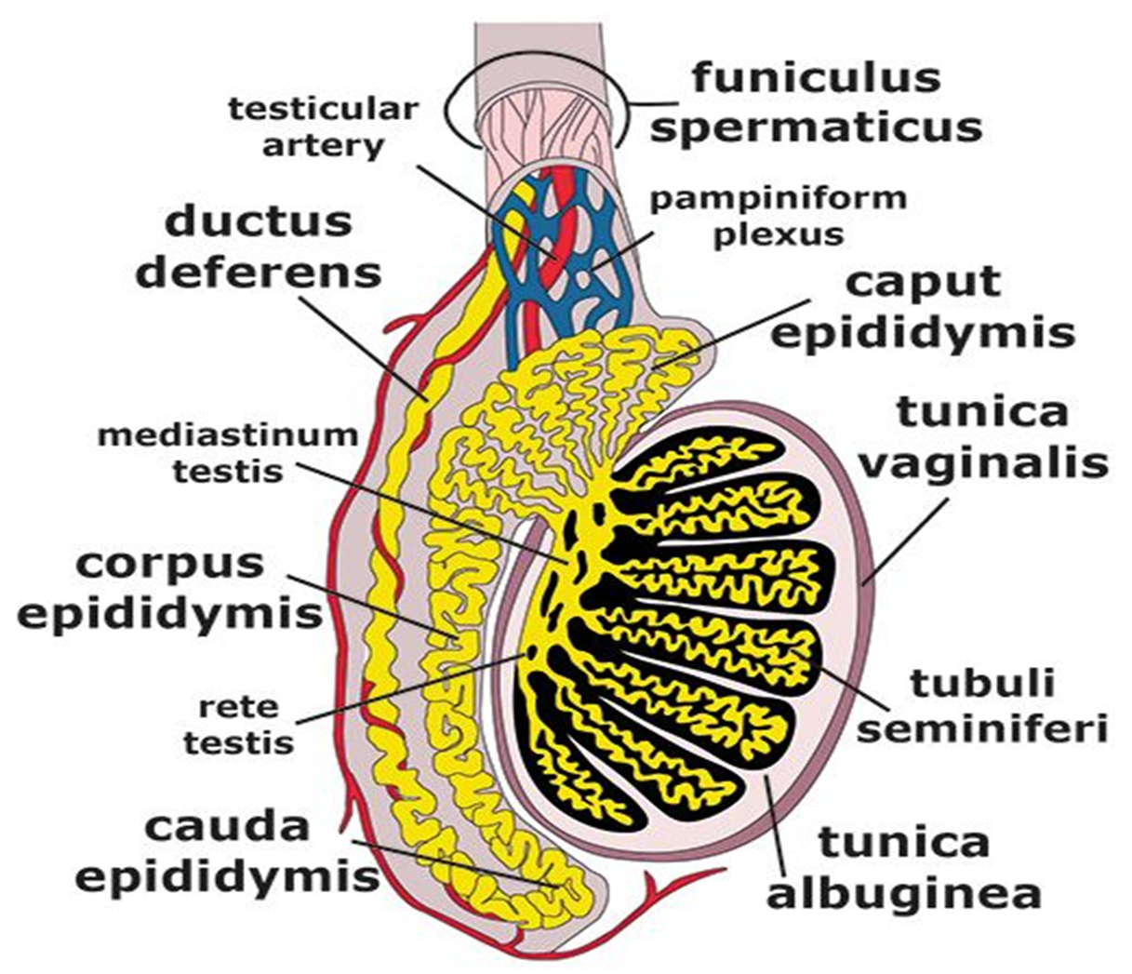

Slide 43
Number of lobules in testis: 200-300.
Number of seminiferous tubules in every lobule: 2-4.
Length of every seminiferous tubule: 60 cm. Therefore, if all the seminiferous tubules are joined together, their overall length becomes 500 m.

Slide 44
Arterial Supply
There are three arterial supplies to the testis:
Testicular (internal spermatic) artery
Artery of the vas deferens (deferential artery)
Cremasteric (external spermatic) artery

Slide 45
The Testicular Artery
The testicular artery provides the testis, which originates from the abdominal aorta in the abdomen in the level of L2 vertebra.
Afterward it enters downward and laterally to goes into the deep inguinal ring, traverses via the inguinal canal inside the spermatic cord to get to the testis.
At the posterior border of testis, it’s split into a number of small branches and 2 large (medial and lateral) branches

Slide 46
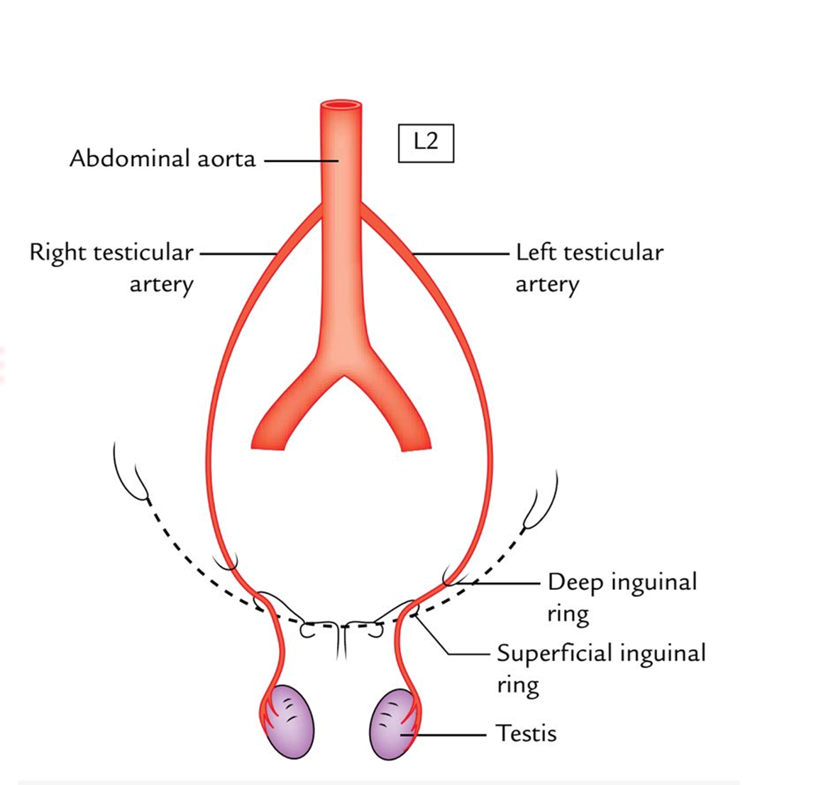

Slide 47
VENOUS DRAINAGE
The pampiniform plexus of veins (the veins appearing from the testis create a plexus of veins referred to as pampiniform plexus) empties the venous blood from the testis.
This plexus ascends up and at the superficial inguinal ring condenses to create 4 veins, which go through the inguinal canal inside the spermatic cord.
At the level of deep inguinal ring, they join to create a 2 testicular veins which accompany the testicular artery.
On the right side, the testicular vein drains into the inferior vena cava for an oblique angle while on the left side it drains into the left renal vein at a right angle.

Slide 48
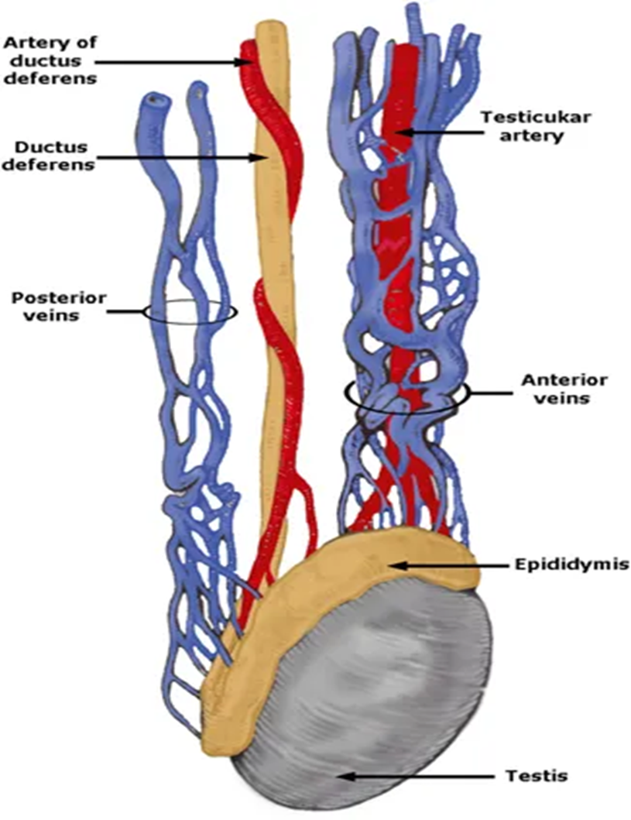

Slide 49
LYMPHATIC DRAINAGE
Lymphatic channels from the testis drain into the para-aortic and interaortocaval lymph nodes.

Slide 50
Clinical Notes
The presence of the scrotum and testes outside of the body is important for parents of newborn male babies.
In about 3% of full-term babies and 30% of premature infants, the testes do not descend into the scrotum but remain inside the body.
This irregular positioning of the testes is called cryptorchidism.
This is an important check to perform as cryptorchidism affects the fertility and also undescended testes are at a greater risk of becoming malignant or cancerous

Slide 51
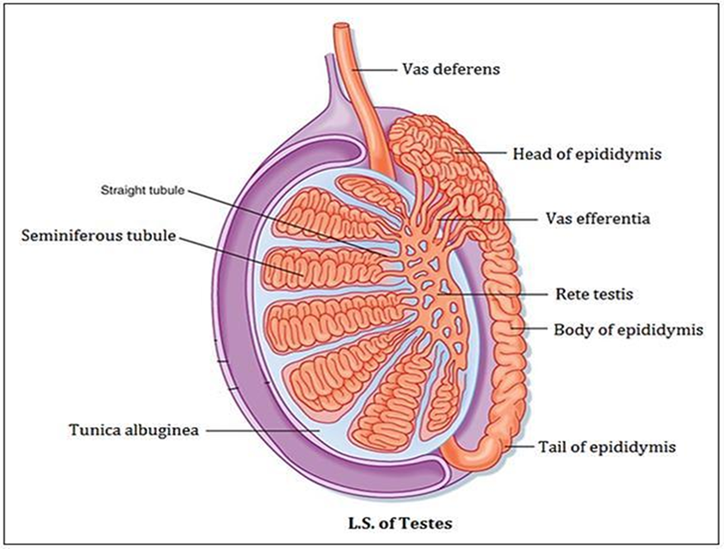
Epididymis
The epididymis is a comma-shaped structure, which is located on to the superior and posterolateral outermost layer of the testis.
It’s created from highly coiled tubes.

Slide 52
Its { 3-4m in total length } Wolffian duct structure
coiled and encapsulated within sheath of convoluted tubule of the tunica vaginalis.
epididymis is covered by contractile tissue
2-4 cell thick contractile layer surrounds ductuli efferentes to proximal body of epididymis
Epididymis are lined with epithelium consisting of 2 types of cells:
- principle cells (more numerous)
- basal cells

Slide 53
PARTS
The epididymis from above downward is split into 3 parts: head, body, and tail.
The head (the upper increased part) is linked to the upper post of testis by efferent ductules and is composed of highly coiled efferent ductules.
The body (middle part) and Tail (lower span part) are created from a single highly coiled duct of epididymis, which appears from the tail as the vas deferens

Slide 54
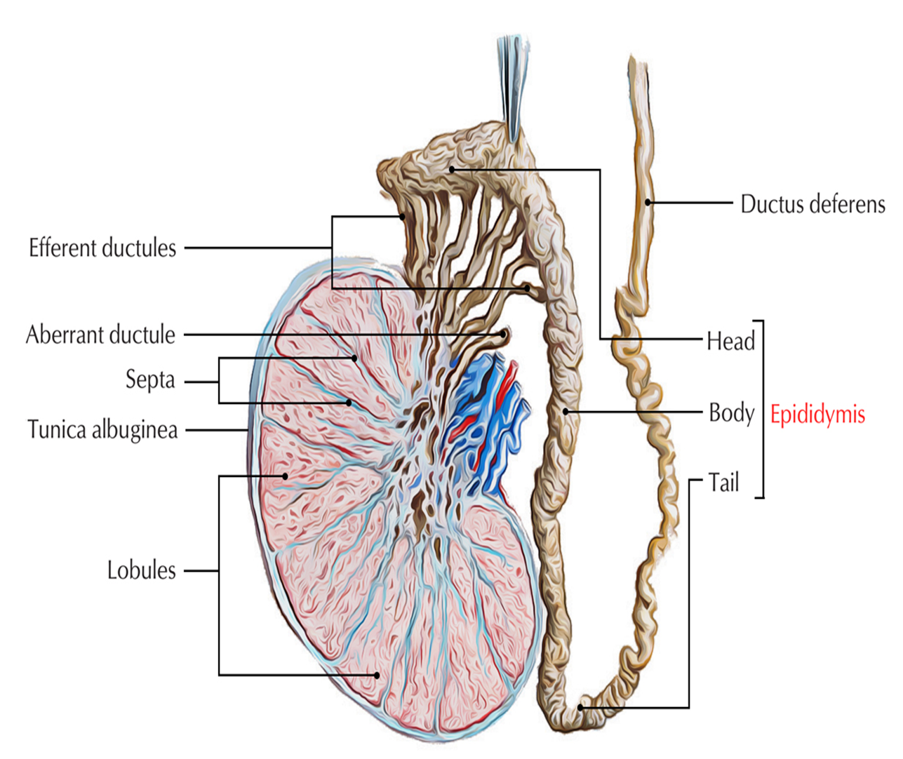

Slide 55
FUNCTIONS
Storage and maturation of spermatozoa.
Absorption of the fluid.
Inclusion of materials to the seminal fluid to nourish the maturating spermatozoa.

Slide 56
Blood Supply To The Epididymis
-Head & body :branch of testicular a. divides into superior & inferior epididymal branches
- Tail : branches from vas deferential artery
Cremasteric artery also serves as collateral source
Arteries enter along septa formed by connective tissue of tunica vaginalis

Slide 57
Venous Drainage Of The Epididymis
- Head : veins join pampiniform plexus or vena marginalis
- Tail and Body : veins join to form vena marginalis epididymis of Haberer

Slide 58
Lymphatic drainage of the epididymis
-Head and Body : same as testis (to RPLN’s)
- Tail : join lymphatics of vas deferens to external iliac nodes

Slide 59
Innervation Of The Epididymis
Primarily from intermediate spermatic nerve (br. of superior part of hypogastric plexus)
and inferior spermatic nerve (branch of pelvic plexus)
Number of nerve fibers increases as you move distally towards tail.

Slide 60
Vas Deferens
The Vas Deferens are 2 in number (left and right).
It is a thick-walled muscular tube which has the work of carrying spermatozoa from the epididymis to the ejaculatory duct.
Derived from the mesonephric (Wolffian) duct
- 30-35cm in length, 2-3mm in diameter (lumen 300-500μm in diameter)
- Starts at epididymal tail & terminates in ejaculatory duct near prostate

Slide 61
Contains 3 layers :
1) outer adventitial connective tissue sheet (contains blood vessels & small nerves)
2) middle layer consisting of 3 layers of muscle 3) inner mucosal layer

Slide 62
COURSE AND RELATIONSHIPS
EXTERNAL COURSE OF VAS DEFERENS
It starts at the inferior pole of the testis as direct continuance of the duct of epididymis and ascends upward behind the testis and medial to the epididymis.
It enters the spermatic cord, where it is located in its posterior part, that is the common site of vasectomy.
It goes through inguinal canal and enters the abdominal cavity by going through the deep inguinal ring located lateral to the inferior epigastric artery.

Slide 63
INTERNAL COURSE OF VAS DEFERENS
It hooks around the lateral side of the inferior epigastric artery and enters backwards and medially across the external iliac vessels and enters the lesser pelvis.
In the lesser pelvis, it runs downward and backward on the lateral pelvic wall crossing successively obliterated umbilical artery, obturator nerve, and vessels.
Afterward it crosses above and medial to the terminal part of the ureter and makes an angular bend downward and medially

Slide 64
Then, it enters behind the base of the bladder in front of the rectal ampulla and on the medial side of the seminal vesicle.
This part of the vas deferens is enlarged and sacculated to create an ampulla which likely keep the semen.
Eventually it converges to get to the base of prostate where it joins the duct of the seminal vesicle to create the ejaculatory duct, immediately posterior to the neck of the bladder

Slide 65
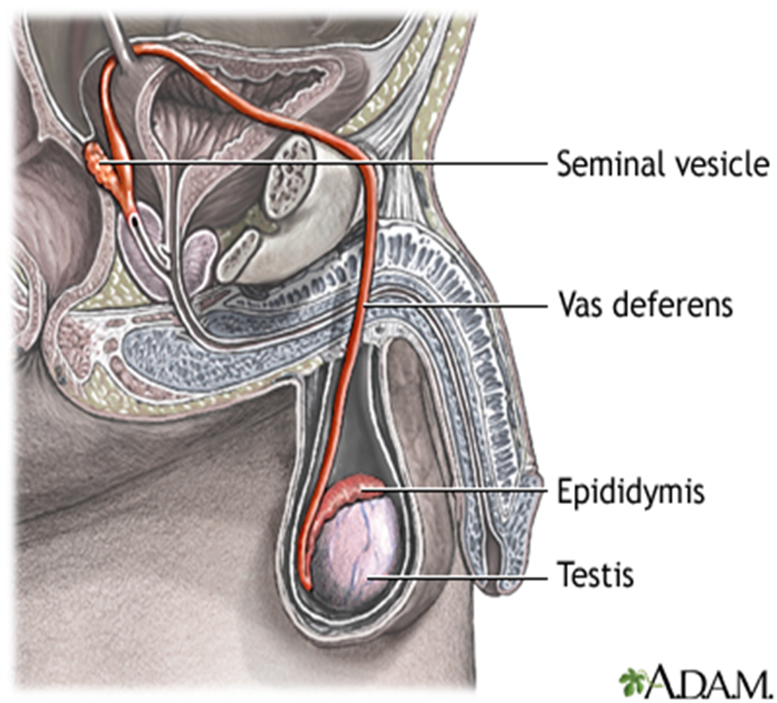

Slide 66
Blood supply to the vas deferens:
deferential artery : branch of inferior vesicle artery .
VENOUS DRAINAGE:
The veins from vas deferens join the vesical venous plexus which in turn drains into the internal iliac veins.
Innervation of the vas deferens :
has both sympathetic & parasympathetic nerve fibers
rich supply of sympathetic adrenergics from hypogastric nerves
minor contribution of parasympathetic cholinergics

Slide 67
Seminal Vesicles
The seminal vesicles are lateral out pouching of the vas - approx. 1.5cm x 5cm with a capacity of 3-4mL
It doesn’t store sperm but seminal fluid (major contributor to volume of ejaculate – 70%)
Covered by a thin layer of smooth muscle - lined by columnar epithelium with goblet cells
Contributes fructose to ejaculum

Slide 68
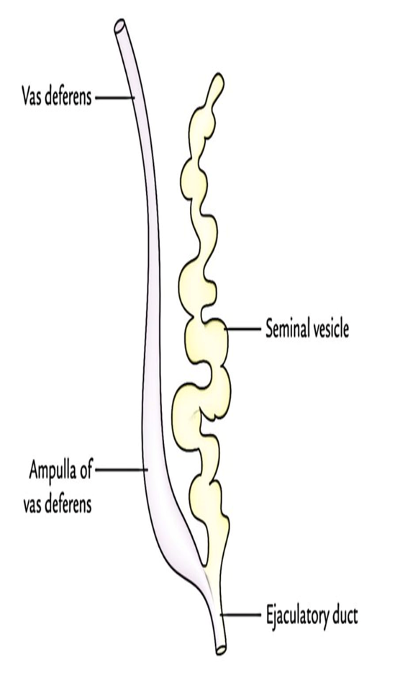
Seminal vesicles

Slide 69
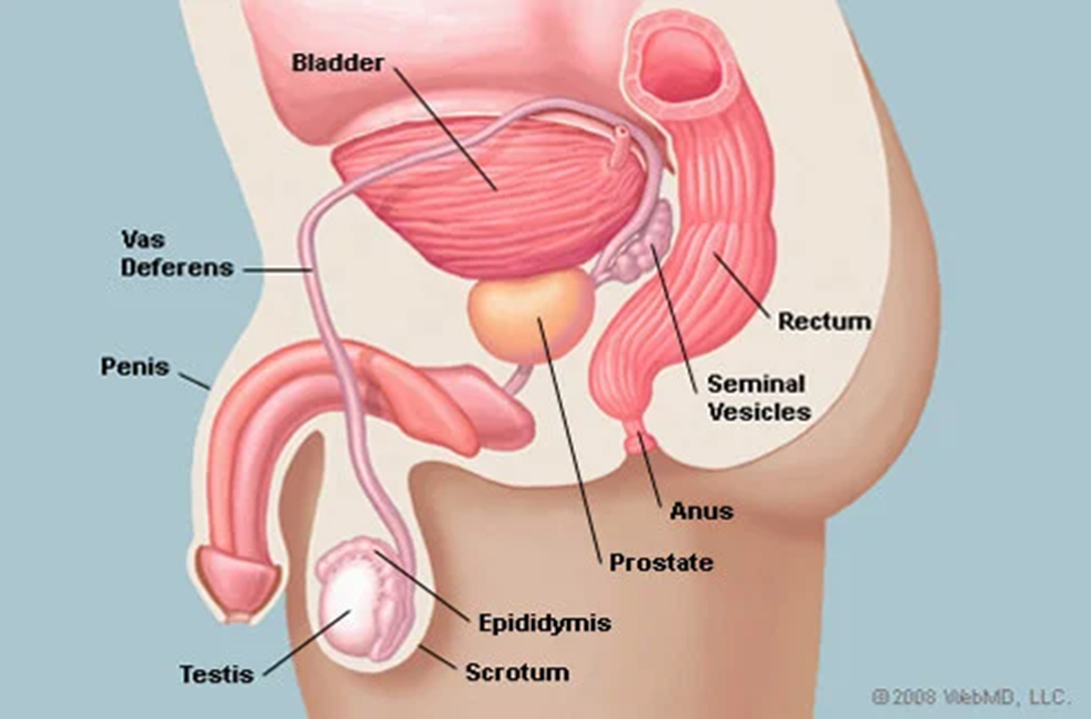
Their location is at the base of the urinary bladder, lateral to the end point of the vas deferens and in front of the rectum

Slide 70
Blood supply :
- vesiculodeferential artery supplies both br. of inferior vesical (br. of internal iliac) - may get more blood supply from superior vesical artery (also a br. of internal iliac) - both drain into the pelvic venous plexus
lymphatic drainage :
- external & internal iliac nodes
Innervation of SV :
- Mostly from the pelvic autonomic plexus - mainly excitatory sympathetic from hypogastric nerves }
- Ejaculation is sympathetic

Slide 71
Ejaculatory Ducts
Present on each side of the median plane
The lower part of the bladder base comprises of just two ejaculatory duct.
The ejaculatory duct is created by the joining of the ductus deferens to the lower end of the seminal vesicle (duct of the seminal vesicle).

Slide 72
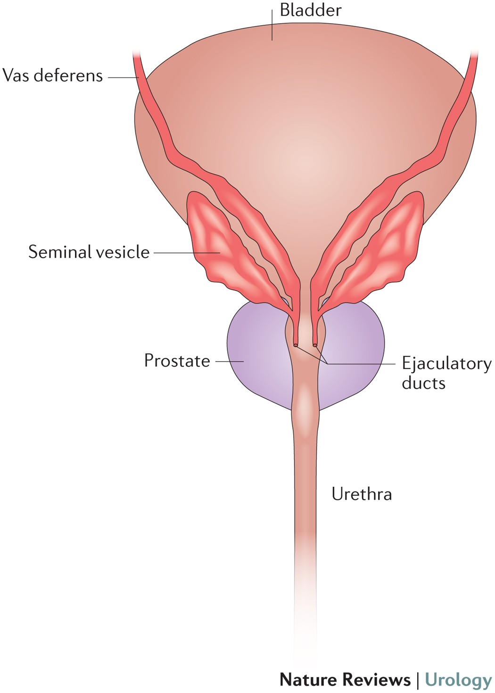
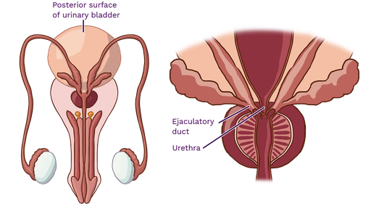

Slide 73
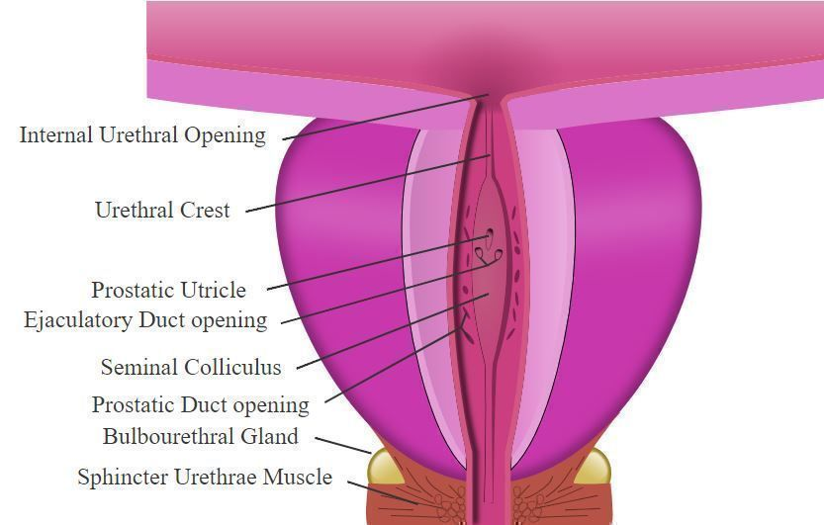
Every duct traverses anteroinferiorly via the upper posterior half of the prostate and along the side of prostatic utricle to open in the posterior wall of prostatic urethra on the seminal colliculus (verumontanum) on either side of the opening of prostatic utricle

Slide 74
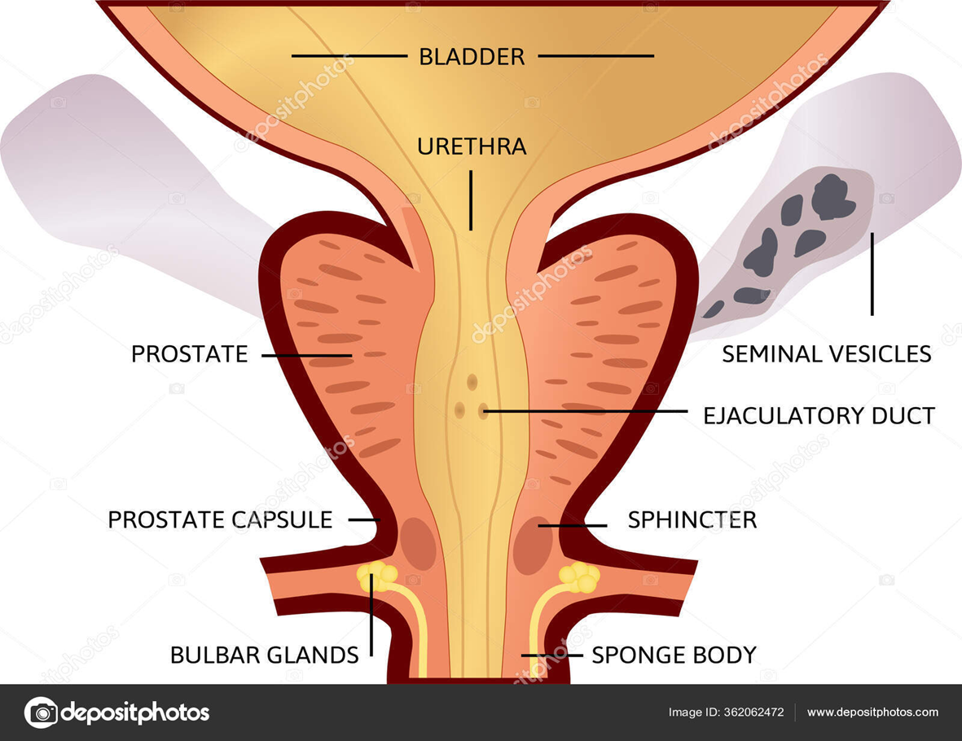

Slide 75


