Slide 1
The role of Glutamate and GABA in the Epileptic process
By
Dr Faten Allyan

Slide 2
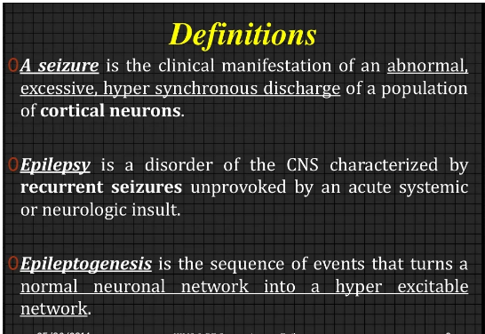

Slide 3
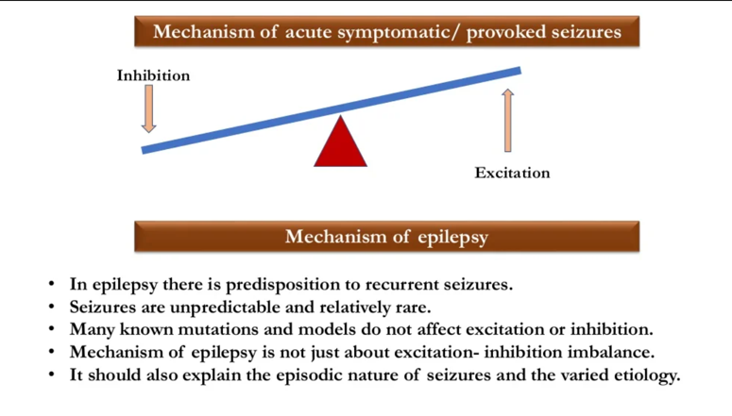

Slide 4
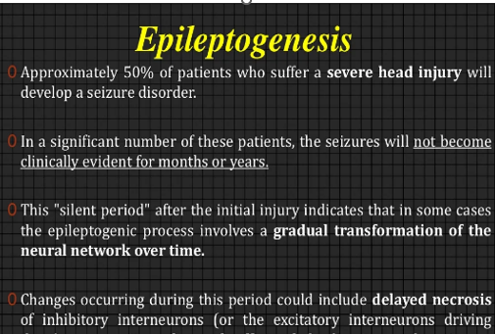

Slide 5
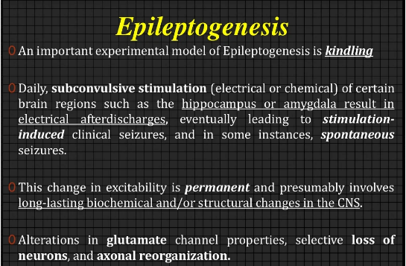

Slide 6
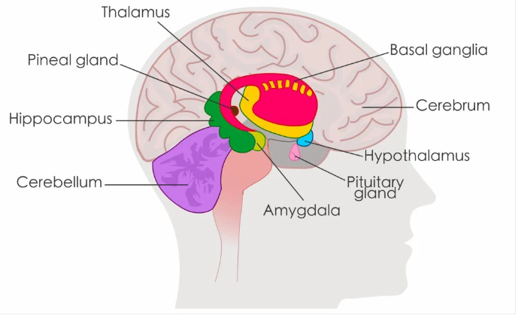

Slide 7
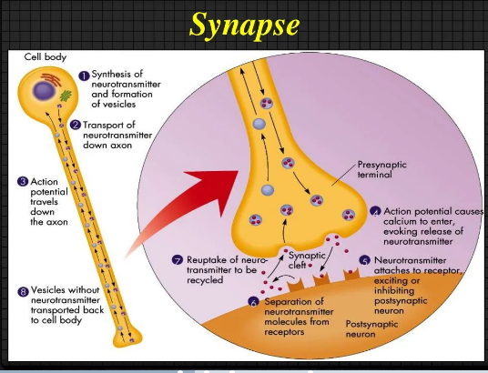

Slide 8
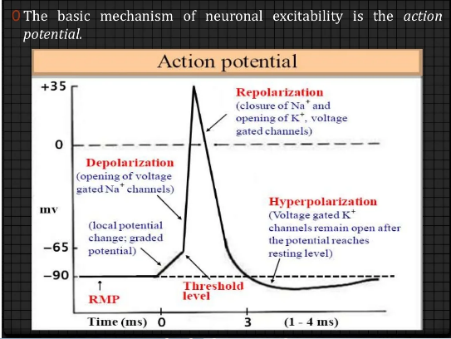
K out of nerve or Cl enter nerve
Na or Ca enter neuron

Slide 9
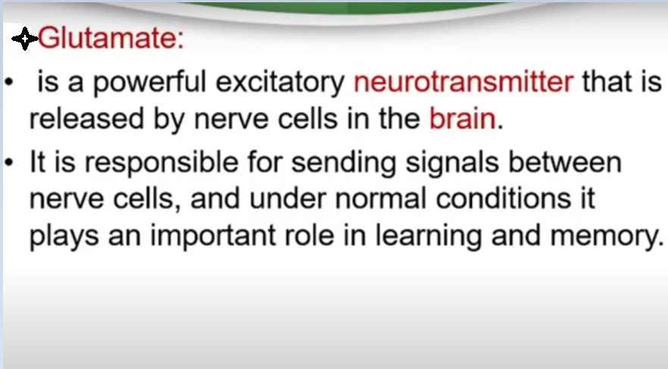

Slide 10
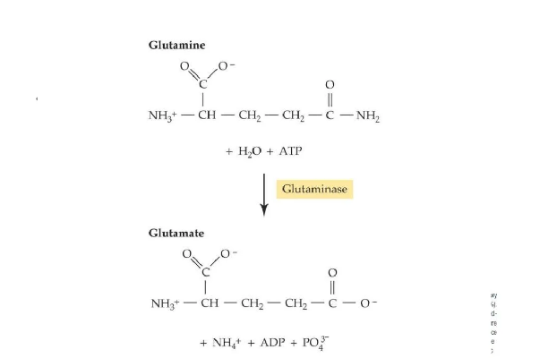

Slide 11
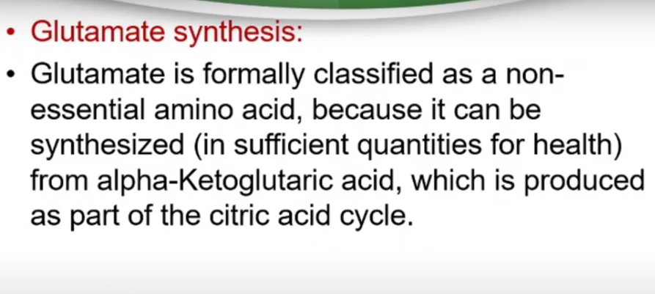
Notes:
nonessential amino acids synthesized by the body.

Slide 12
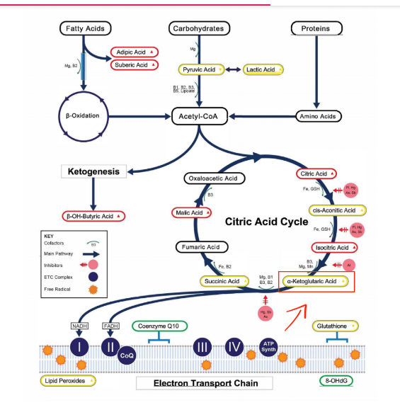

Slide 13
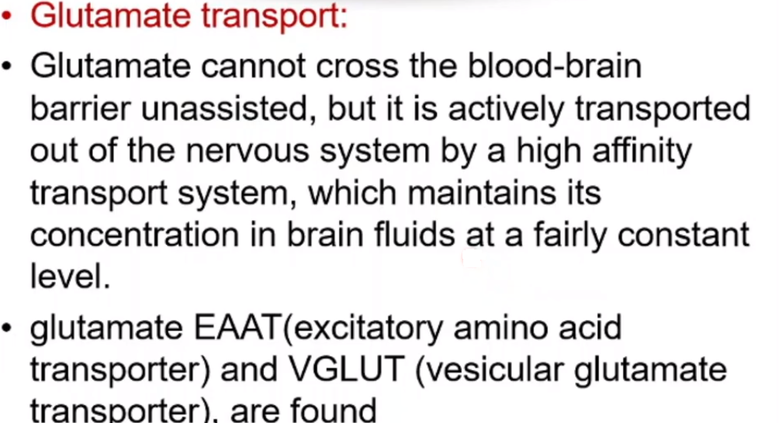
in neuron
Notes:
Active transport involves the movement of molecules from lower concentration to higher concentration with the use of energy. Passive transport involves the movement of molecules from higher concentration to lower concentration and no amount of energy is required.

Slide 14
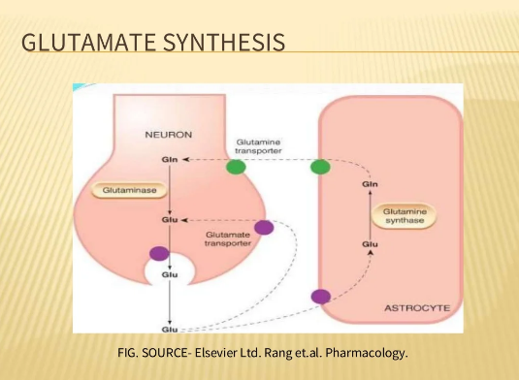

Slide 15
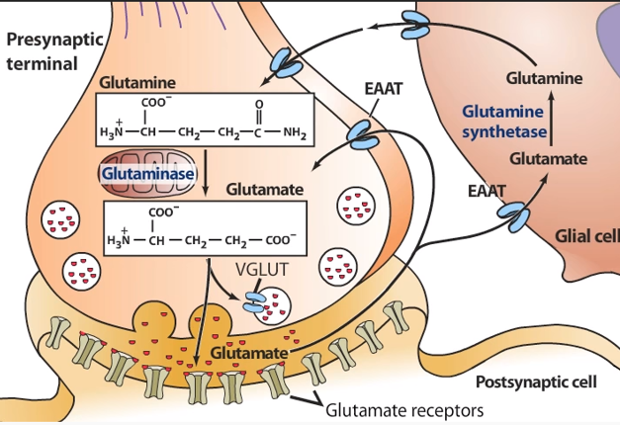

Slide 16
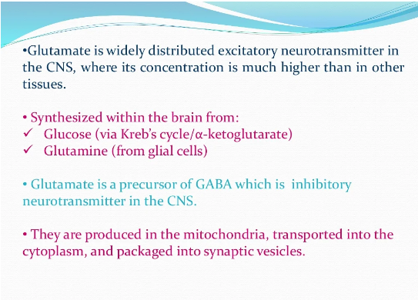

Slide 17
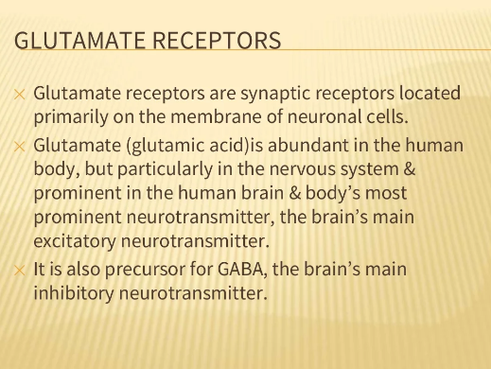

Slide 18
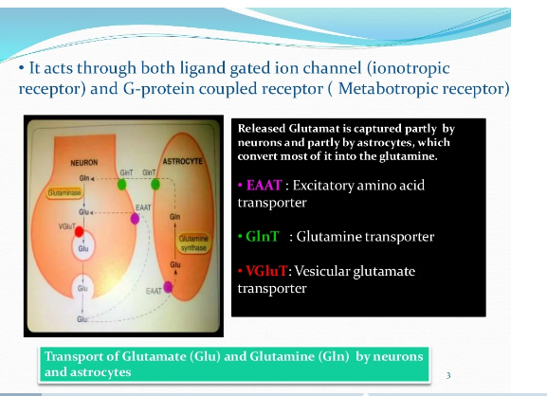
uploading glutamate into synaptic vesicles

Slide 19
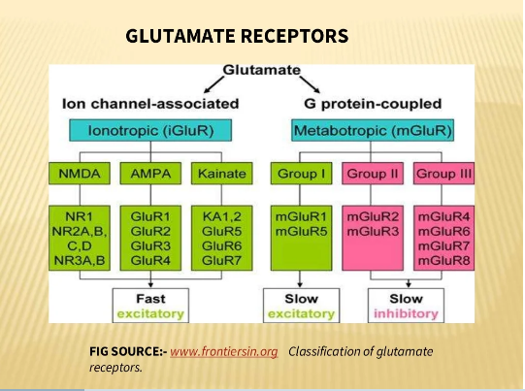

Slide 20
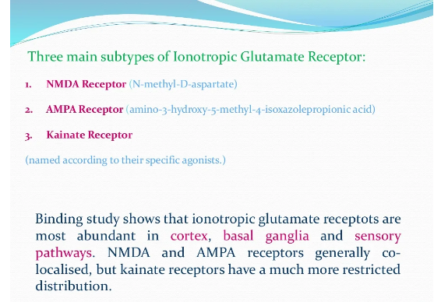

Slide 21
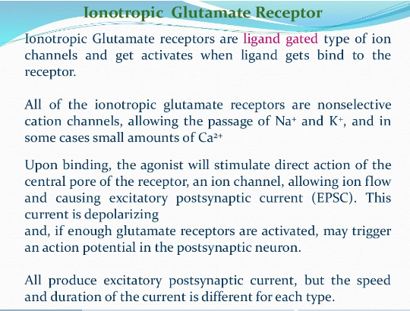

Slide 22
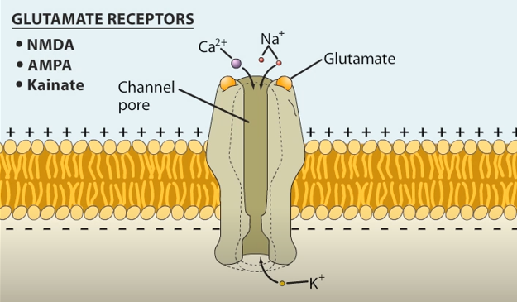

Slide 23

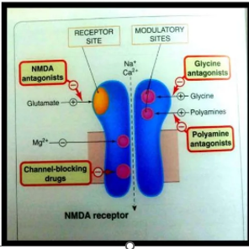
The activation of NMDA receptor requires binding of a ligand (glutamate) to the GluN2 subunits, membrane depolarization to remove the Mg²⁺ block of the channel and prevent excessive activation
and Binding of an essential co-agonist, glycine to the GluN1 subunits.

Slide 24
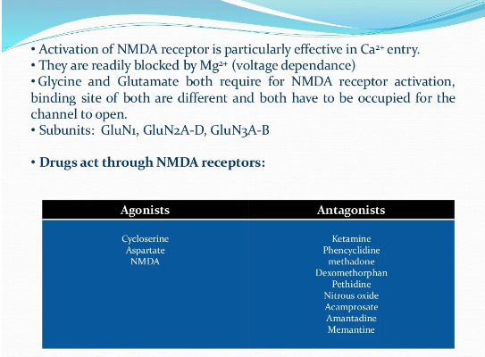


Slide 25
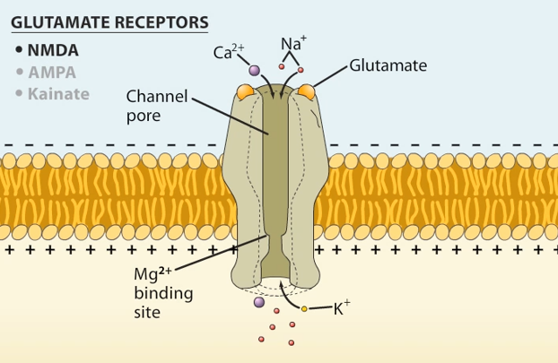
Mg2+ blocks the NMDA receptor by binding to channel pore and prevents its excessive activation.

Slide 26
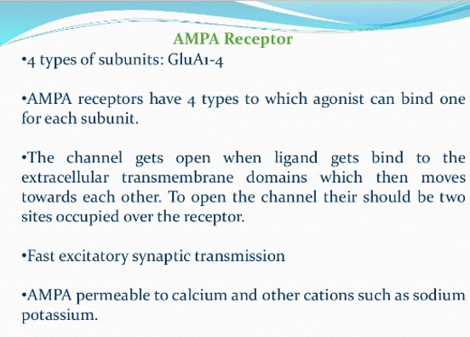

Slide 27
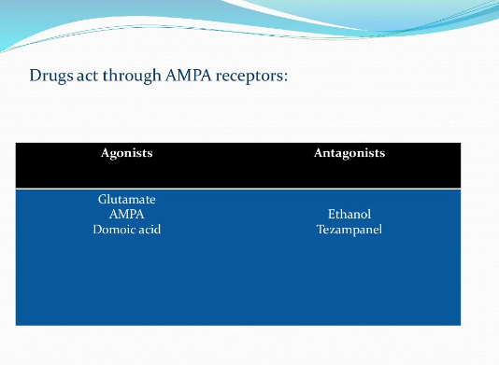
Anticonvulsants

Slide 28
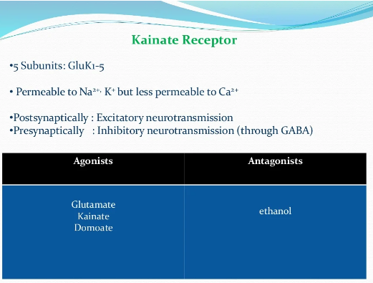
Kynurenic acid
anticonvulsant

Slide 29
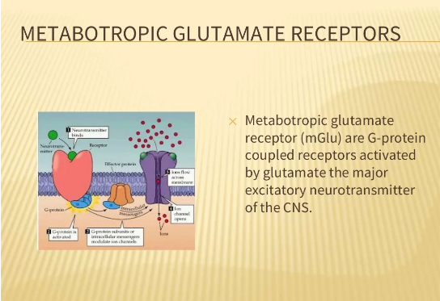

Slide 30
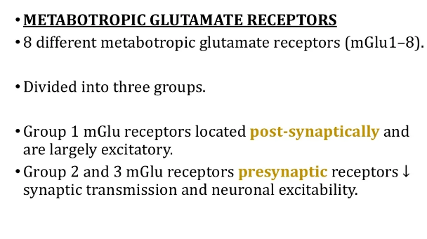

Slide 31
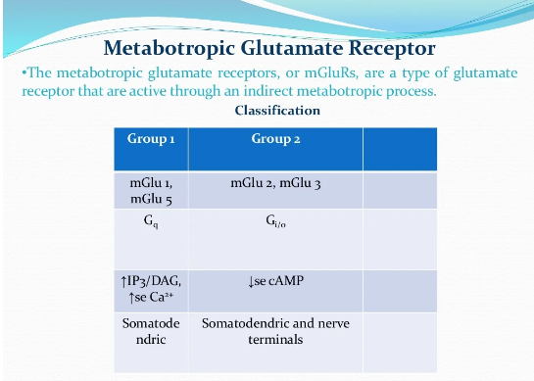

Slide 32
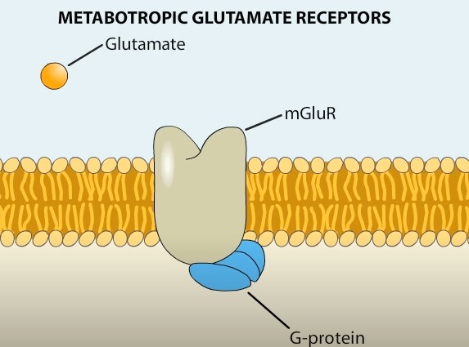

Slide 33
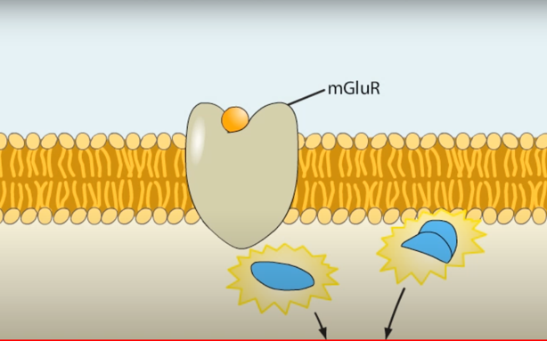
Signaling cascade

Slide 34
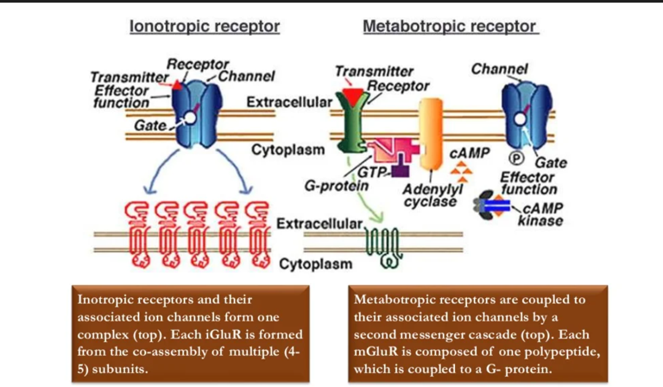

Slide 35
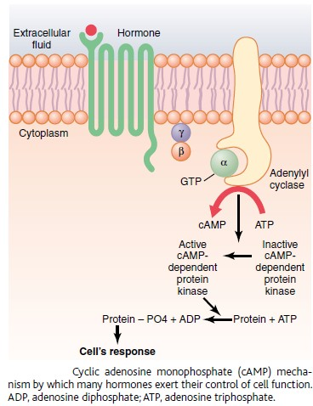
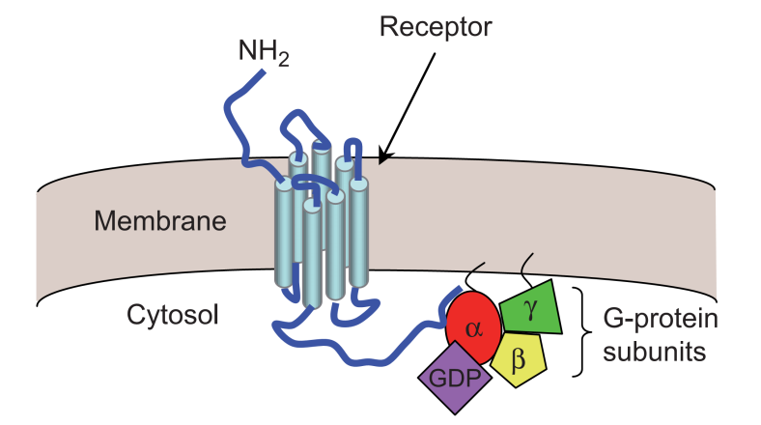

Slide 36
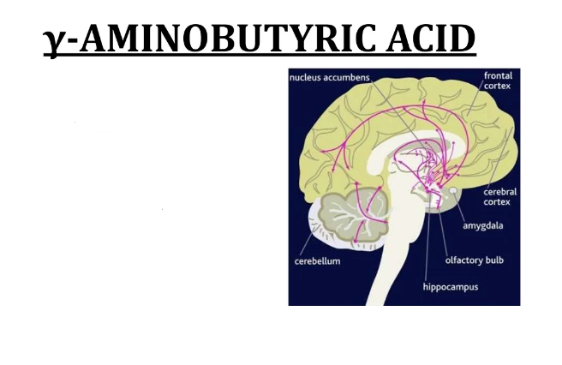
GABA

Slide 37
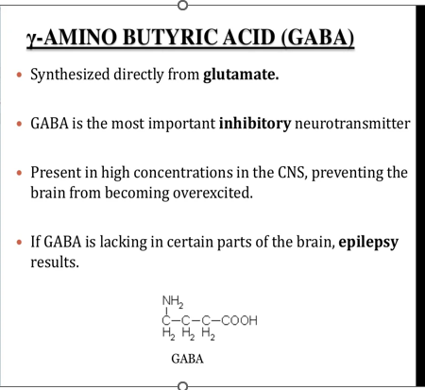

Slide 38
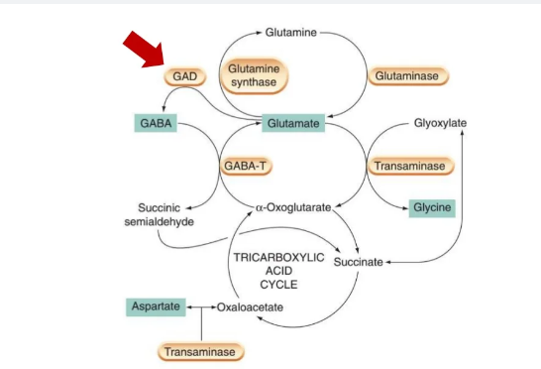
Glutamic acid decarboxylase (GAD) is the rate-limiting enzyme that catalyses the conversion of glutamate to GABA, the main inhibitory neurotransmitter of the CNS.

Slide 39
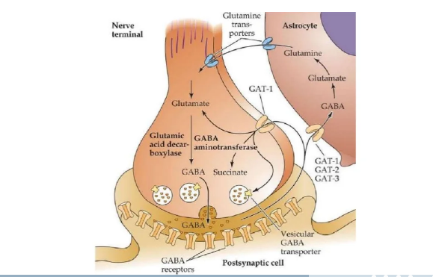

Slide 40
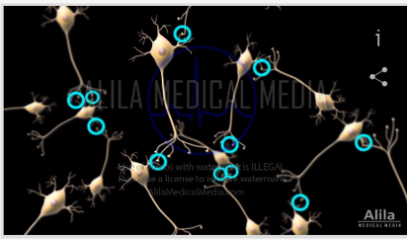
It about half of synapses in the brain across through GABA receptors therefore become responded

Slide 41
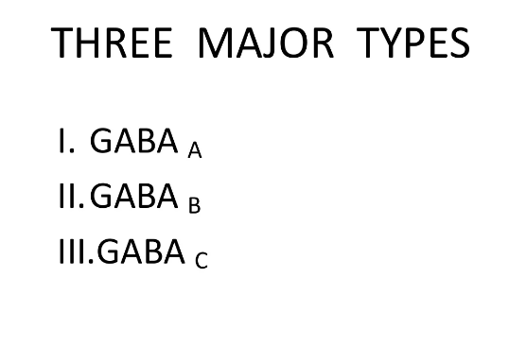
GABA receptors

Slide 42
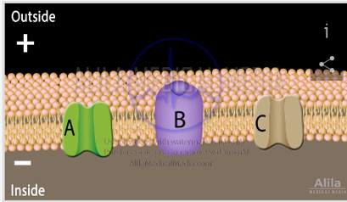
There are there types of GABA receptors : GABA A,GABA B. GABA C

Slide 43
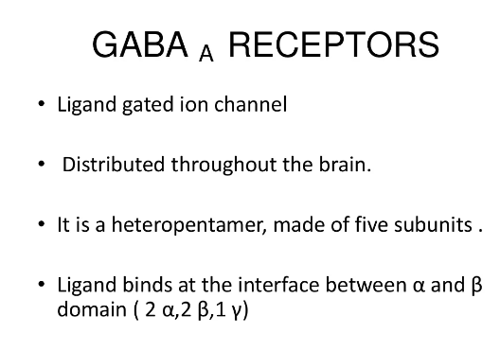
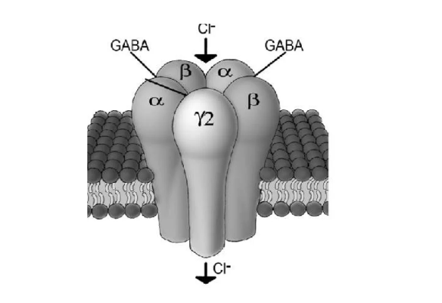

Slide 44
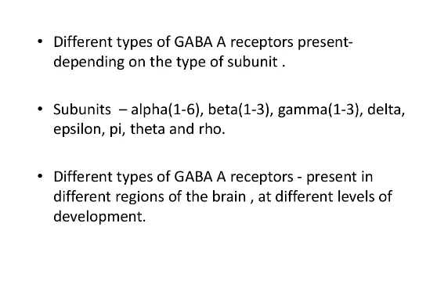

Slide 45
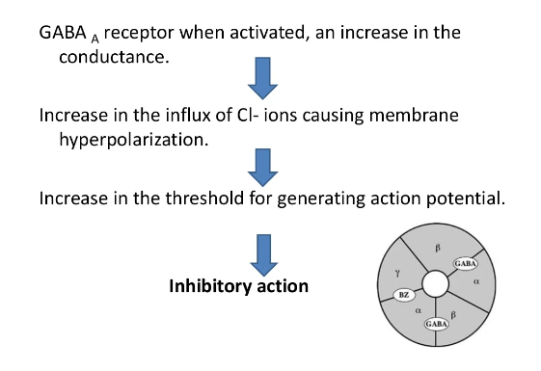

Slide 46
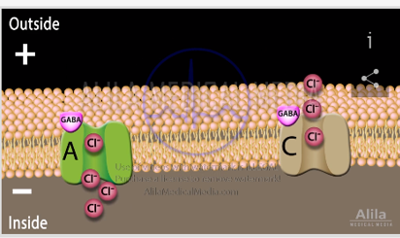
When GABA bind receptor channel open to permit of Cl to release in side neuron cell
This make high negativity (hyperpolarization ) inhibitory effect

Slide 47
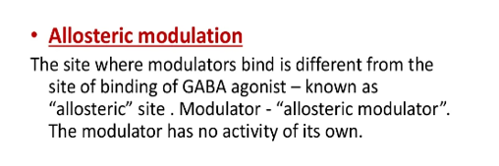
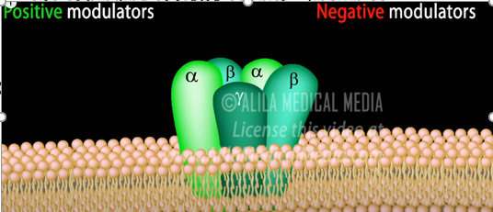
change in the shape and activity of a protein receptor that results from : combination with another substance at a point other than the chemically active site

Slide 48
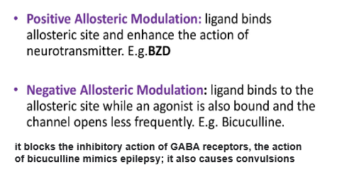

Slide 49


Slide 50

Benzodiazepines increase inhibition effect of GABA
Benzodiazepines produce relieve anxiety and muscle spasms, and reduce seizures

Slide 51


Slide 52


Slide 53

GABA B role through protein G activate K+ channel that permit to release K out the nerve(hyperpolaraization)

Slide 54

K out of cell hyperpolarization

Slide 55


Slide 56


Slide 57


Slide 58


Slide 59


Slide 60


