Slide 1
Antipsychotics
Dr.Samaher Jaber Younis
BCPS

Slide 2
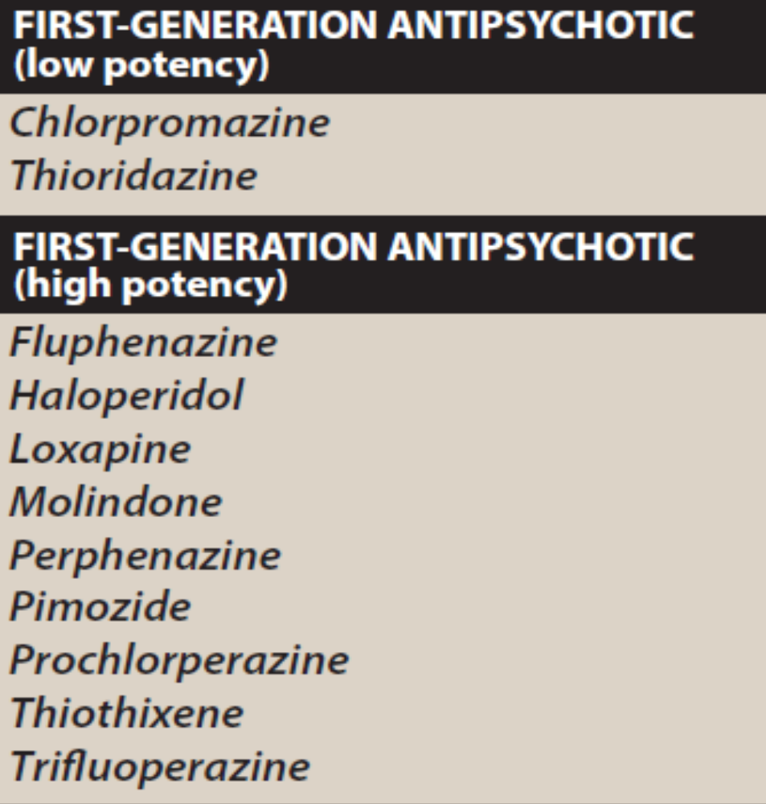
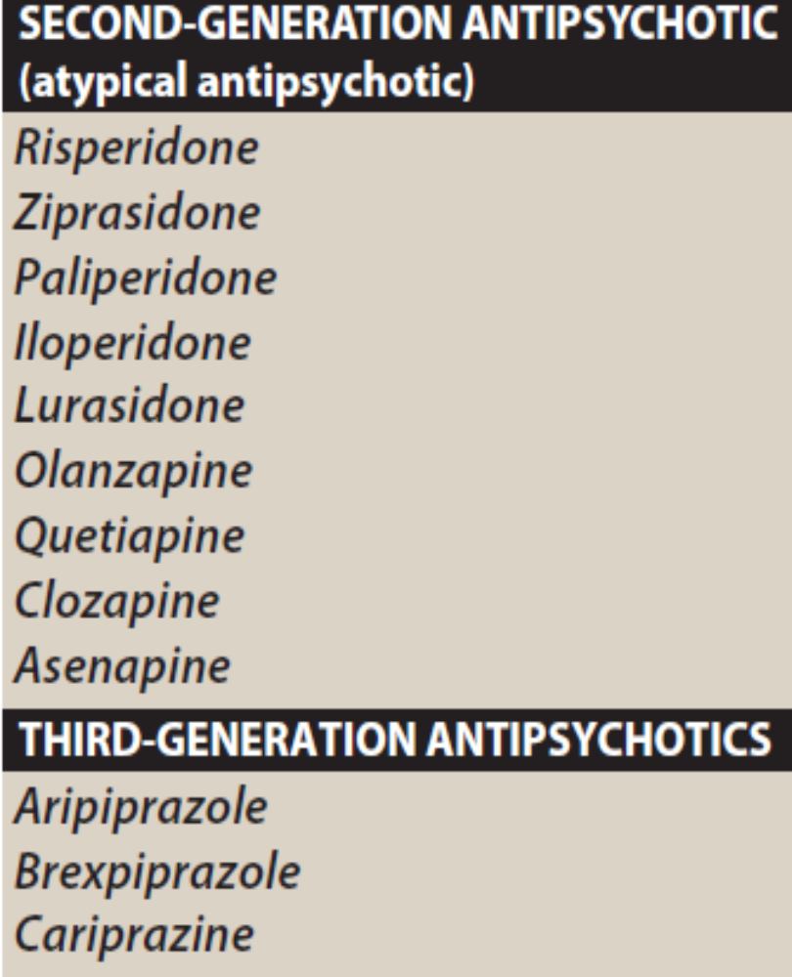
The first-generation drugs are further classified as “low potency” or “high potency.” This classification does not indicate clinical effectiveness of the drugs, but rather specifies affinity for the dopamine D2 receptor, which,
in turn, may influence the adverse effect profile of the drug.

Slide 3
First-generation antipsychotics
The first-generation antipsychotic drugs (also called conventional) are competitive inhibitors at a variety of receptors, but their antipsychotic effects reflect competitive blockade of dopamine D2 receptors. First generation antipsychotics are more likely to be associated with movement disorders known as extrapyramidal symptoms (EPS), particularly drugs that bind tightly to dopaminergic neuroreceptors, such as haloperidol. Movement disorders are somewhat less likely with medications that bind less potently, such as chlorpromazine. No one drug is clinically more effective than another

Slide 4
Second-generation antipsychotic drugs
The second-generation antipsychotic drugs (also called “atypical” antipsychotics) have a lower incidence of EPS than the first- generation agents, but are associated with a higher risk of metabolic adverse effects, such as diabetes, hypercholesterolemia, and weight gain. The second-generation drugs owe their unique activity to blockade of both serotonin and dopamine receptors.
1. Drug selection: Second-generation agents are generally used as first-line therapy for schizophrenia to minimize the risk of debilitating EPS associated with the first-generation drugs that act primarily at the dopamine D2 receptor. The second-generation antipsychotics exhibit an efficacy that is equivalent to, and occasionally exceeds, that of the first-generation antipsychotic agents. Differences in therapeutic efficacy among the second-generation drugs have not been established, and individual patient response and comorbid conditions must often be used to guide drug selection.
2. Refractory patients: Approximately 10% to 20% of patients with schizophrenia have an insufficient response to first- and second-generation antipsychotics. For these patients, clozapine has shown to be an effective antipsychotic with a minimal risk of EPS. However, its clinical use is limited to refractory patients because of serious adverse effects. Clozapine can produce bone marrow suppression, seizures, and cardiovascular side effects, such as orthostasis. The risk of severe agranulocytosis necessitates frequent monitoring of white blood cell counts.

Slide 5
Mechanism of action
1. Dopamine antagonism: All of the first-generation and most of the second-generation antipsychotic drugs block D2 dopamine receptors in the brain and the periphery.
2. Serotonin receptor–blocking activity: Most of the second-generation agents exert part of their action through inhibition of serotonin receptors (5-HT), particularly 5-HT2A receptors. Clozapine has high affinity for D1, D4, 5-HT2, muscarinic, and α-adrenergic receptors, but it is also a weak dopamine D2 receptor antagonist. Risperidone blocks 5-HT2A receptors to a greater extent than it does D2 receptors, as does olanzapine. The second-generation antipsychotics aripiprazole, brexpiprazole, and cariprazine are partial agonists at D2 and 5-HT1A receptors, as well as antagonists of 5-HT2A receptors. Quetiapine is relatively weak at blockade of D2 and 5-HT2A receptors. Its low risk for EPS may also be related to the relatively short period of time it binds to the D2 receptor. Pimavanserin appears to act as an inverse agonist and antagonist at the 5-HT2A receptor and the 5-HT2C receptor, with no appreciable affinity for dopamine receptors. Pimavanserin is indicated for psychosis associated with Parkinson disease

Slide 6
Actions
The clinical effects of antipsychotic drugs reflect a blockade at dopamine and/or serotonin receptors. However, many antipsychotic agents also block cholinergic, adrenergic, and histaminergic receptors. It is unknown what role, if any, these actions have in alleviating the symptoms of psychosis. However, the undesirable adverse effects of antipsychotic drugs often result from pharmacological actions at these other receptors.
1. Antipsychotic effects: All antipsychotic drugs can reduce hallucinations and delusions associated with schizophrenia (known as “positive” symptoms) by blocking D2 receptors in the mesolimbic system of the brain. The “negative” symptoms, such as blunted affect, apathy, and impaired attention, as well as cognitive impairment, are not as responsive to therapy, particularly with the first-generation antipsychotics. Many second-generation agents, such as clozapine, can ameliorate the negative symptoms to some extent.
2. Extrapyramidal effects: Dystonias (sustained contraction of muscles leading to twisting, distorted postures), Parkinson-like symptoms, akathisia (motor restlessness), and tardive dyskinesia (involuntary movements, usually of the tongue, lips, neck, trunk, and limbs) can occur with both acute and chronic treatment. Blockade of dopamine receptors in the nigrostriatal pathway is believed to cause these unwanted movement symptoms. The second-generation antipsychotics exhibit a lower incidence of EPS.

Slide 7
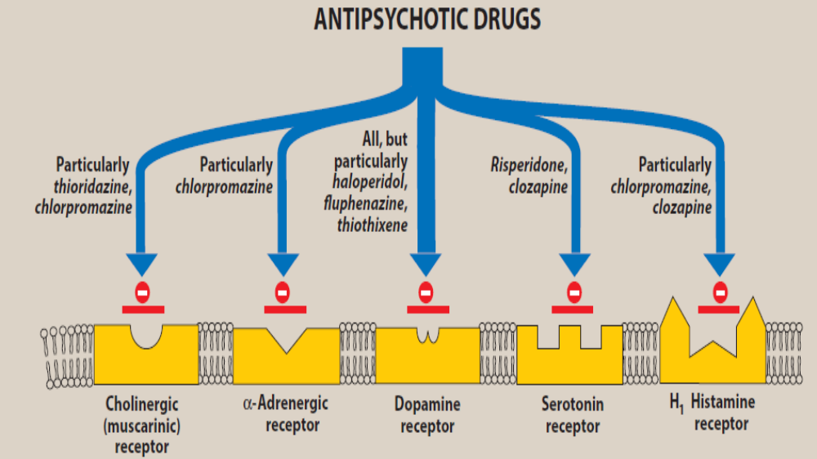

Slide 8




Slide 9
3. Antiemetic effects: The antipsychotic drugs have antiemetic effects that are mediated by blocking D2 receptors of the chemoreceptor trigger zone of the medulla.
4. Anticholinergic effects: Some of the antipsychotics, particularly thioridazine, chlorpromazine, clozapine, and olanzapine, produce anticholinergic effects. These effects include blurred vision, dry mouth (the exception is clozapine, which increases salivation), confusion, and inhibition of gastrointestinal and urinary tract smooth muscle, leading to constipation and urinary retention. The anticholinergic effects may actually assist in reducing the risk of EPS with these agents.
5. Other effects:
Blockade of α-adrenergic receptors causes orthostatic hypotension and light- headedness.
The antipsychotics also alter temperature-regulating mechanisms and can produce poikilothermia (condition in which body temperature varies with the environment).
In the pituitary, antipsychotics that block D2 receptors may cause an increase in prolactin release.
Sedation occurs with those drugs that are potent antagonists of the H1-histamine receptor, including chlorpromazine, olanzapine, quetiapine, and clozapine.
Sexual dysfunction may also occur with the antipsychotics due to various receptor-binding characteristics.
Weight gain is also a common adverse effect of antipsychotics and is more significant with the second-generation agents.

Slide 10
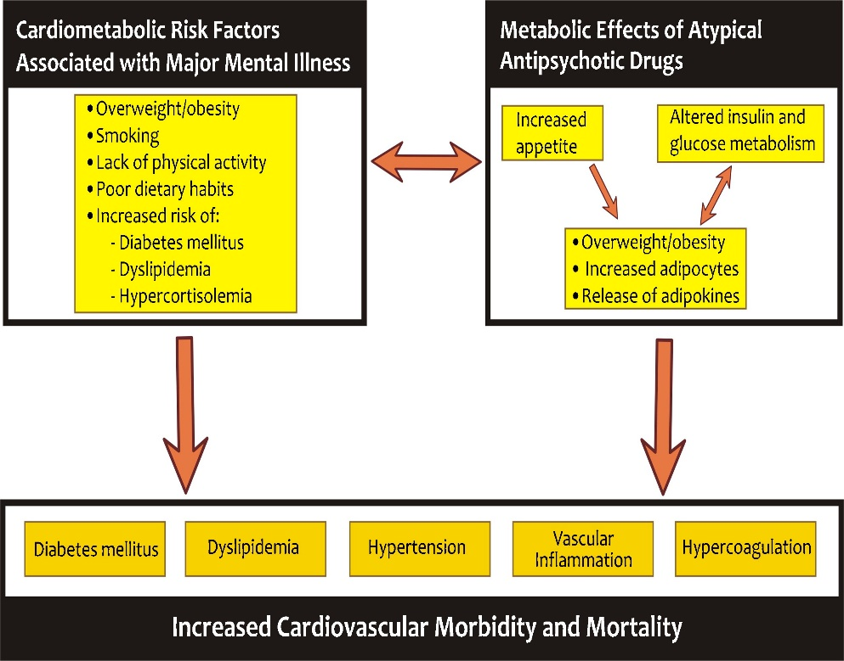

Slide 11
Therapeutic uses
1. Treatment of schizophrenia: The antipsychotics are the only efficacious pharmacological treatment for schizophrenia. The first-generation antipsychotics are generally most effective in treating the positive symptoms of schizophrenia. The atypical antipsychotics with 5-HT2A receptor–blocking activity may be effective in many patients who are resistant to the traditional agents, especially in treating the negative symptoms of schizophrenia.
2. Prevention of nausea and vomiting: The older antipsychotics (most commonly, prochlorperazine are useful in the treatment of drug-induced nausea

Slide 12
Other uses: The antipsychotic drugs can be used as tranquilizers to manage agitated and disruptive behavior secondary to other disorders. Chlorpromazine is used to treat intractable hiccups. Pimozide is primarily indicated for treatment of the motor and phonic tics of Tourette disorder. However, risperidone and haloperidol are also commonly prescribed for this tic disorder. Also, risperidone and aripiprazole are approved for the management of disruptive behavior and irritability secondary to autism. Many antipsychotic agents are approved for the management of the manic and mixed symptoms associated with bipolar disorder. Lurasidone and quetiapine are indicated for the treatment of bipolar depression. Paliperidone is approved for the treatment of schizoaffective disorder. Some antipsychotics (aripiprazole, brexpiprazole, and quetiapine) are used as adjunctive agents with antidepressants for treatment-refractory depression.

Slide 13
Absorption and metabolism
After oral administration, the antipsychotics show variable absorption that is unaffected by food (except for ziprasidone, lurasidone, and paliperidone, the absorption of which is increased with food). These agents readily pass into the brain and have a large volume of distribution. They are metabolized to many different metabolites, usually by the cytochrome P450 system in the liver, particularly the CYP2D6, CYP1A2, and CYP3A4 isoenzymes. Some metabolites are active and have been developed as pharmacological agents themselves (for example, paliperidone is the active metabolite of risperidone, and the antidepressant amoxapine is the active metabolite of loxapine). Fluphenazine decanoate, haloperidol decanoate, risperidone microspheres, paliperidone palmitate, aripiprazole monohydrate, aripiprazole lauroxil, and olanzapine pamoate are long-acting injectable (LAI) formulations of antipsychotics. These formulations usually have a therapeutic duration of action of 2 to 4 weeks, with some having a duration of 6 to 12 weeks. Therefore, these LAI formulations are often used to treat outpatients and individuals who are nonadherent with oral medications.

Slide 14
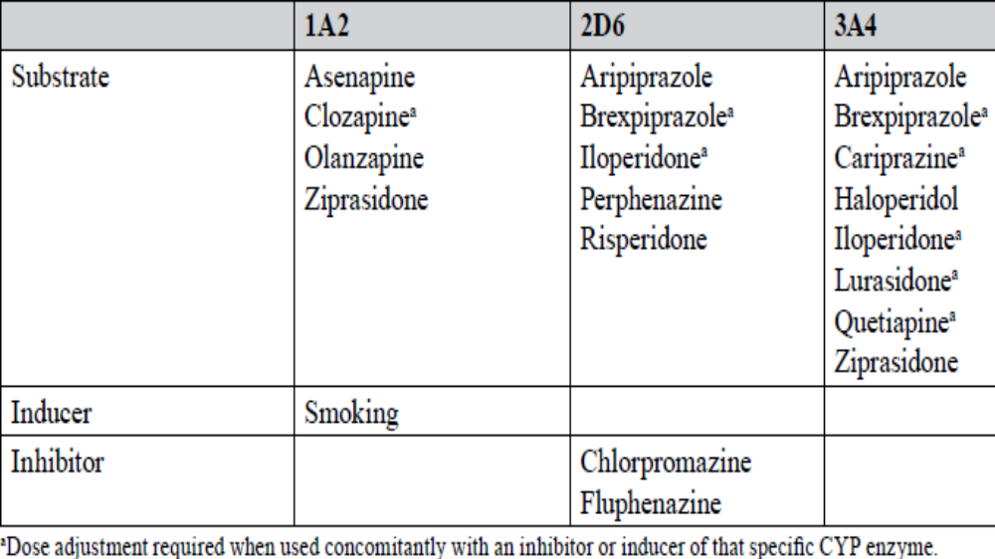

Slide 15
Adverse effect profiles are relatively uniform for agents with similar dopamine potency.
a. Sedation: More likely with low-potency agents. Sedation is usually worse initially and then tolerated
better with time. Sedation tends to be dose related.
b. Anticholinergic effects: Dry mouth, constipation, blurred vision, and urinary hesitancy can occur.
c. Orthostatic hypotension (OH): Low-potency agents block the α-adrenergic receptor, which can cause OH.
d. EPS: Four main manifestations:
i. Parkinsonism: This is manifested by symptoms such as bradykinesia, rigidity, tremor, or akinesia.
Parkinsonism is usually responsive to anticholinergic agents such as diphenhydramine, trihexyphenidyl, and benztropine.
ii. Dystonia: These episodes are often acute. The risk is greatest in young men and with high doses of parenteral antipsychotics. Examples include torticollis, laryngospasm, and oculogyric crisis. Dystonia is also treated with anticholinergics.
iii. Akathisia: This is a somatic restlessness and the inability to stay still or calm. Reducing the antipsychotic dose and changing to an agent with a lower incidence of akathisia are the best options, but these are not always feasible. Akathisia responds poorly to anticholinergics. Lipophilic (fat soluble) β-blockers such as propranolol and nadolol have been used, but data analyses for efficacy are inconclusive. Benzodiazepines may reduce symptoms.

Slide 16
iv. Tardive dyskinesia: Characterized by abnormal involuntary movements that occur with long term antipsychotic therapy. Tardive dyskinesia usually involves the orofacial muscles and is often insidious. If caught early, it can be reversible. With continued drug exposure, particularly at high doses, tardive dyskinesia is often irreversible. Risks are likely related to total cumulative dose. Those taking high antipsychotic doses, those older than 54 years, women, and those with mood disorders are also at an increased risk. Symptoms may decrease with lowering the antipsychotic dose (after an initial symptom increase). However, this dose reduction must be weighed against worsening symptoms of schizophrenia. Changing to an agent that is associated with less tardive dyskinesia is also an option. The risk is higher with FGAs than with SGAs. Clozapine has not been associated with tardive dyskinesia, and changing to this drug may be appropriate for patients with moderate to severe symptoms. The other atypical antipsychotics also appear to have a low potential to cause tardive dyskinesia.
Valbenazine and deutetrabenazine are both U.S (FDA) approved as the first drugs to carry an indication for tardive dyskinesia. The exact mechanism of action is unknown,

Slide 17
e. Neuroleptic malignant syndrome: Occurs with all agents but appears more common with high potency FGAs. This syndrome is manifested by agitation, confusion, changing levels of consciousness, muscle rigidity, fever, tachycardia, autonomic instability, and diaphoresis. The mortality rate is high, and it should be taken seriously. Discontinue the offending agent and give supportive therapy, including fluids and cooling. Bromocriptine and dantrolene have been used with varying success.
f. Endocrine effects: Breast enlargement, galactorrhea, sexual dysfunction, and menstrual changes can occur because of hyperprolactinemia caused by antipsychotics, particularly FGAs. Prolactin secretion is blocked by dopamine. Dopamine blockers can increase prolactin concentrations (hyperprolactinemia).
g. Weight gain: Occurs in up to 40% of patients, with low-potency agents having higher risk. Important interventions include keeping the dose as low as possible and implementing dietary management. Weight gain may occur because of actions at histamine or serotonin receptors.
h. Sexual dysfunction: Erectile dysfunction occurs in 23%–54% of men. Loss of libido and anorgasmia may occur in men and women.

Slide 18
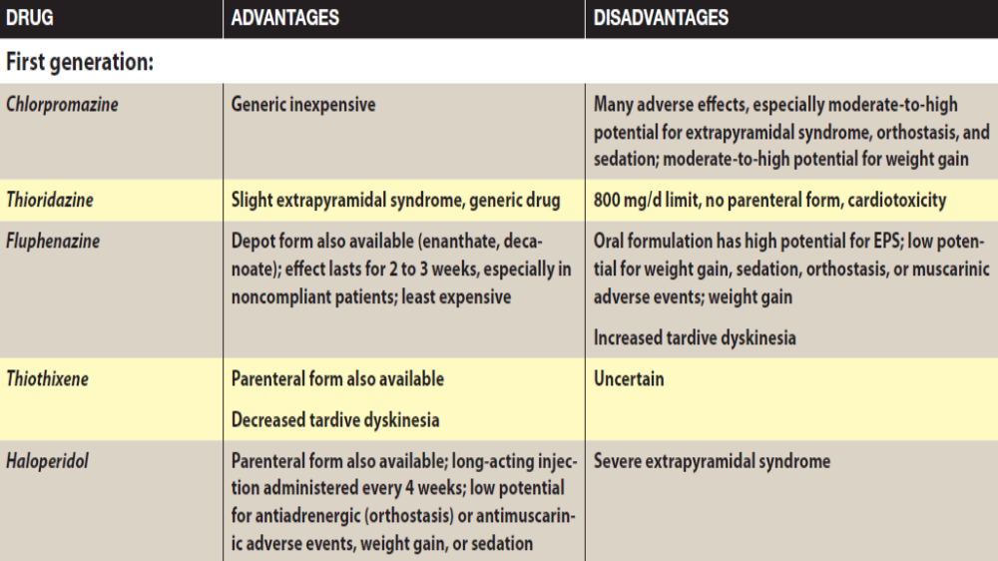

Slide 19
