Slide 1
Brainstem anatomy

Slide 2
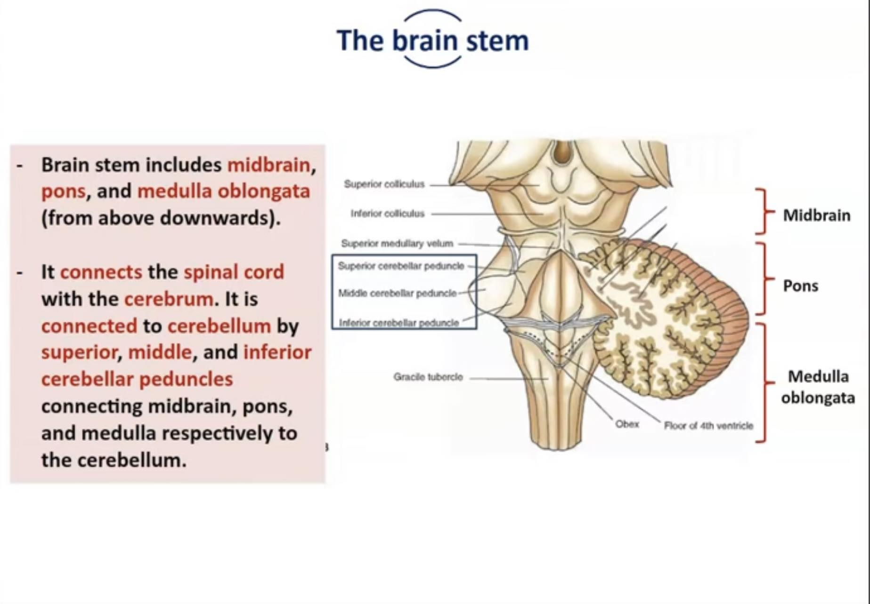

Slide 3
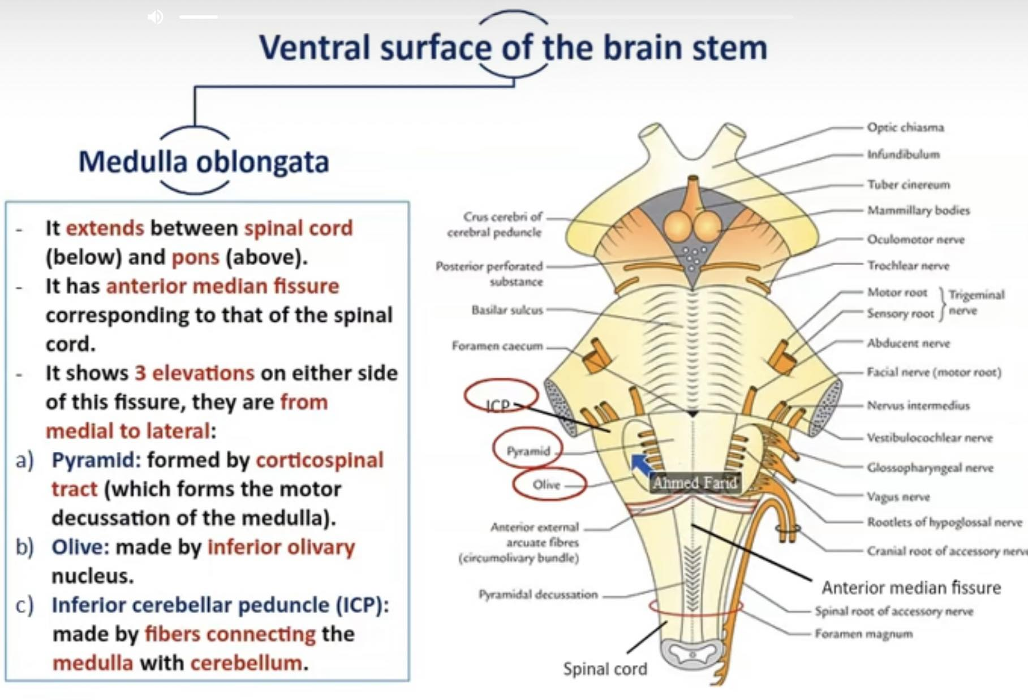

Slide 4
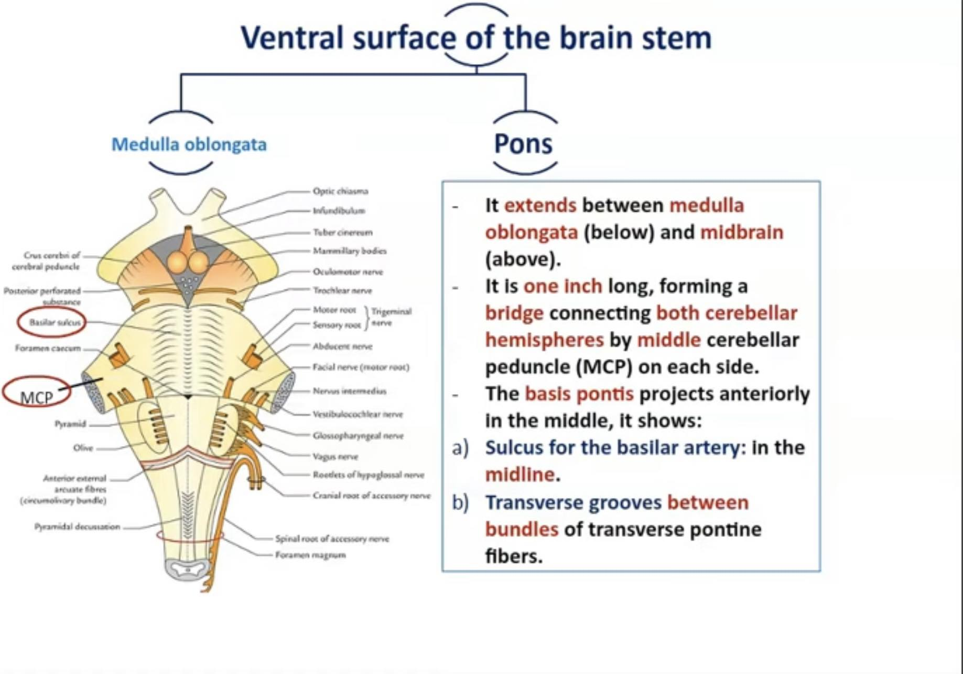

Slide 5
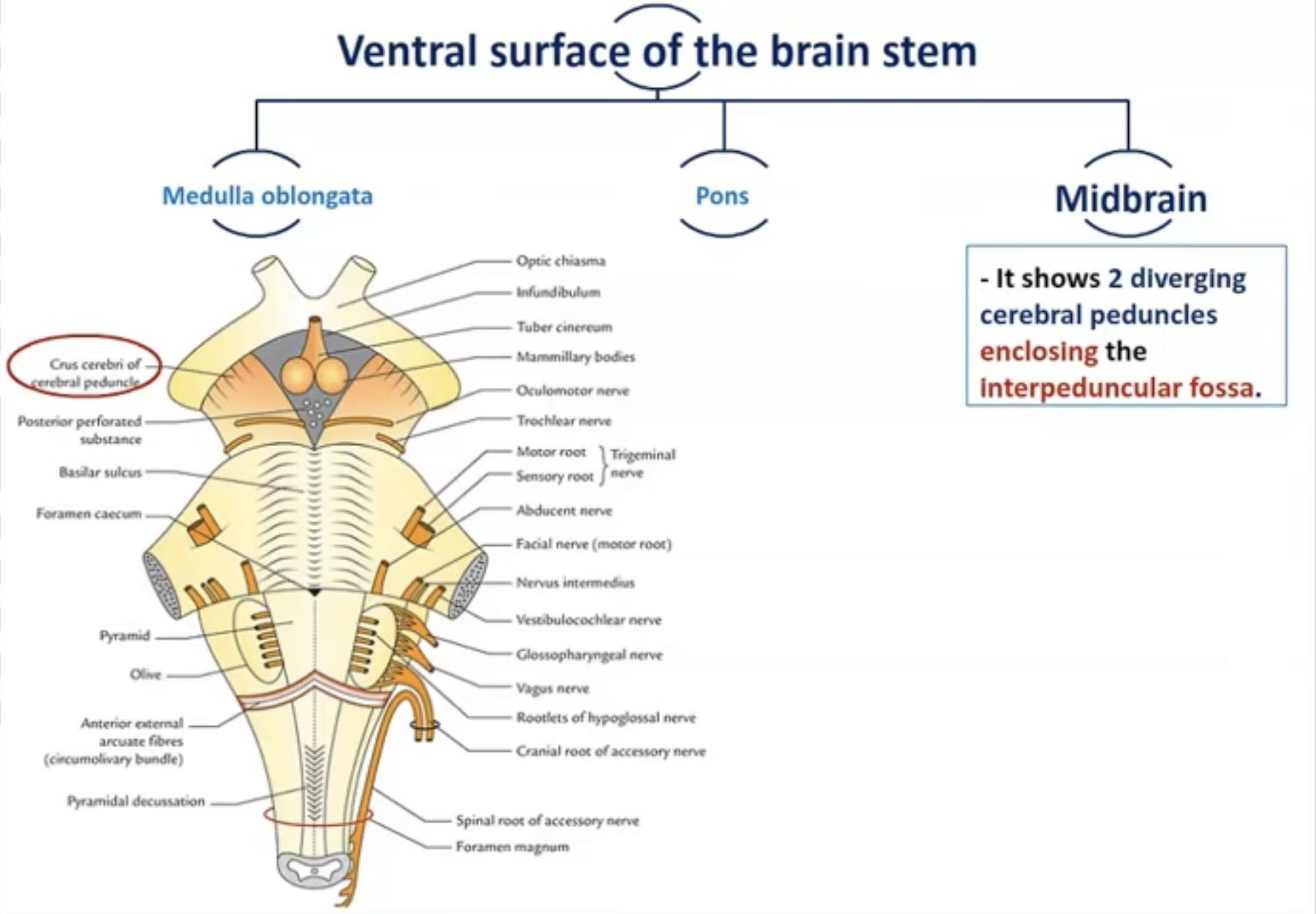

Slide 6
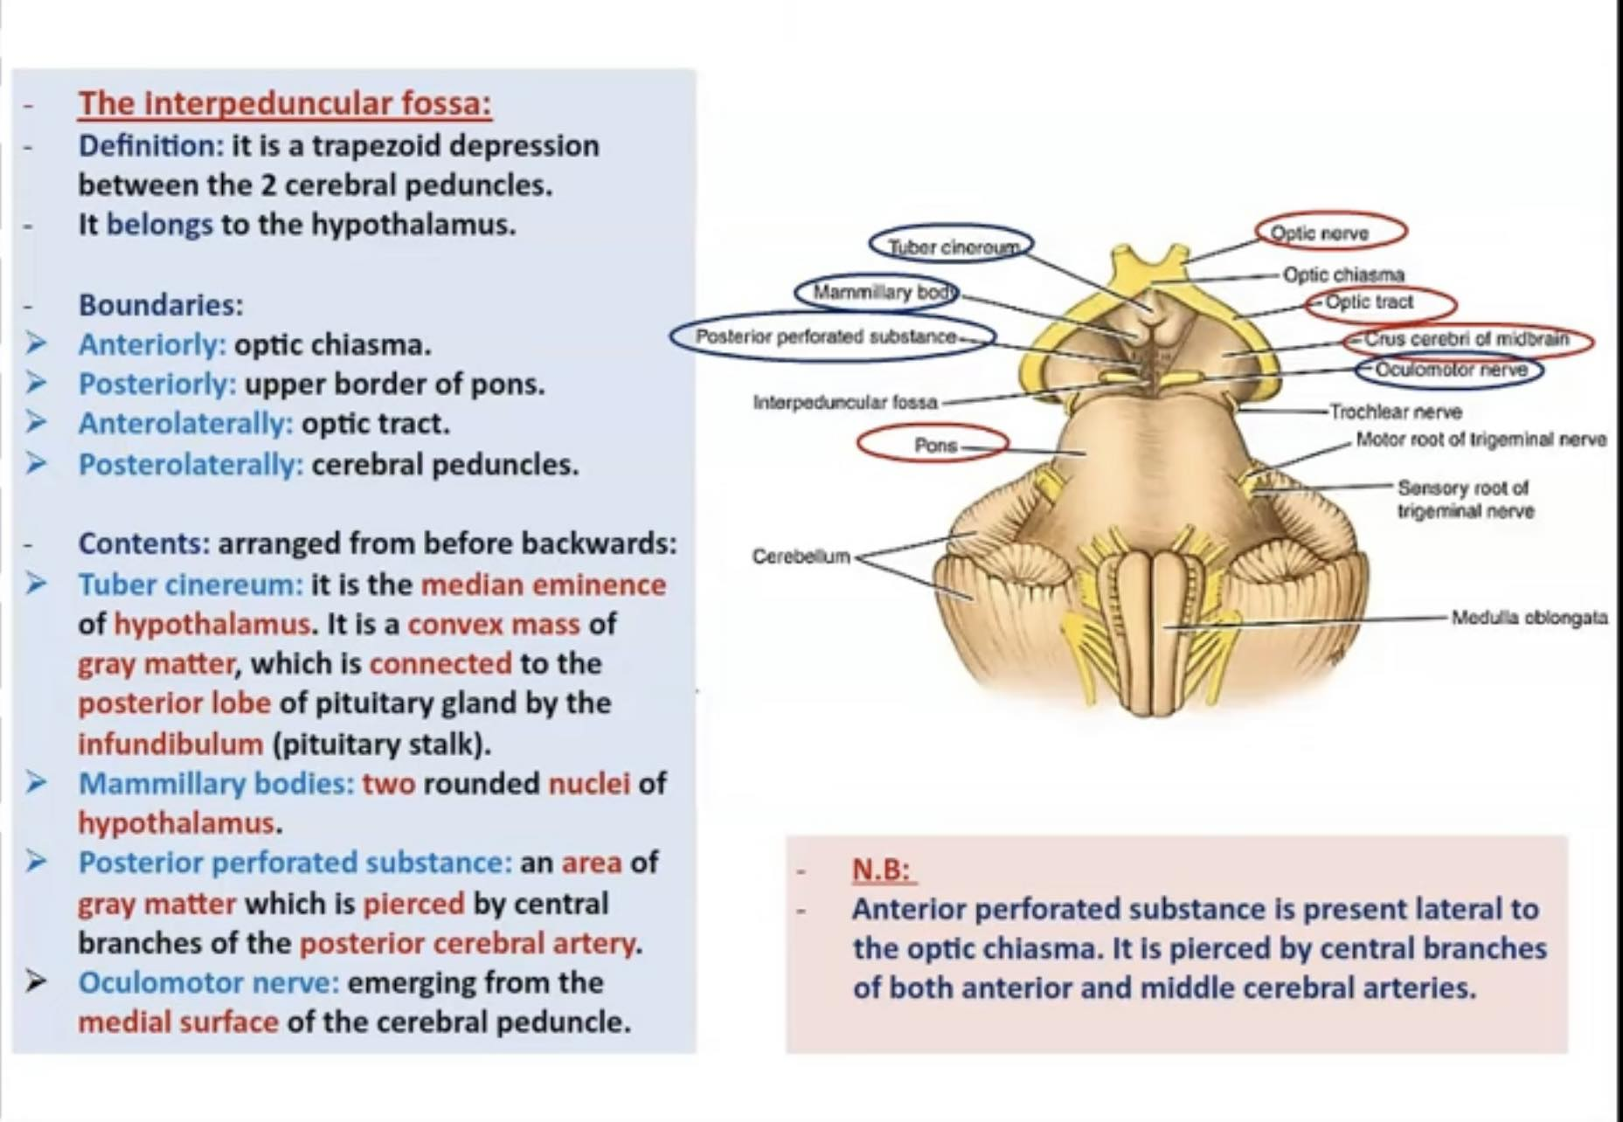

Slide 7
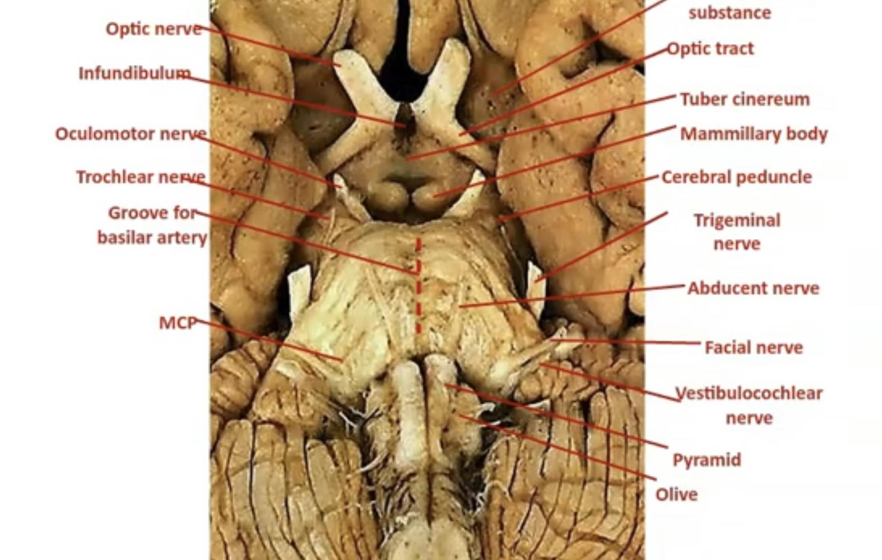

Slide 8
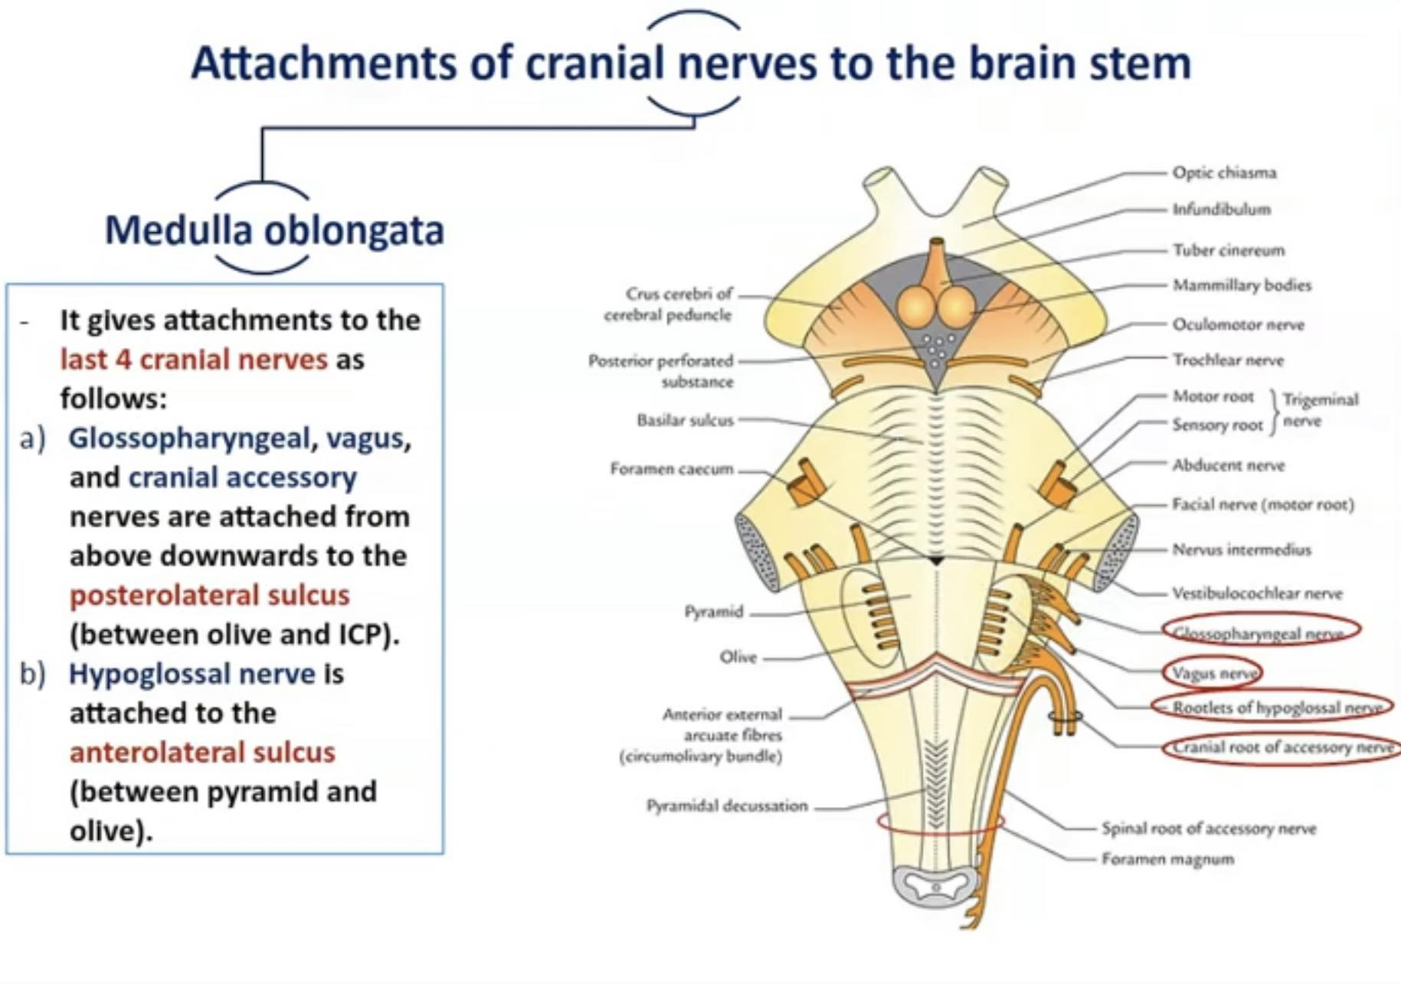

Slide 9
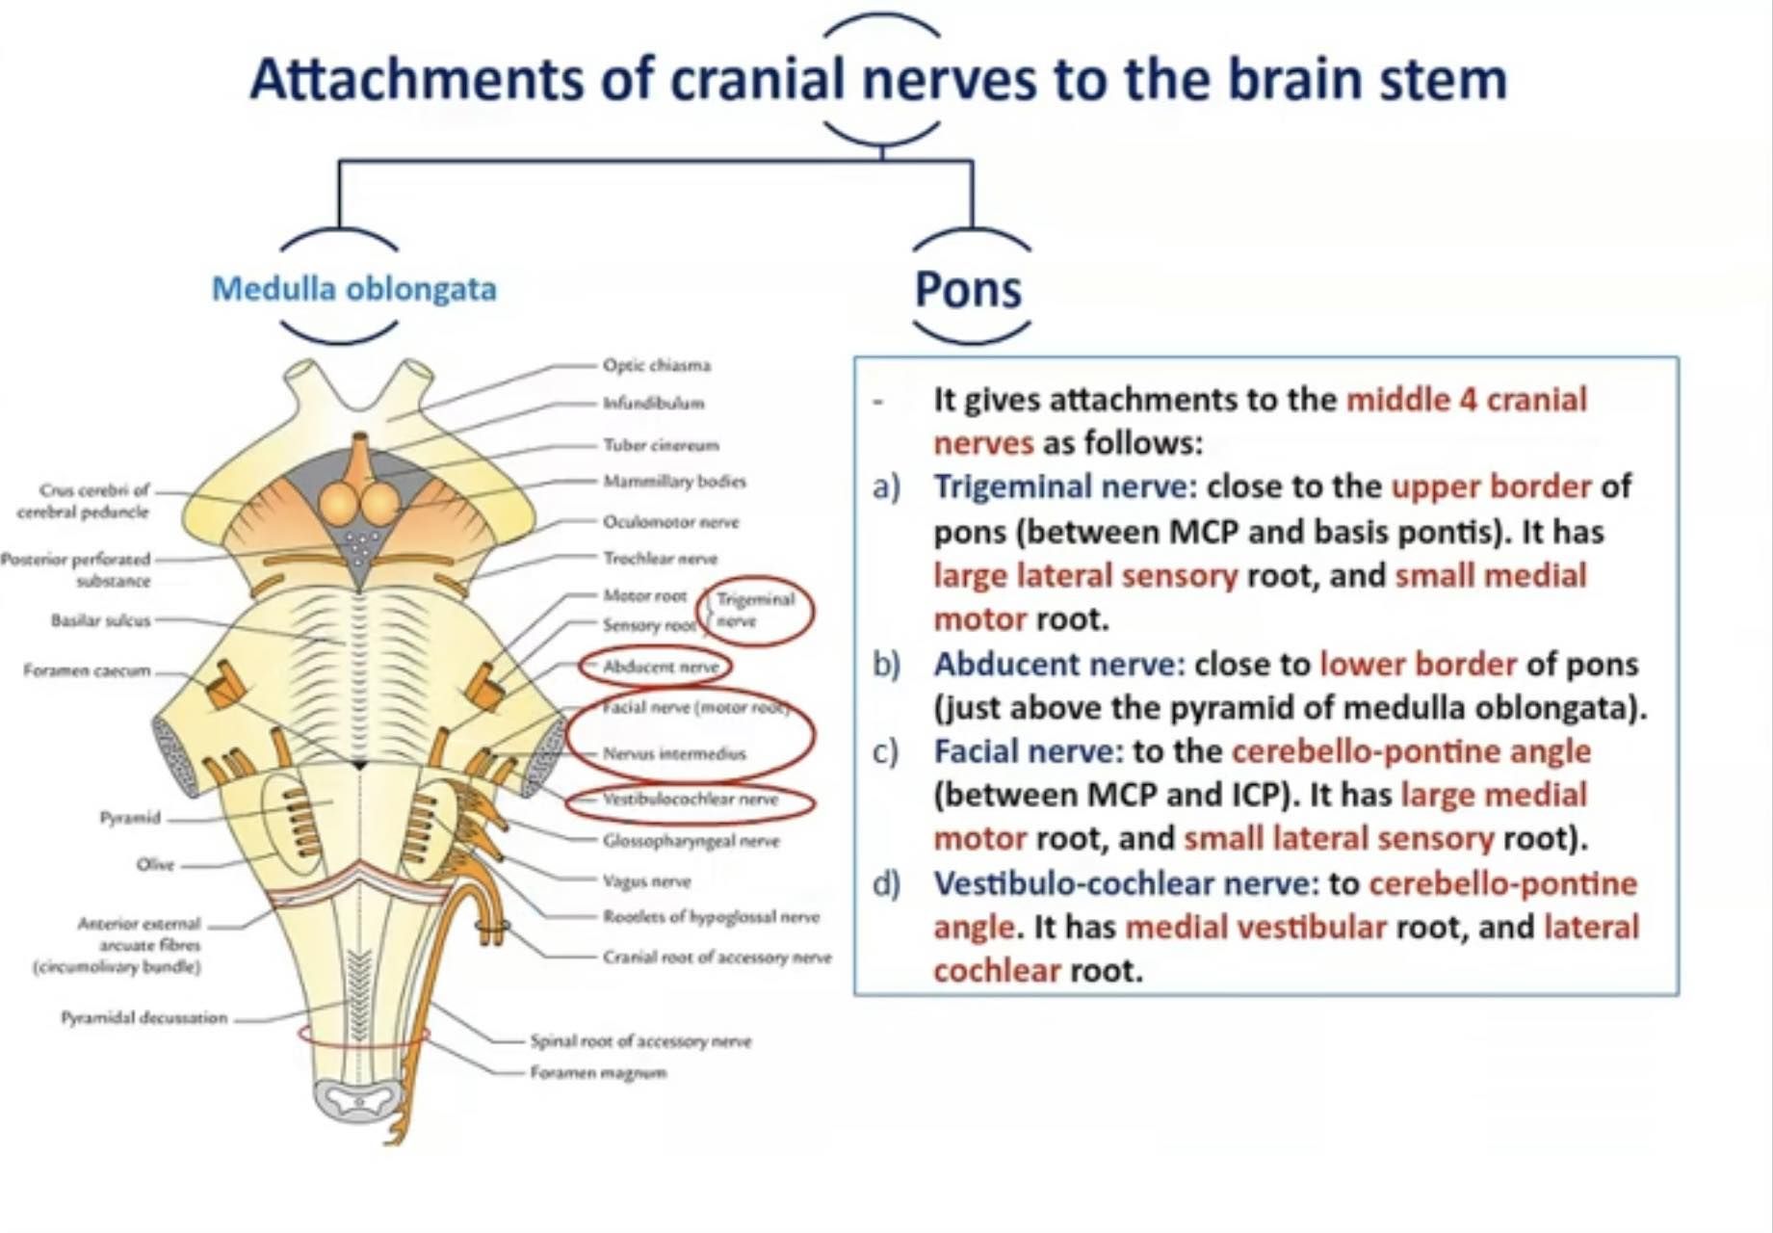

Slide 10
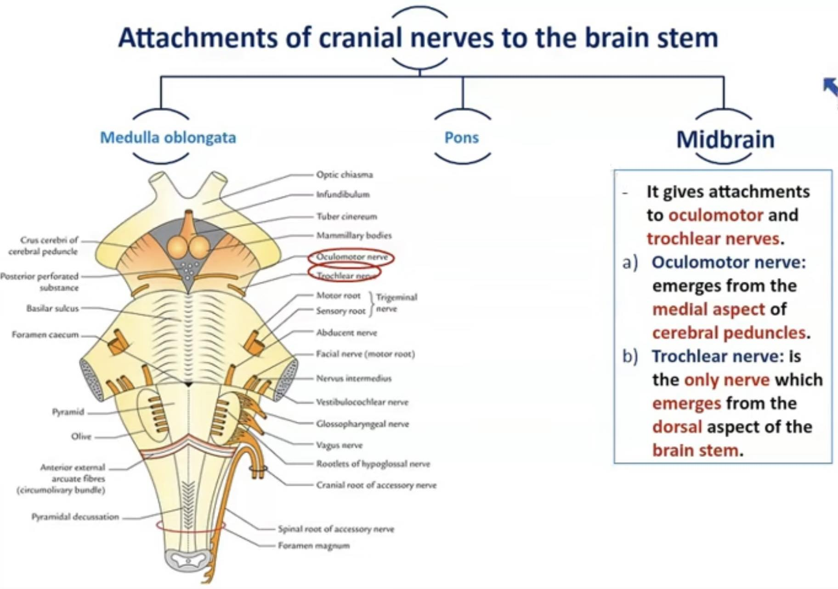

Slide 11
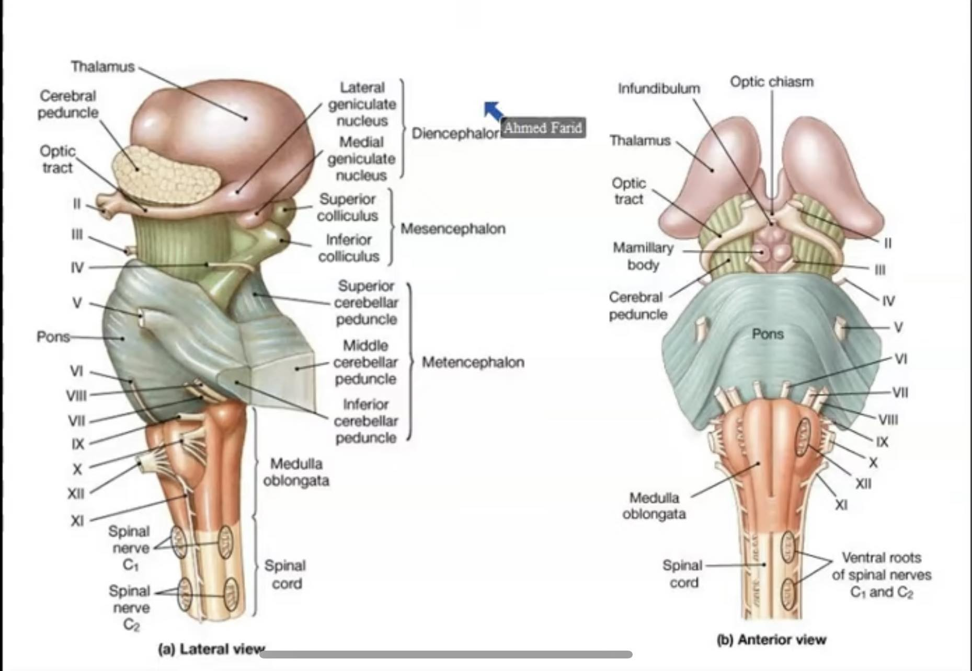

Slide 12
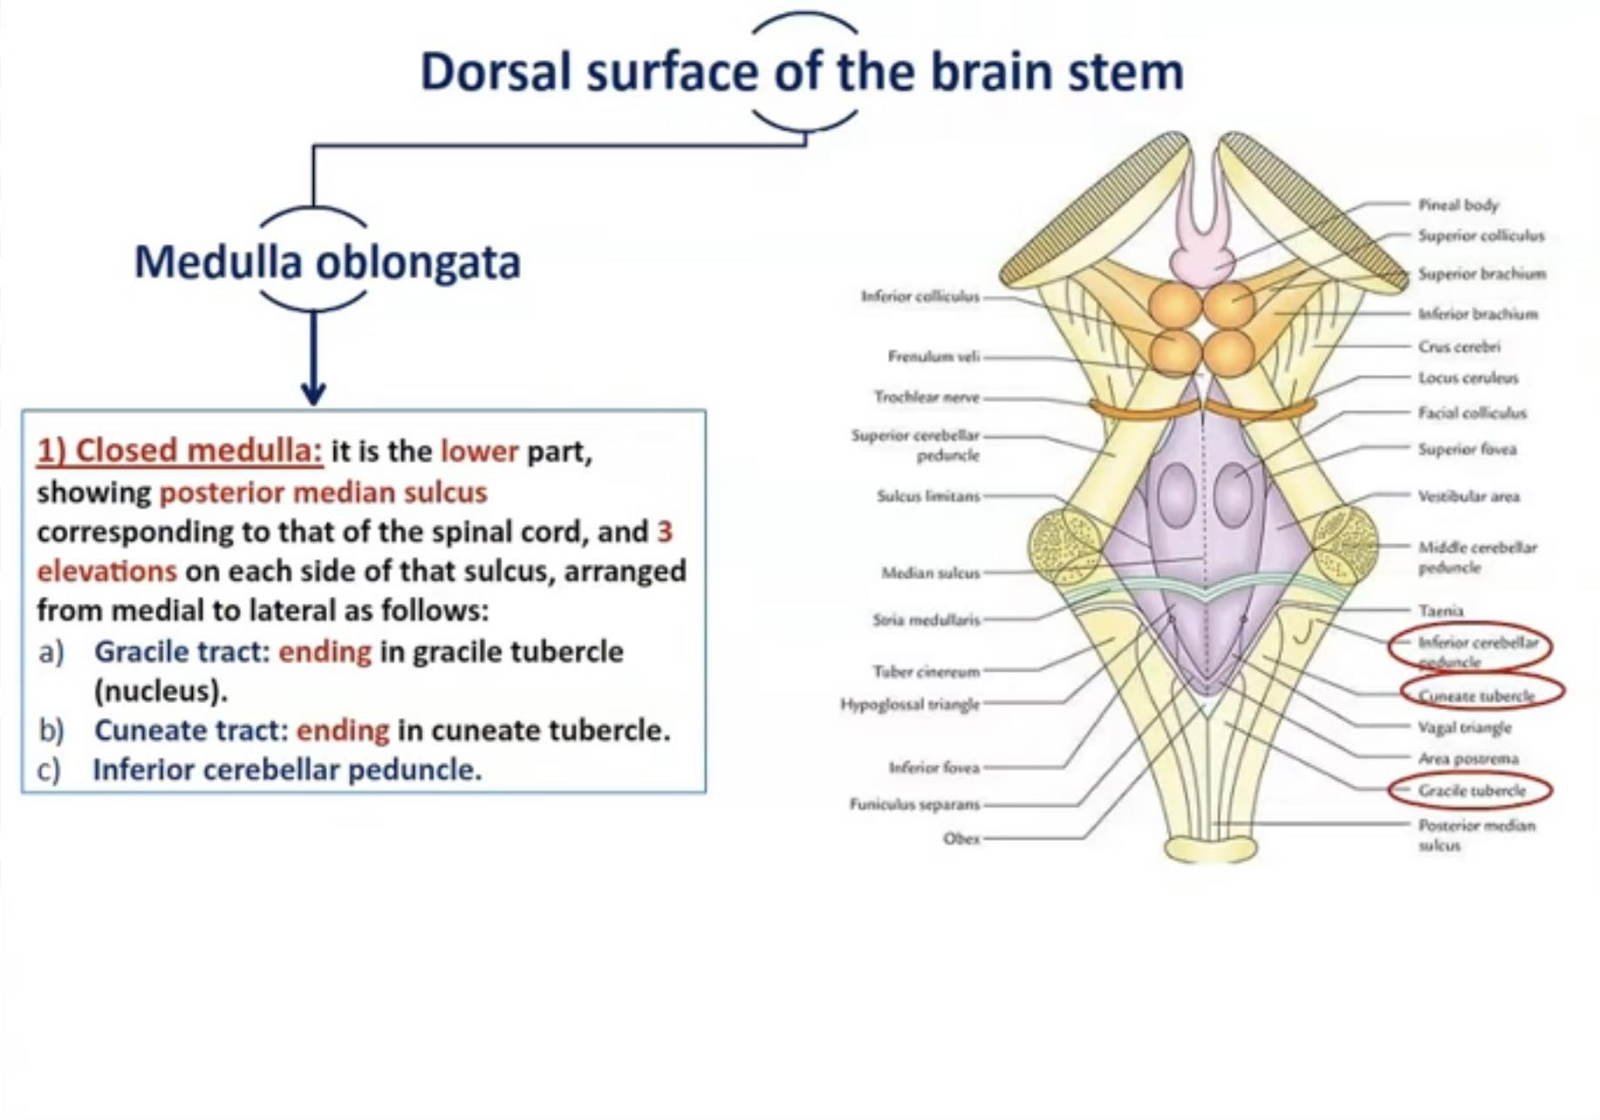

Slide 13
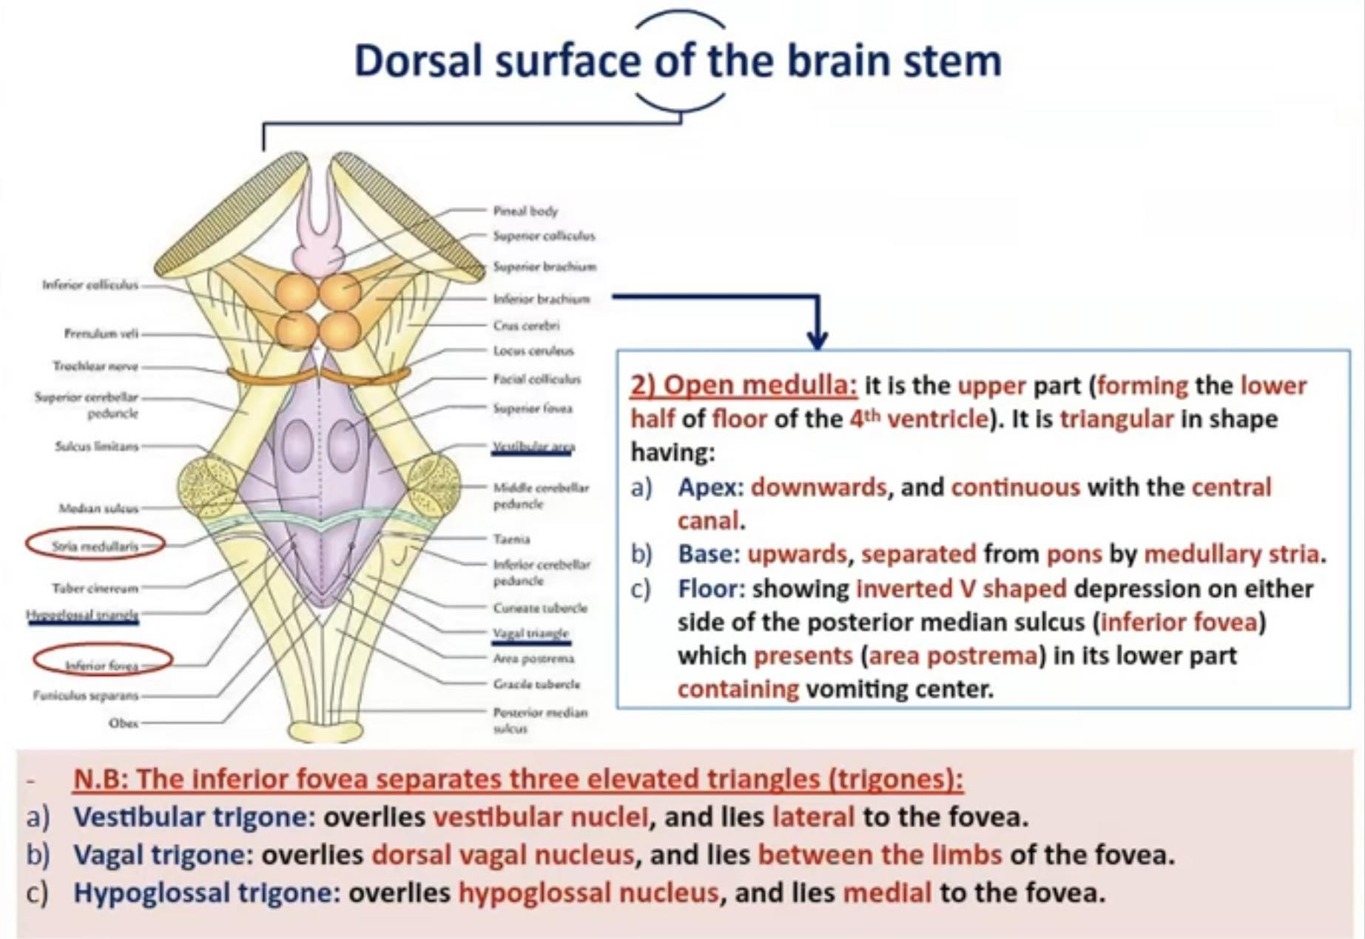

Slide 14
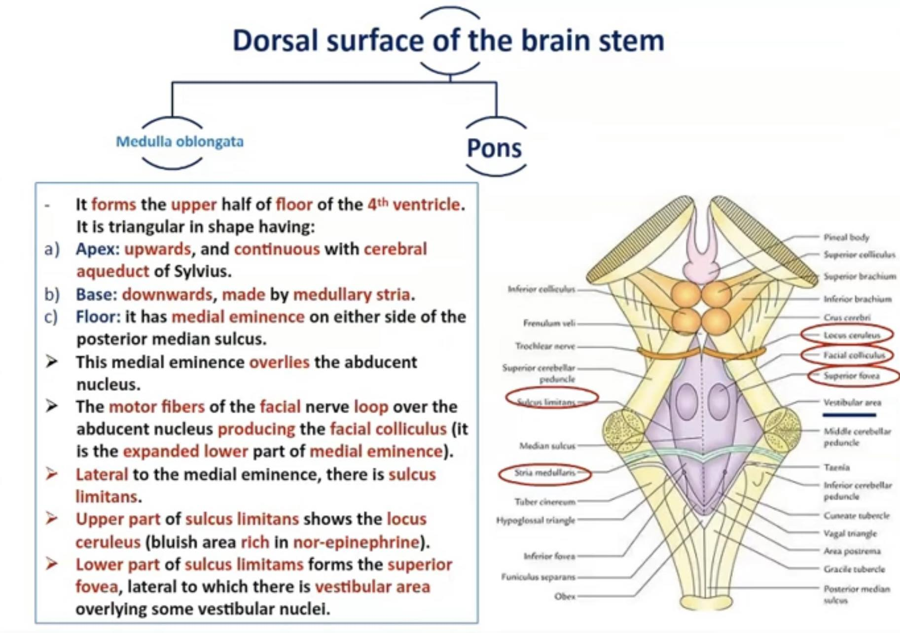

Slide 15
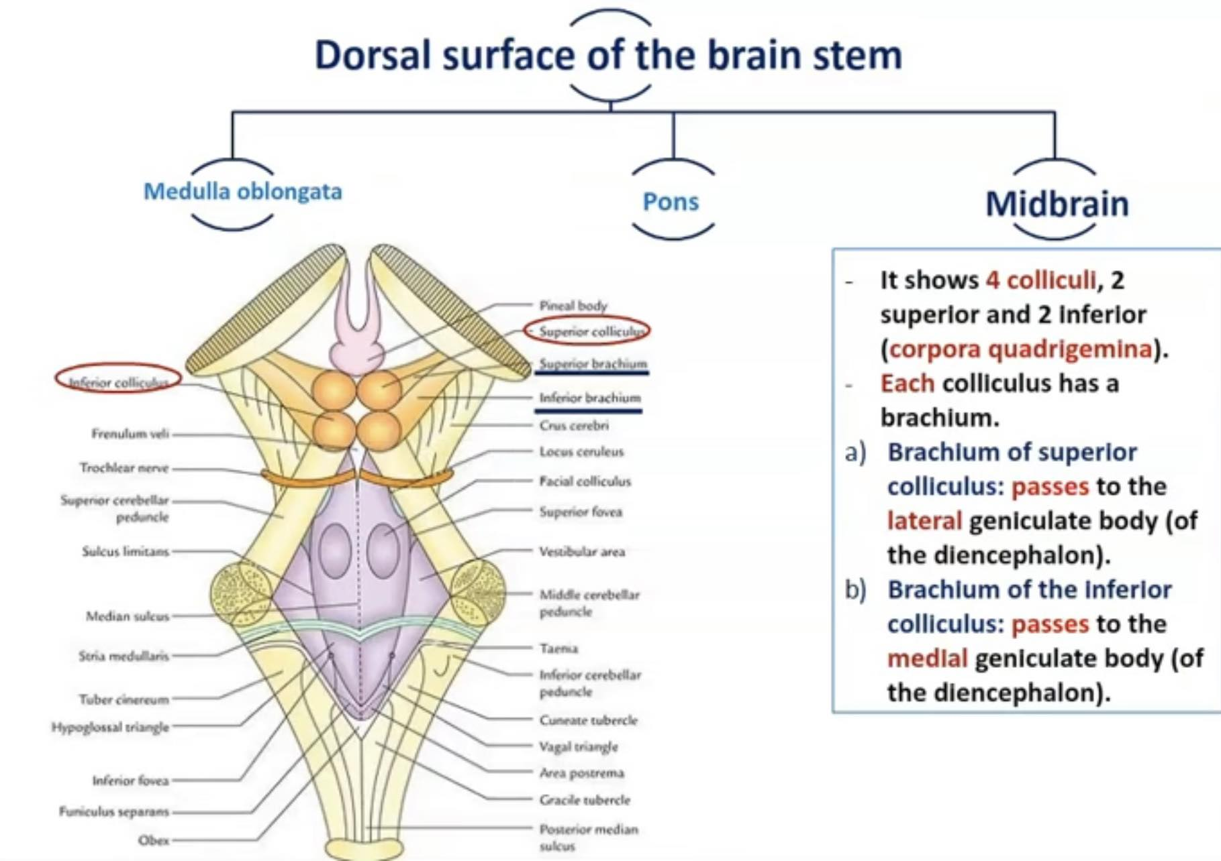

Slide 16
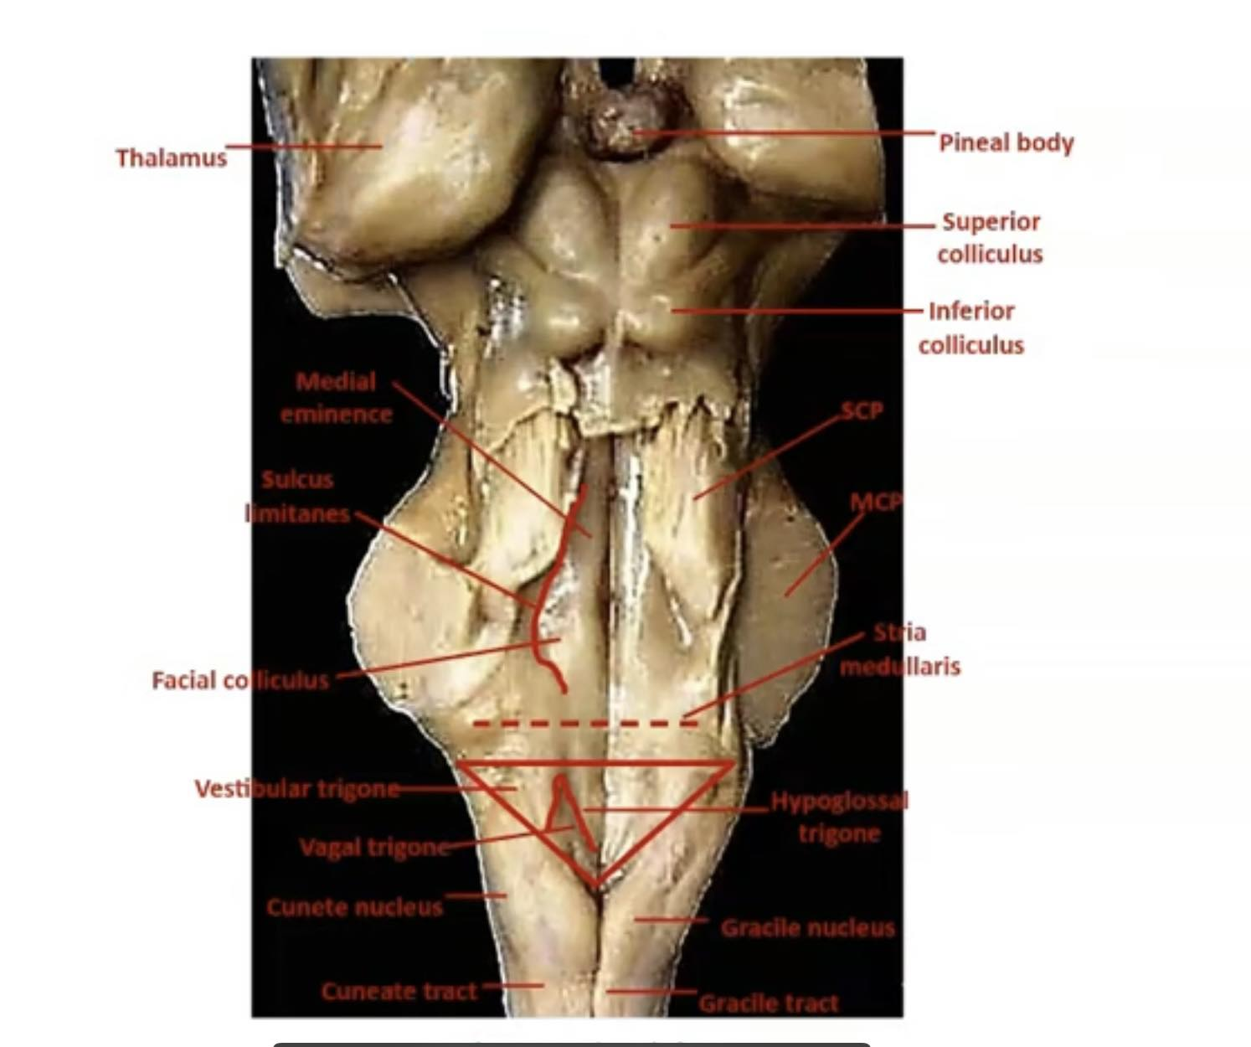

Slide 17
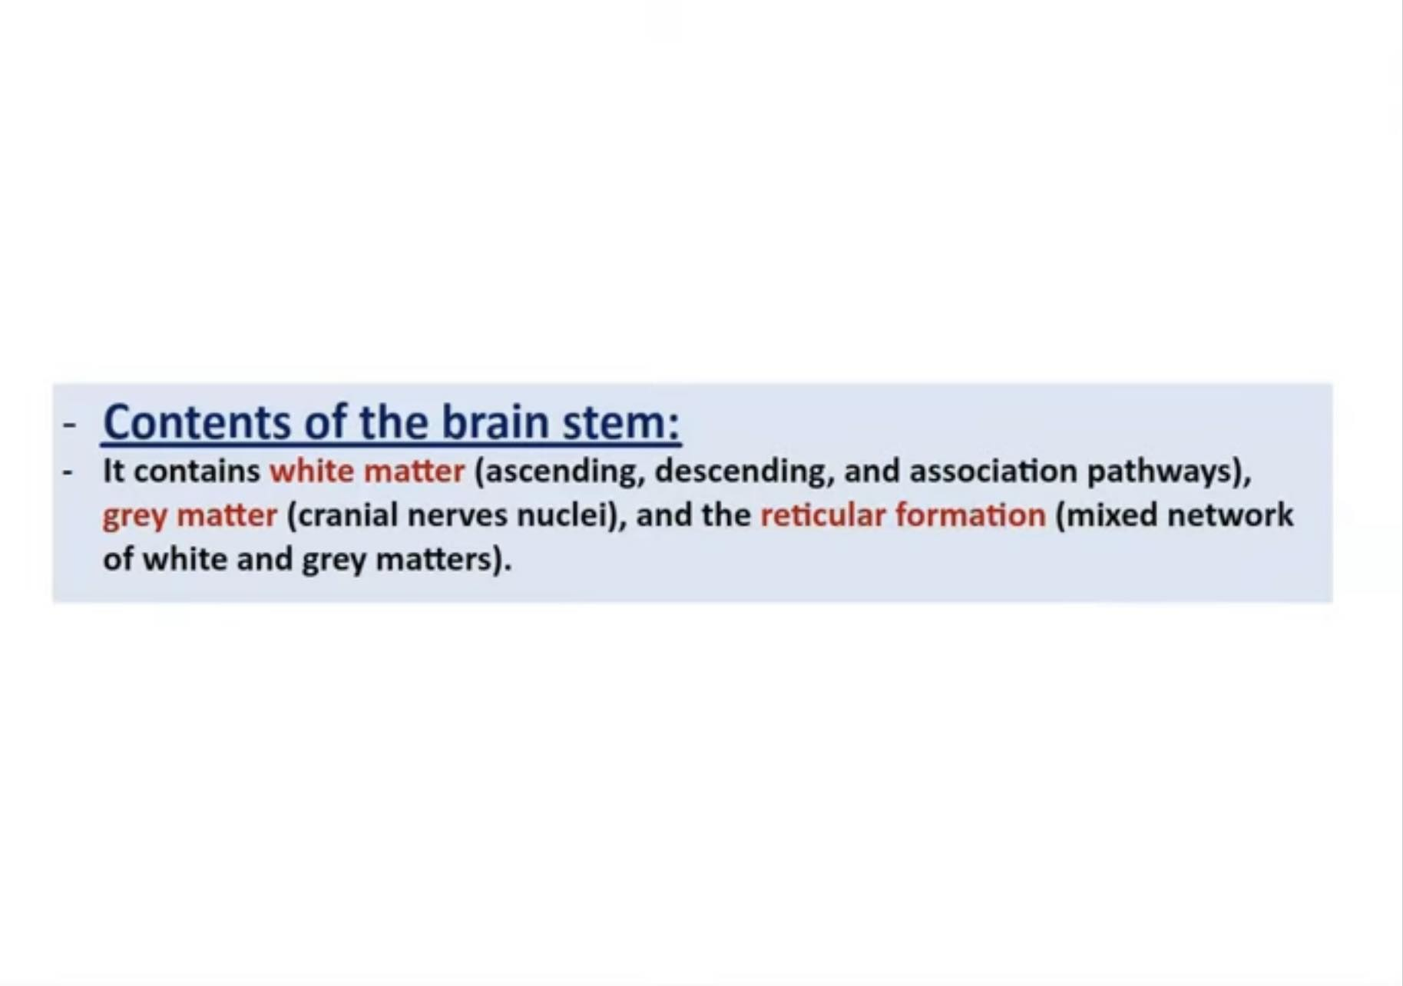

Slide 18
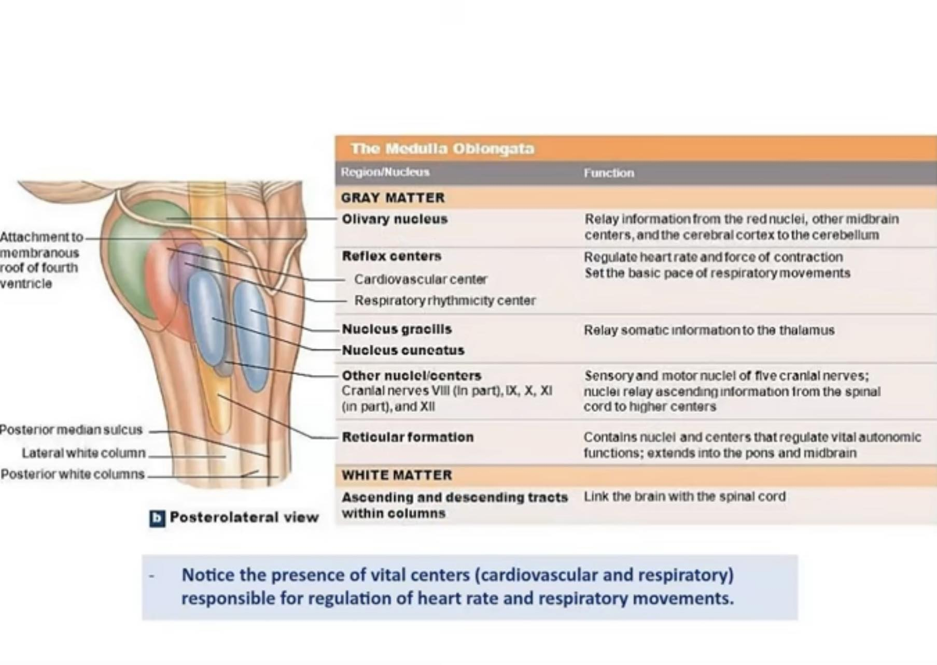

Slide 19
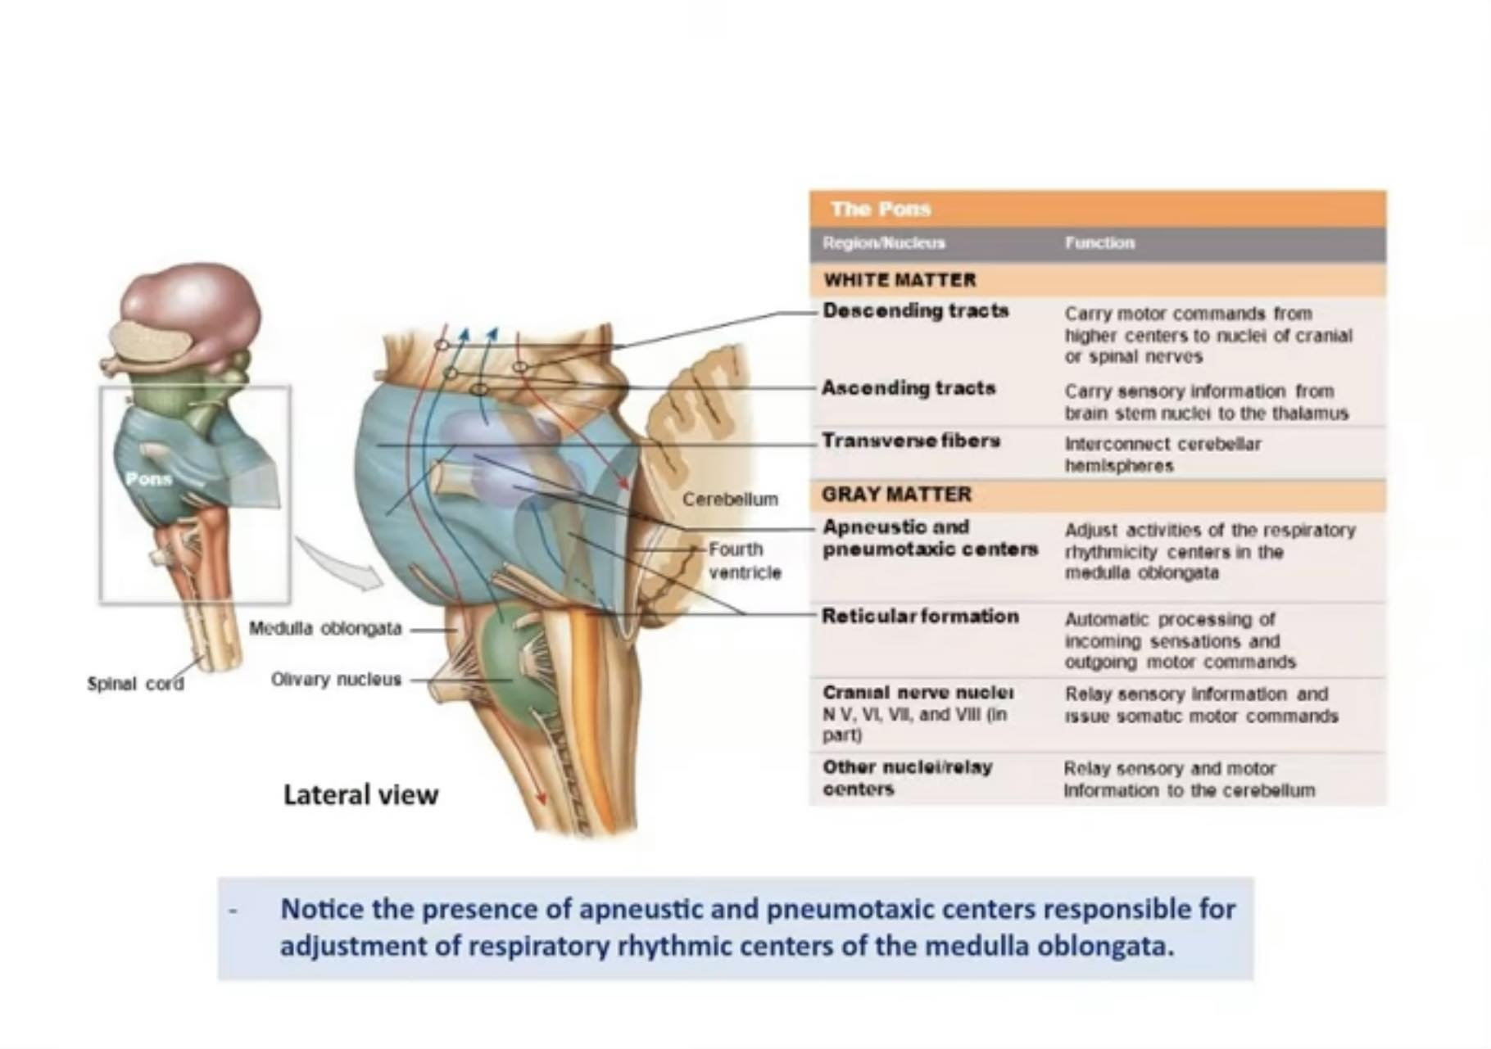

Slide 20
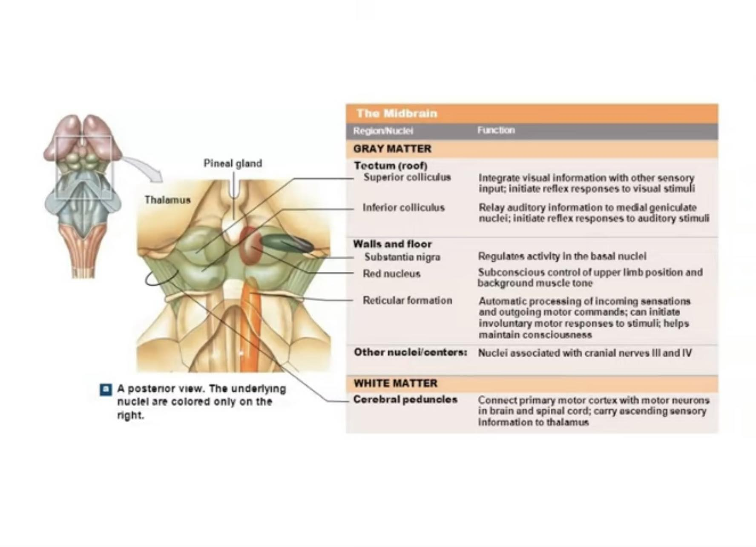

Slide 21
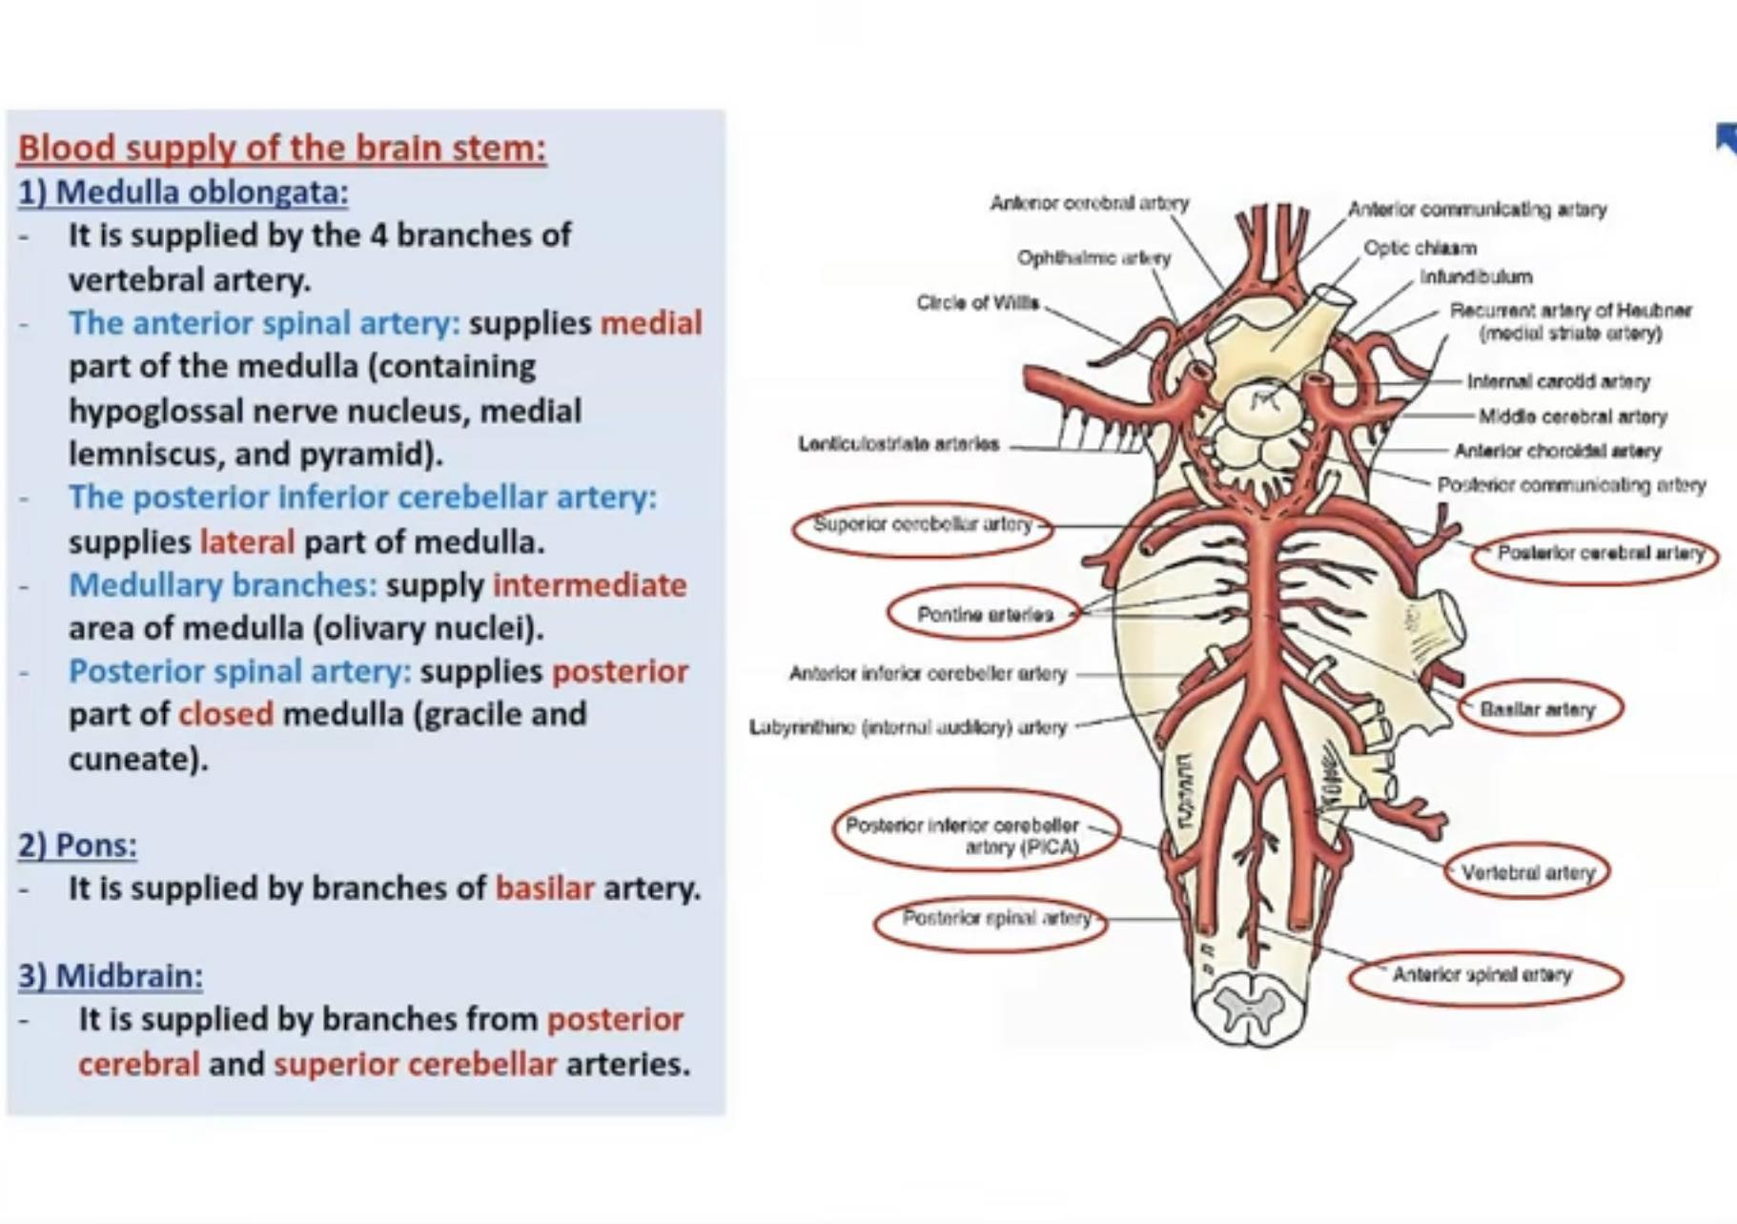

Slide 22
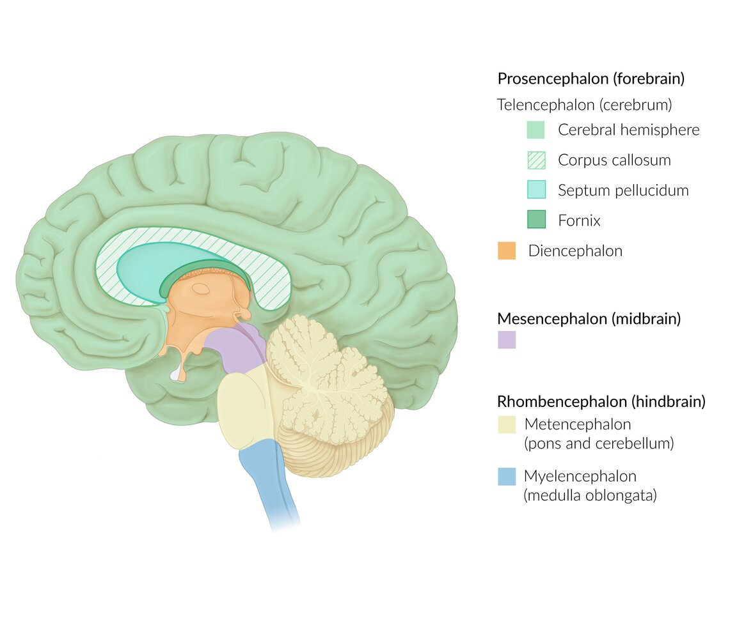
Notes:
Regions of the brain with embryological derivation
The illustration depicts the regions of the mature brain (names in parentheses) and their embryological derivation from the 3 primary vesicles (prosencephalon, mesencephalon, rhombencephalon) and 5 subdivisions (telencephalon, diencephalon, mesencephalon, metencephalon, myelencephalon). Note that this nomenclature is not always consistent, as some sources also refer to the regions of the mature brain using the embryological terminology (e.g., “prosencephalon” instead of “forebrain,” etc).
Note also that while the posterior pituitary (neurohypophysis) is a downgrowth of the diencephalon (and therefore shown in orange), the anterior pituitary (adenohypophysis) is separately derived as an upgrowth of the oral ectoderm (therefore shown in white).

Slide 23
Overview
Composition
  Nuclei of CN III–XII
  Major ascending (sensory) and descending (motor) pathways
  Reticular formation (responsible for alertness)
Function
  Regulation of awareness and sleep cycle
  Regulation of autonomic functions (e.g., circulation, respiration, gastrointestinal activity, salivation, lacrimation)
  Conduction

Slide 24
Each of the 3 parts of the brainstem contains CN nuclei: 2 (CN III and IV) in the midbrain, 4 (CN V–VIII) in the pons, and 4 (CN IX–XII) in the medulla oblongata.
4 CN nuclei are medial: CN III, IV, VI, and XII.

Slide 25
Midbrain
Characteristics
Location: rostral to the pons, ventral to the cerebellum, caudal to the thalamus
Function
  Processing of auditory and visual information
  Coordination of eye movement
  Modulation of extrapyramidal motor function
  Conduction of fiber tracts
  Nociception
  Arousal and alertness
Composition: three main components
  Crura cerebri
  Tegmentum
  Tectum
Embryogenesis: derived from mesencephalon

Slide 26
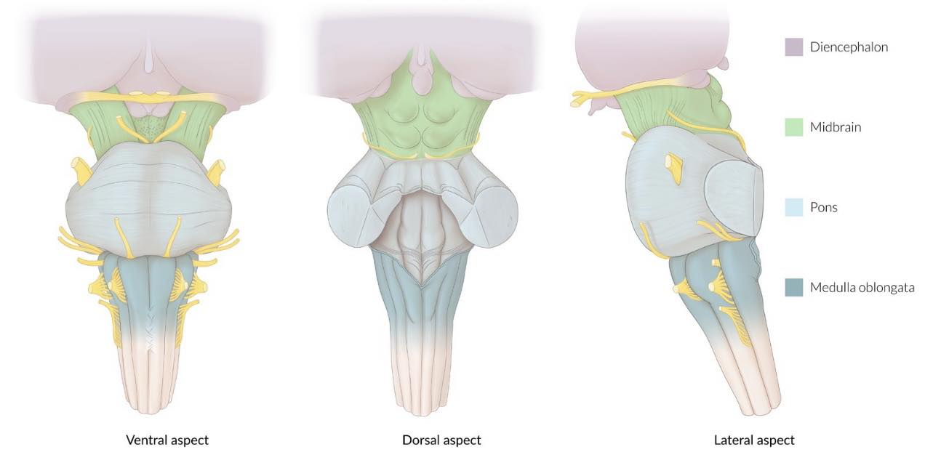
Notes:
Brainstem and diencephalon
Ventral, dorsal, and lateral aspects of the brainstem (medulla oblongata, pons, midbrain) and the diencephalon. The points of entry/exit and course of various cranial nerves are shown as well.

Slide 27
Components of the midbrain
Overview of the midbrain
Structure | Location | Components | Function/Characteristics
Tectum | Posterior to the cerebral aqueduct Forms the roof of the midbrain | Superior colliculi | Relay voluntary and involuntary eye movements (e.g., saccades) Facilitate optic reflexes Receive input from the retina and the pretectal area Project to the lateral geniculate bodies
 |  | Inferior colliculi | Part of the auditory pathway Receive input from the lateral lemniscus Project to the medial geniculate bodies

Slide 28
Tegmentum | Extends from midbrain to pons Between the tectum and the base of the midbrain | Sensory pathways and nuclei of oculomotor nerve (CN III) and trochlear nerve (CN IV) Mesencephalic nucleus of trigeminal nerve (CN V) Substantia nigra (see below) Red nucleus (see below) | Involved in modulation of extrapyramidal motor function
Substantia nigra | Within the tegmentum | Pars compacta: contains dopaminergic neurons with high levels of melanin Pars reticularis: contains mainly GABAergic neurons | Involved in initiating and coordinating movements Receives inhibitory input (GABA) from the striatum Projects dopaminergic fibers to the striatum (↑ motor function) Projects GABAergic fibers to motoric nuclei (e.g., ventral lateral, ventral anterior) of the thalamus (↓ motor function)

Slide 29
Red nucleus | Within the tegmentum, at the level of the oculomotor nerve nucleus | Caudal magnocellular part Rostral parvocellular part | Coordination of movement and gait Preservation of muscular tone Receives and relays input from the cerebral cortex and the cerebellum Origin of the rubrospinal tract and rubroolivary tracts
Crura cerebri | Form the base of the midbrain | Corticospinal tracts Corticopontine tracts Corticobulbar tracts | Voluntary movement of the contralateral side of the body Coordination of planned movement Voluntary movement of muscles of the face and neck

Slide 30
Cerebellar peduncles | Arise at the lateral ventral aspect of the pons | Superior cerebellar peduncles Middle cerebellar peduncles Inferior cerebellar peduncles | Relay motor planning signals from the cerebellum Relay proprioceptive signals to the cerebellum Connection of Pons to cerebellum Cerebellum to midbrain Cerebellum to medulla and spinal cord
Cerebral aqueduct | Between the tegmentum and the tectum Surrounded by periaqueductal gray matter | Cerebrospinal fluid | Connects the 3rd and 4th ventricles Stenosis of this structure causes non-communicating hydrocephalus
Periaqueductal gray matter | Surrounds the cerebral aqueduct | Dorsal tegmental nucleus Dorsal raphe nucleus | Part of the antinociceptive system

Slide 31
Medial longitudinal fasciculus | Found on each side near the midline ventral to the fourth ventricle (in the medulla and pons) and cerebral aqueduct (in the midbrain) | White matter fiber bundles (ascending and descending) | Coordinate eye movement Highly myelinated (to enable fast coordinated eye movements) Connect CN III, CN IV, and CN VI Lesions lead to internuclear ophthalmoplegia Common site of involvement in multiple sclerosis (esp. bilateral lesions)
Central tegmental tract | From the midbrain to the inferior olivary nucleus in the medulla | Ascending reticulothalamic fibers Descending rubroolivary fibers Taste fibers ascending from solitary nucleus to the VPM nucleus of thalamus | Coordination of movement Relay of taste fibers

Slide 32
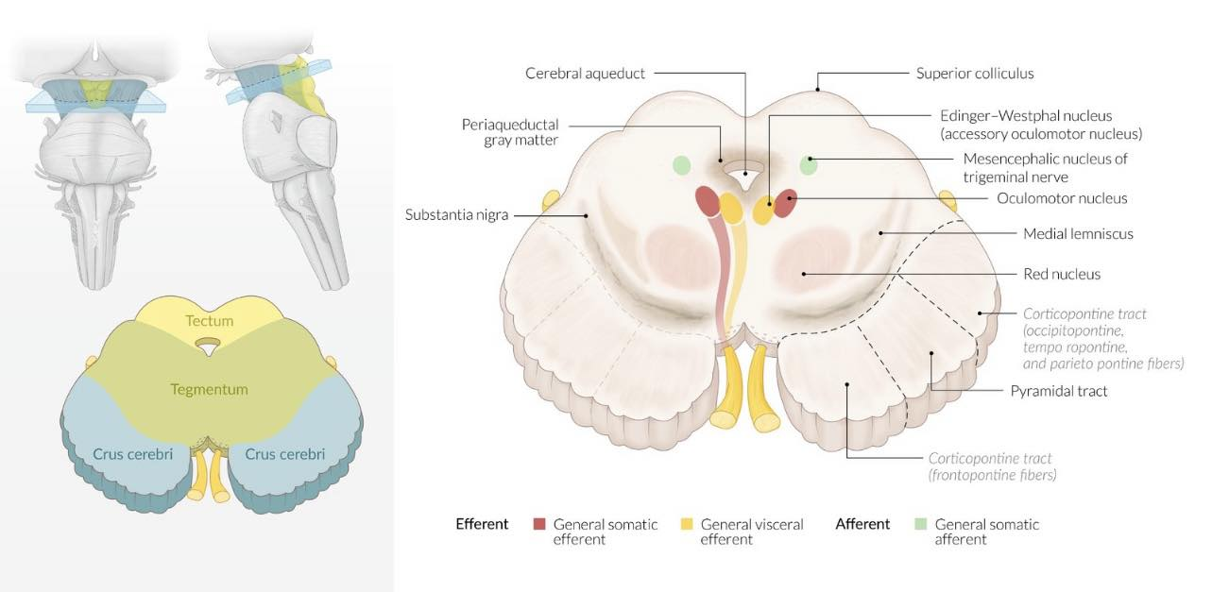

Slide 33
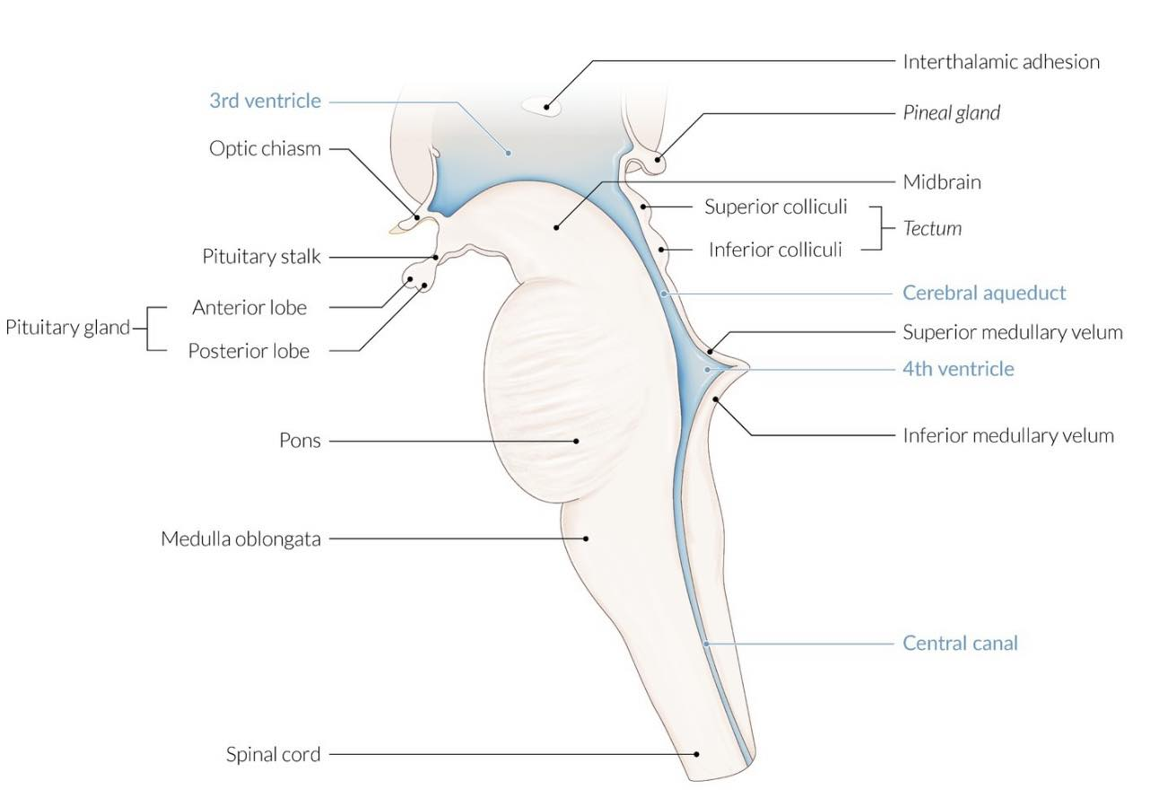
Notes:
Brainstem and ventricular system
Sagittal section of the brainstem reveals the three major components (from cranial to caudal: midbrain, pons, medulla oblongata) and their associated structures. The parts of the CSF space that traverse the brainstem are shown in blue.

Slide 34
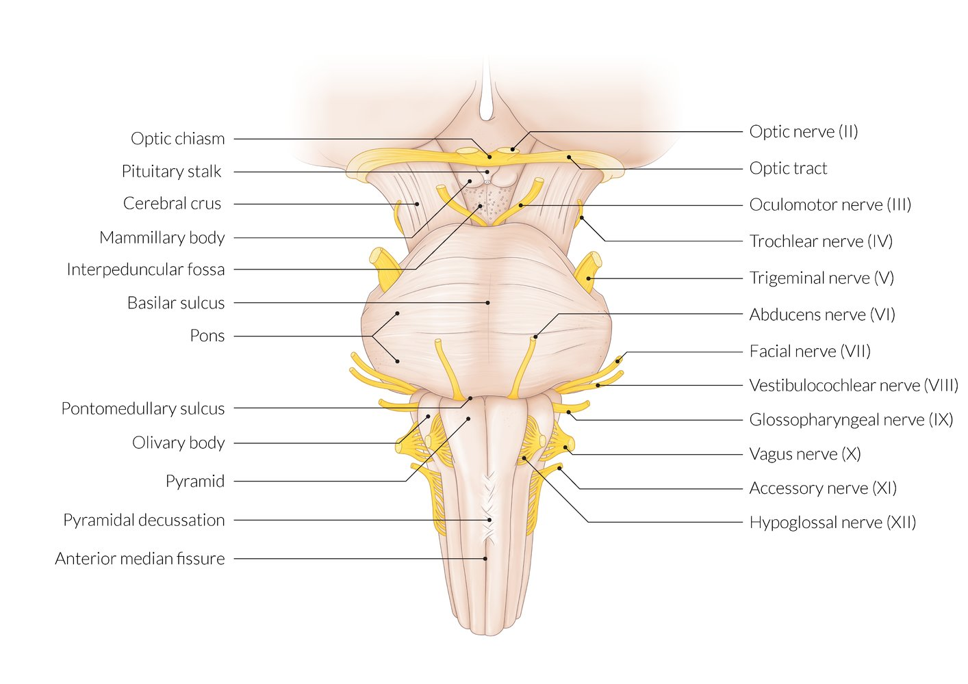

Slide 35
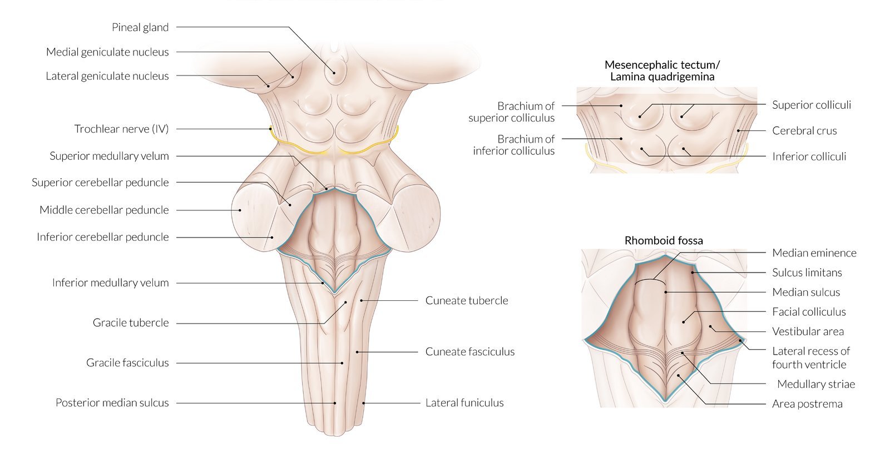
Notes:
Brainstem and cerebellar peduncles
Dorsal view
The mesencephalic tectum and rhomboid fossa have distinct structures and functions. The rhomboid fossa is flanked by three pairs of cerebellar peduncles (superior, middle, and inferior) that connect the brainstem to the ipsilateral cerebellar cortex.

Slide 36
Pons
Characteristics
Function
  Conduction of nerve fibers and tracts (e.g., transmission of pain, temperature, proprioception, and auditory signals)
  Regulation of autonomic functions
Composition: divided into 2 parts (dorsal to ventral)
  Pontine tegmentum: contains CN nuclei
    Trigeminal (CN V)
    Abducens (CN VI)
    Facialis (CN VII)
    Vestibulocochlear (CN VIII)
Basilar pons: contains relay nuclei (e.g., pontine nuclei) and nerve tracts

Slide 37
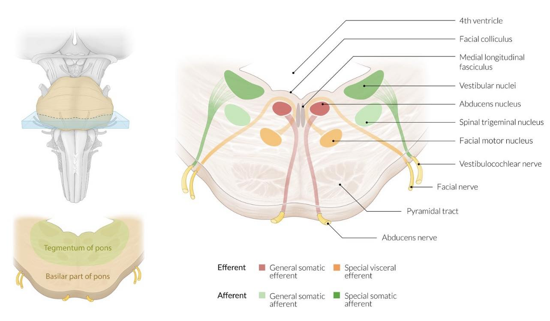

Slide 38
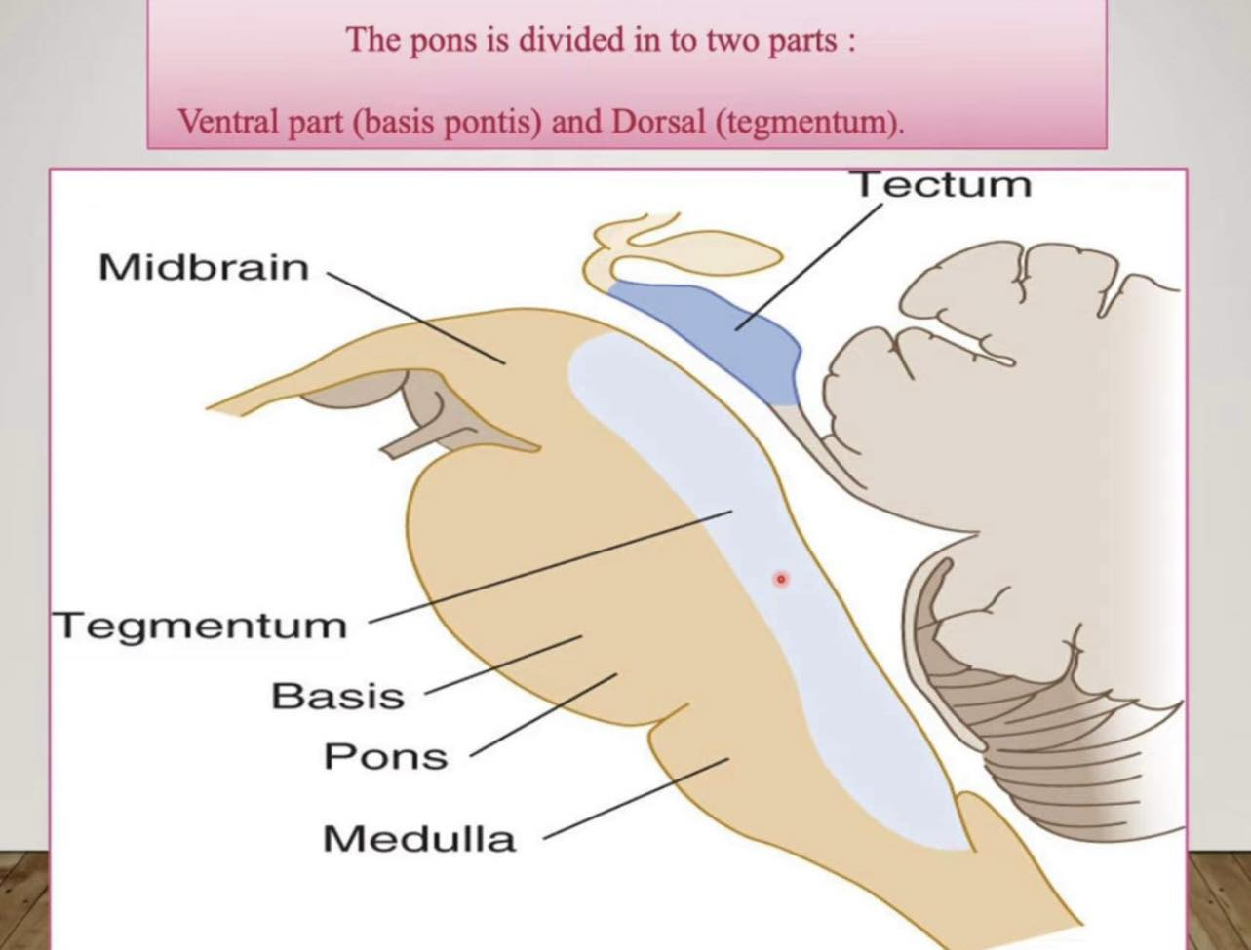

Slide 39
Medulla oblongata
Characteristics
Function
  Regulation of autonomic functions (e.g., circulation, respiration, gastrointestinal activity)
  Contains centers for swallowing, sneezing, coughing, and vomiting
  Conduction of motor and sensory information
CompositionCN nuclei
  Part of the sensory trigeminal nerve nucleus (CN V)
  Glossopharyngeal (CN IX)
  Vagus (CN X)
  Accessorius (CN XI)
  Hypoglossal (CN XII)

Slide 40
Fissures
  Ventrolateral sulcus (preolivary sulcus)
    Contains rootlets of CN XII
  Posterolateral sulcus: contain rootlets of CN IX–XI
Pyramids
Area postrema
A number of brainstem nuclei (e.g., nucleus gracilis, nucleus cuneatus, inferior olivary nucleus)

Slide 41
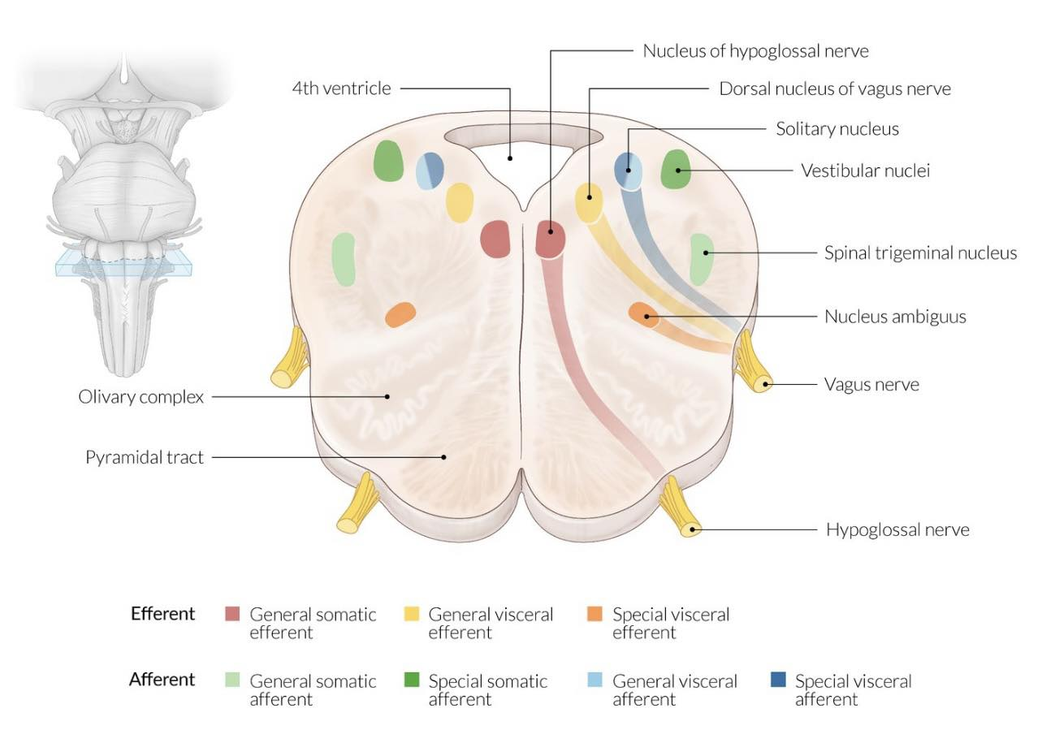

Slide 42
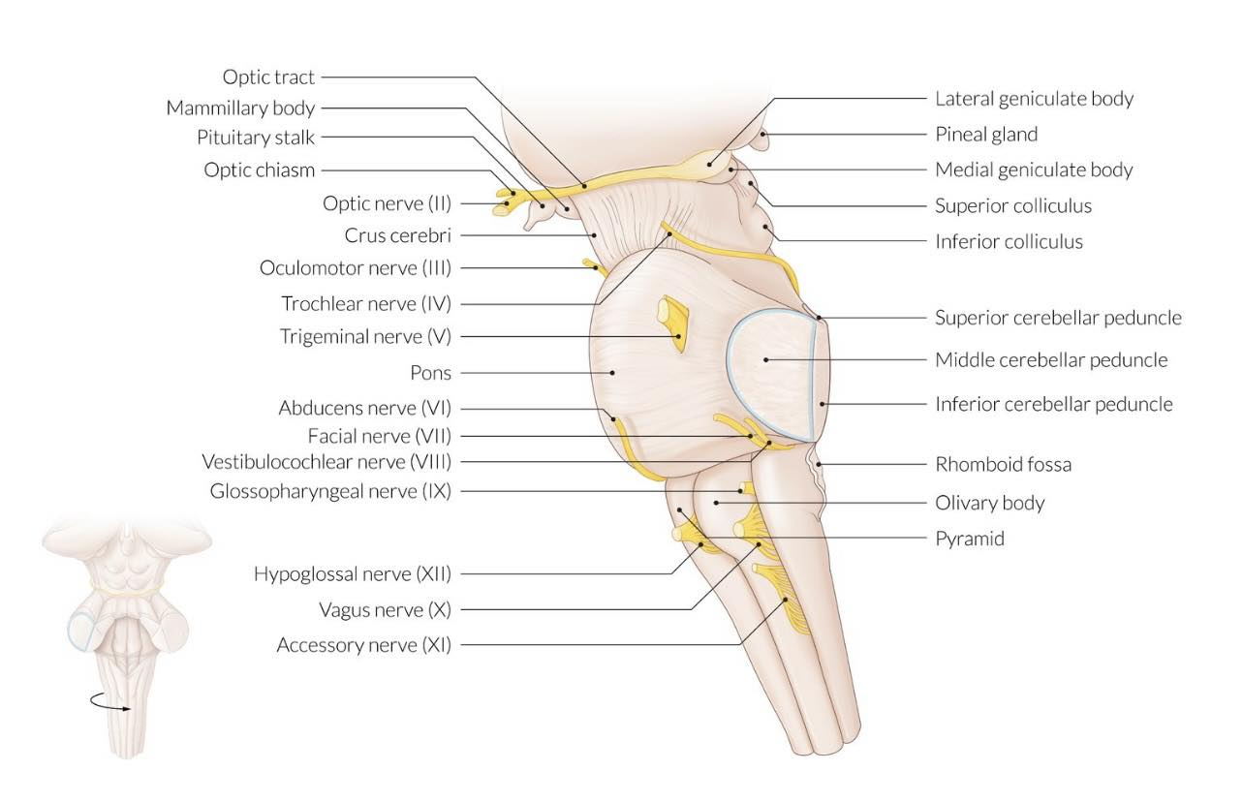

Slide 43
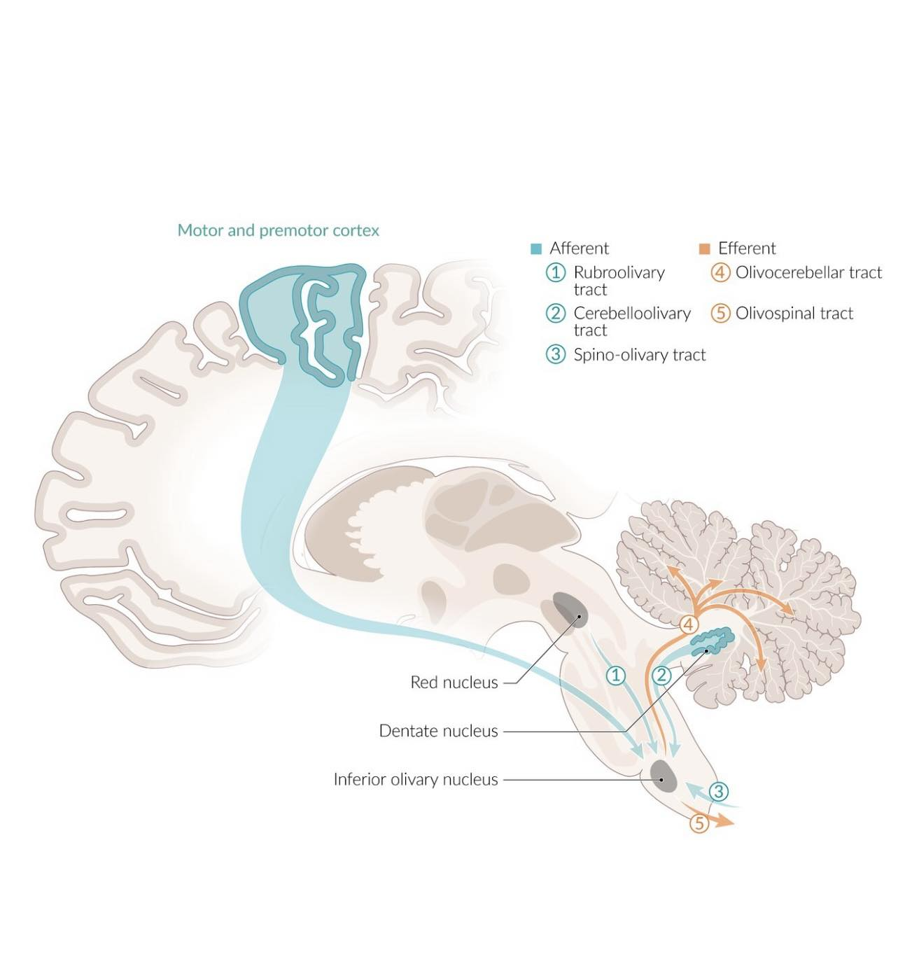

Slide 44
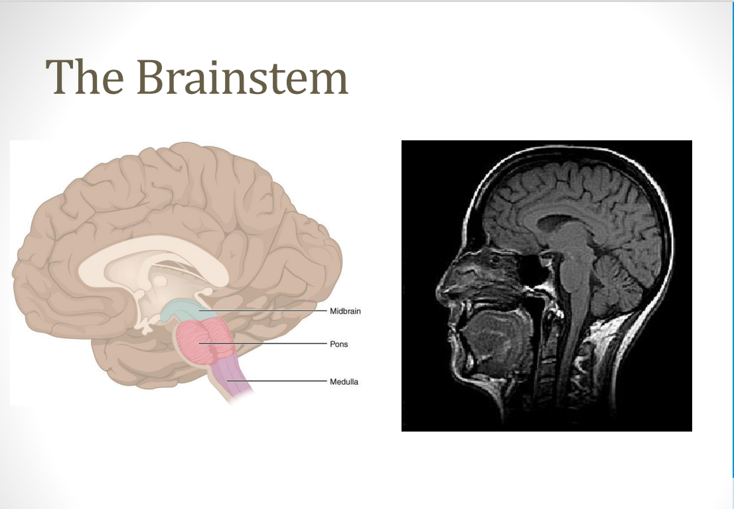

Slide 45
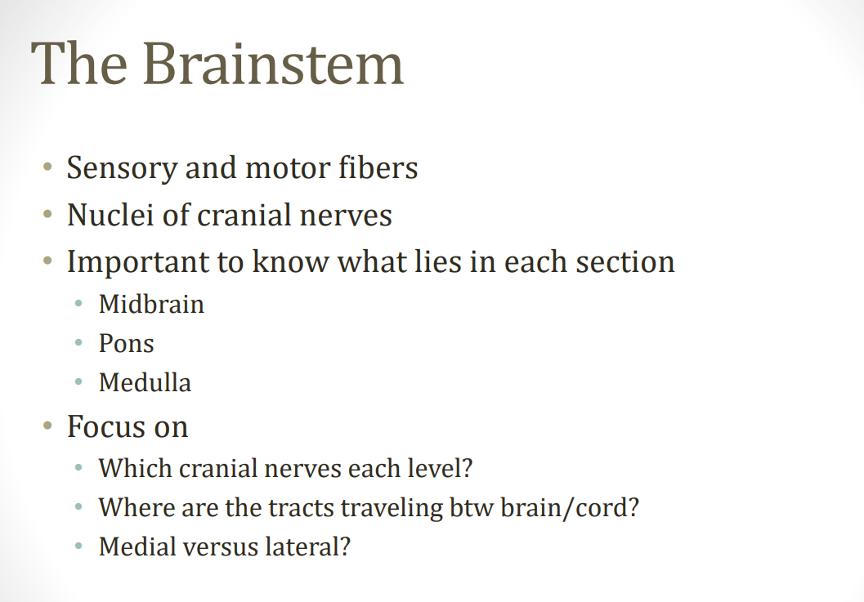

Slide 46
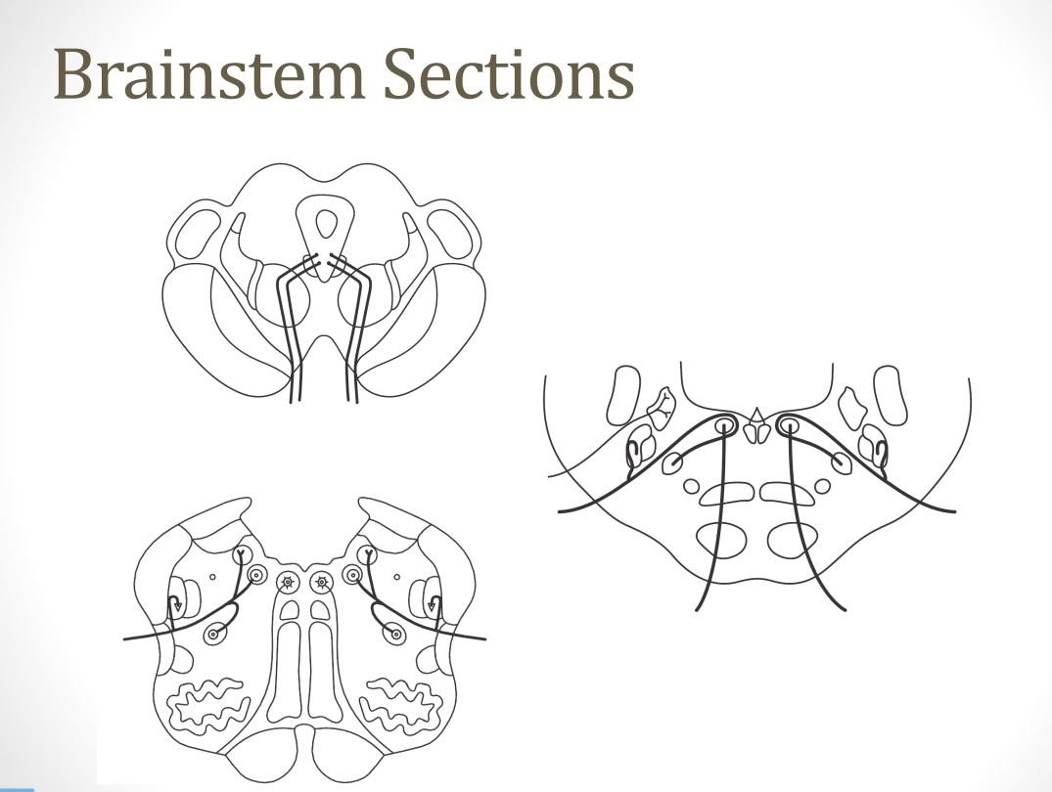

Slide 47
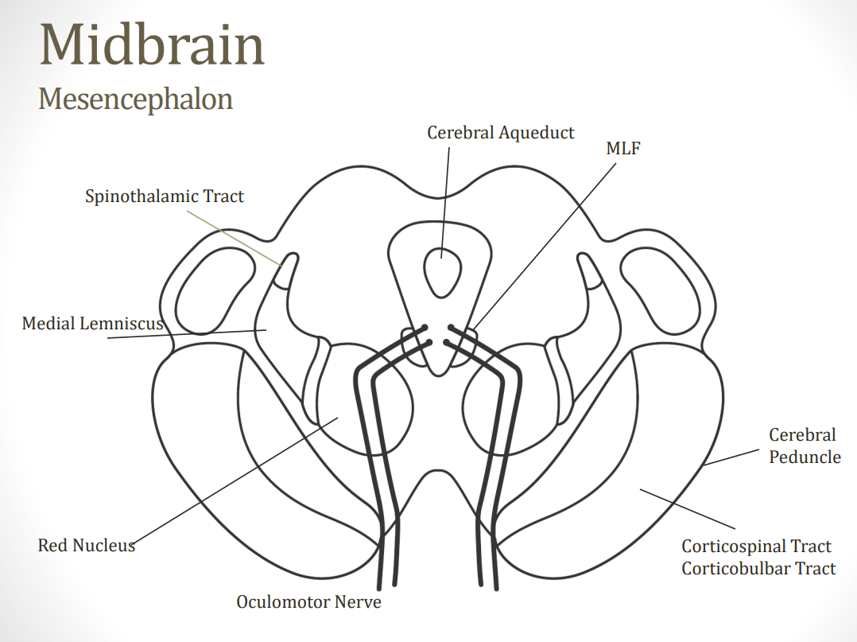

Slide 48
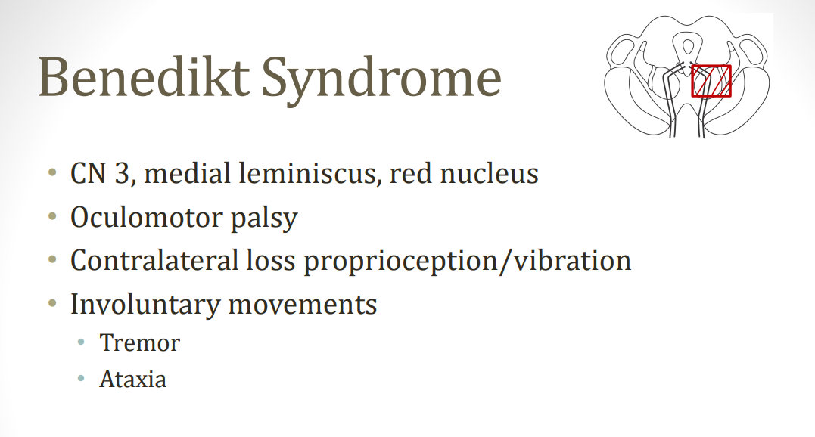

Slide 49
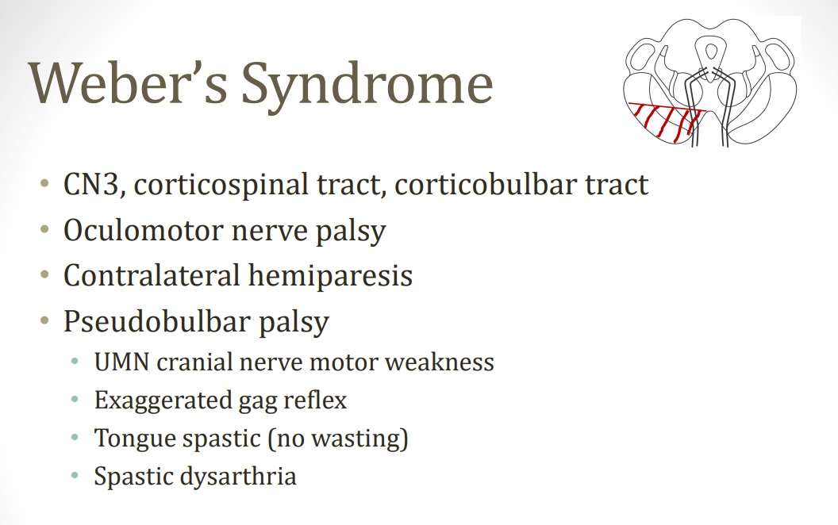

Slide 50
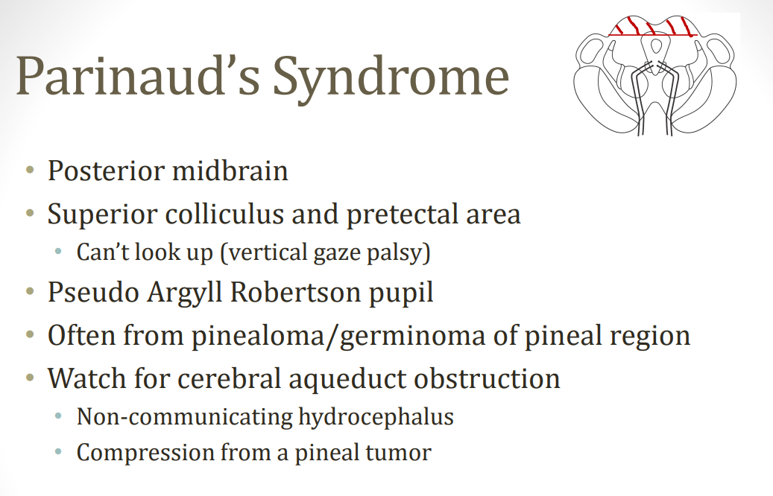

Slide 51
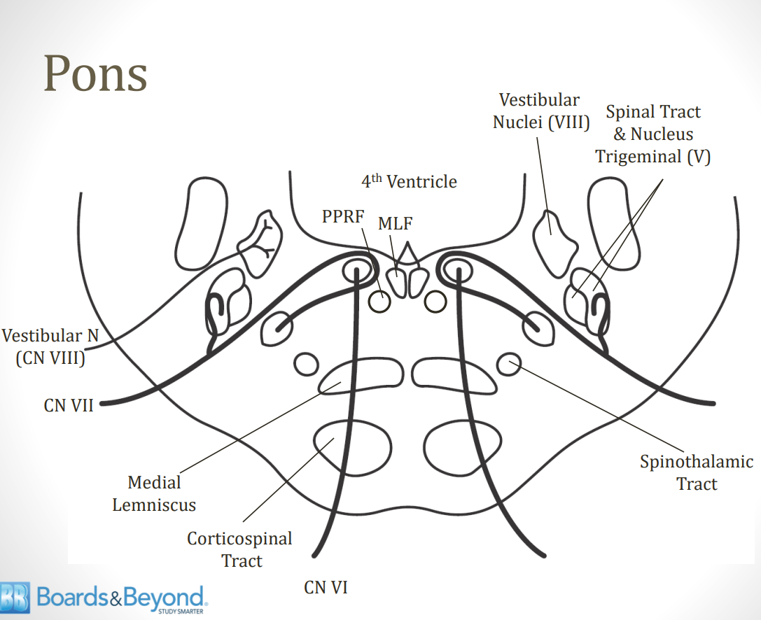

Slide 52
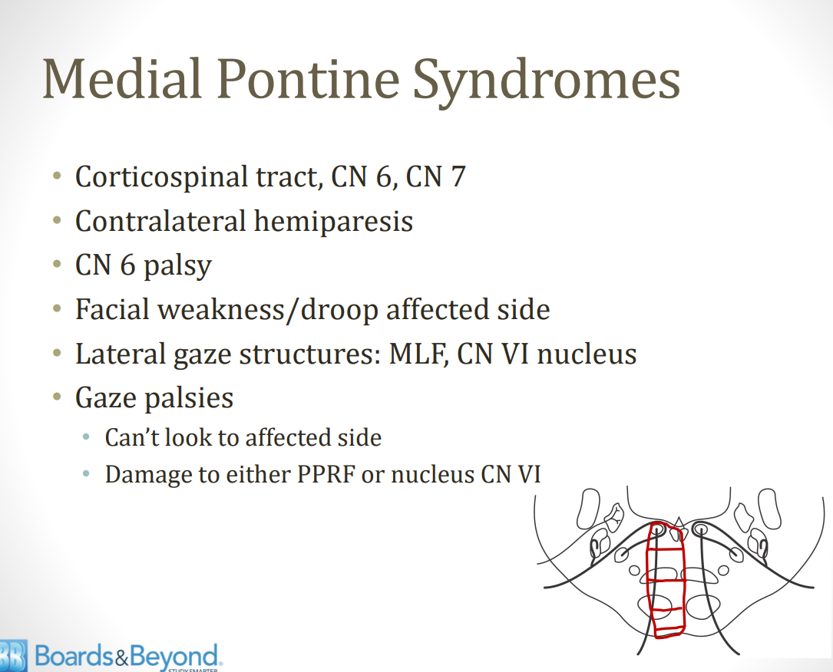

Slide 53
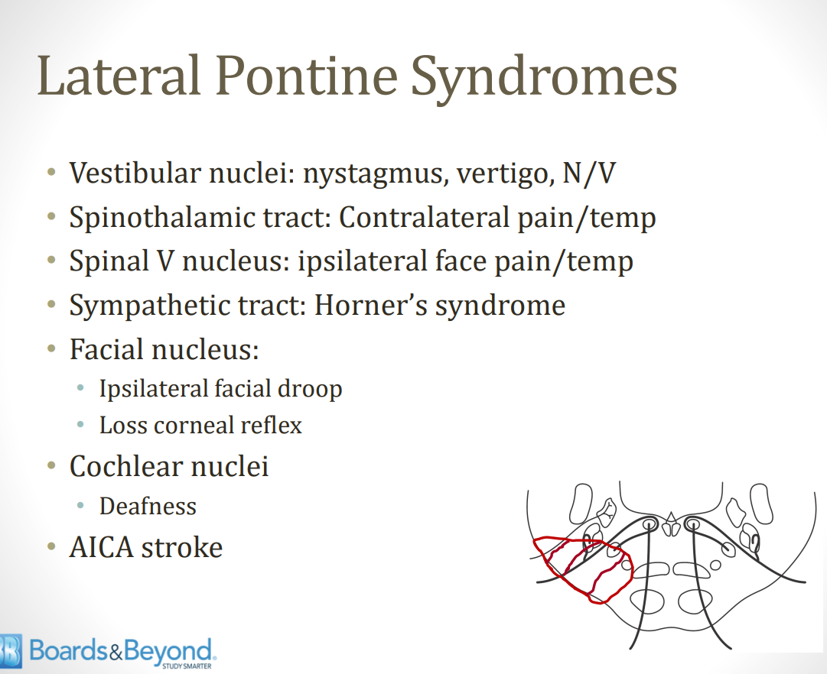

Slide 54
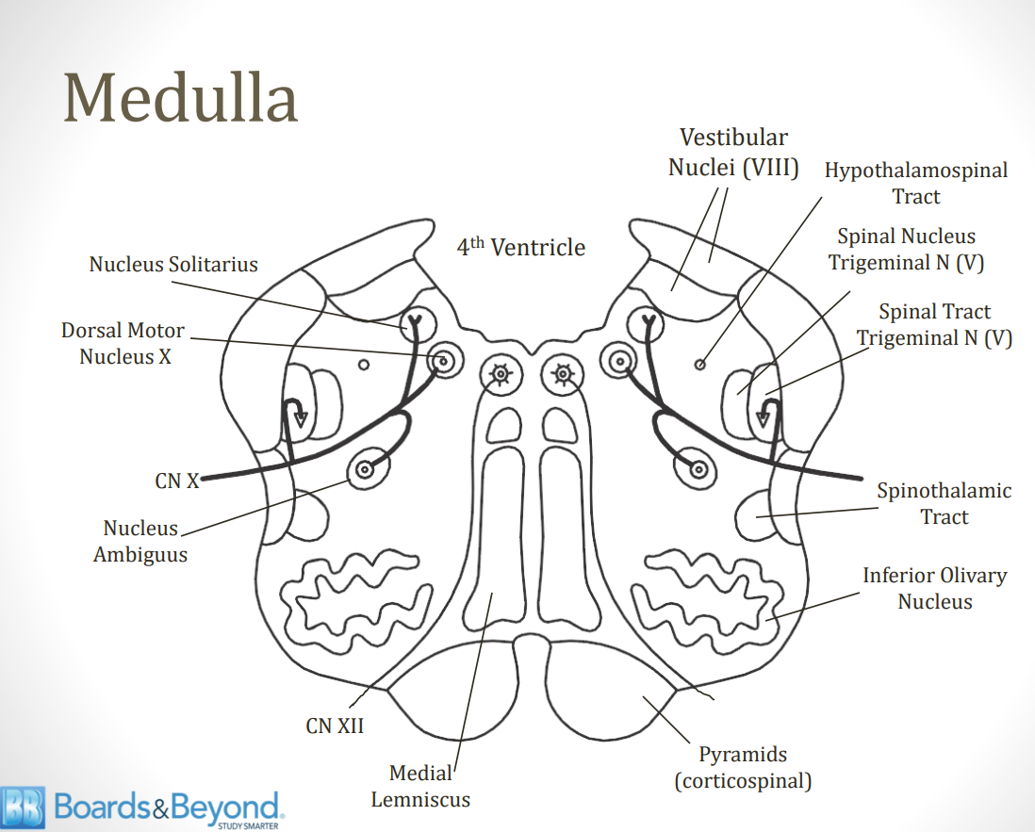

Slide 55
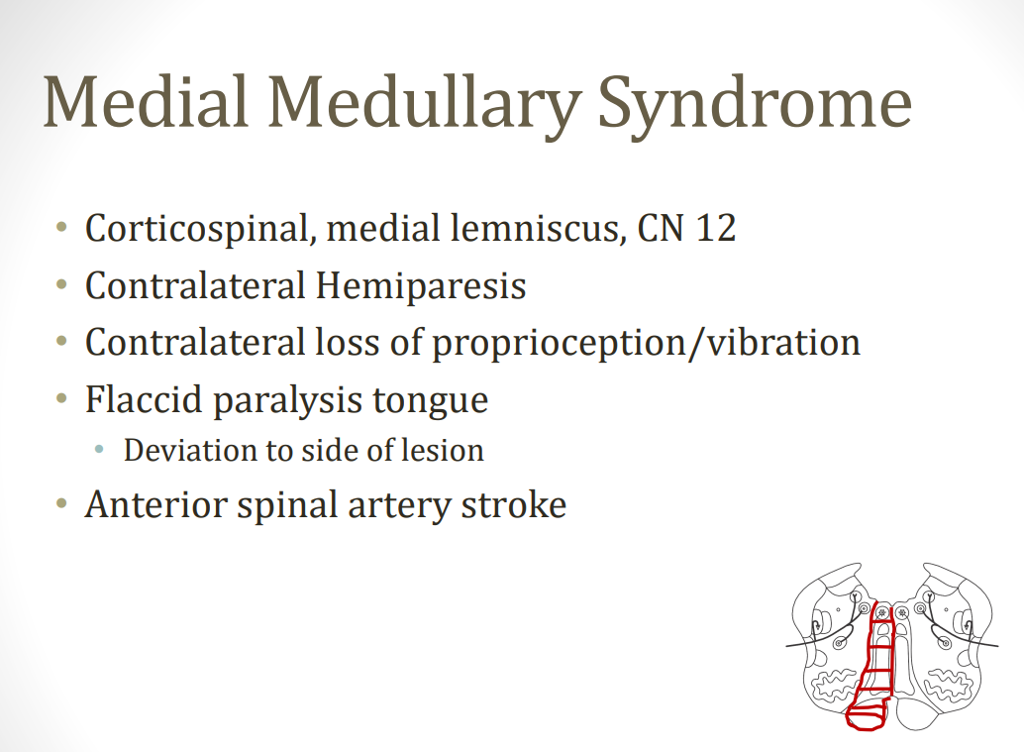

Slide 56
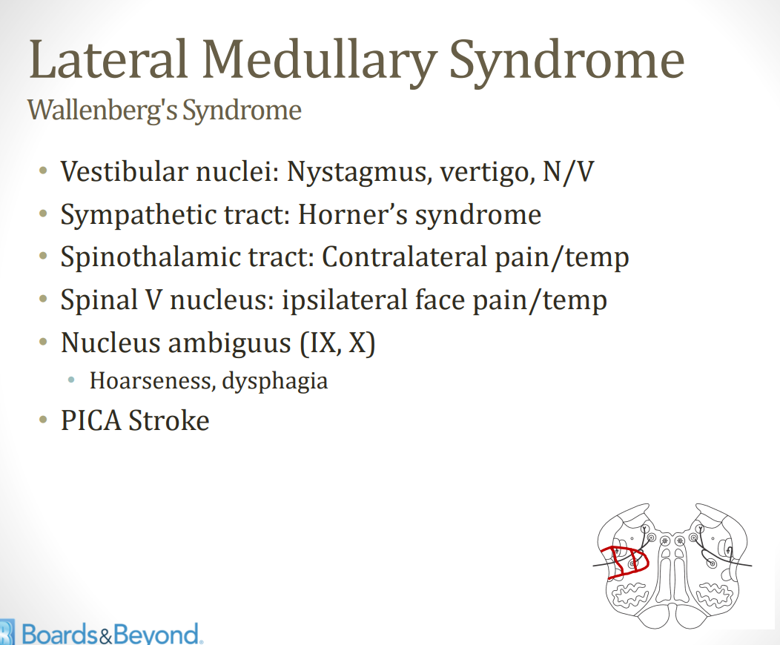

Slide 57
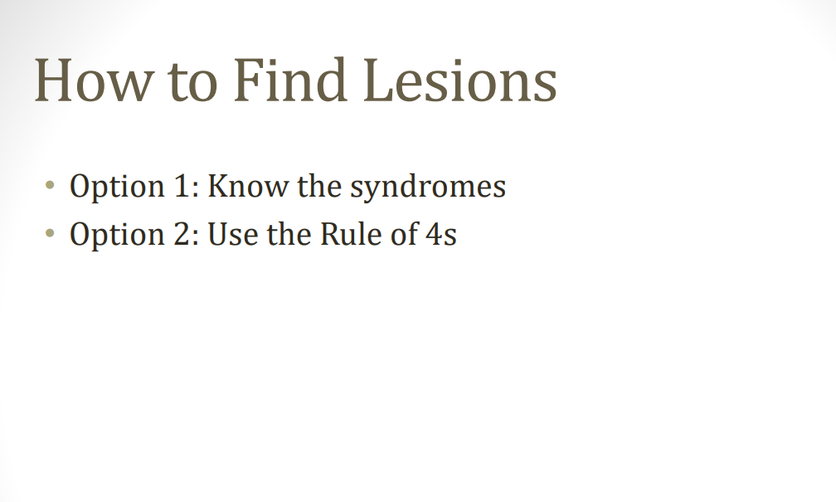

Slide 58
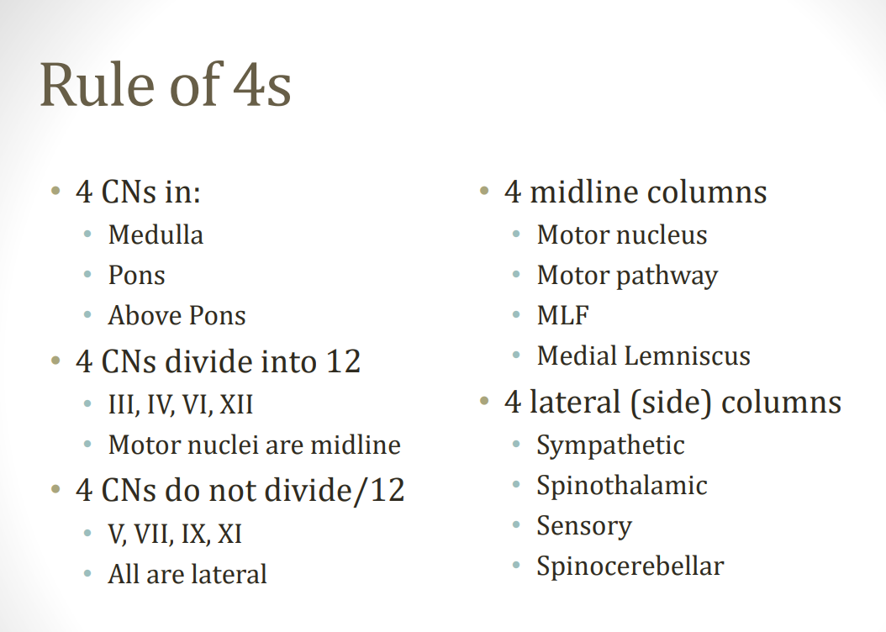

Slide 59
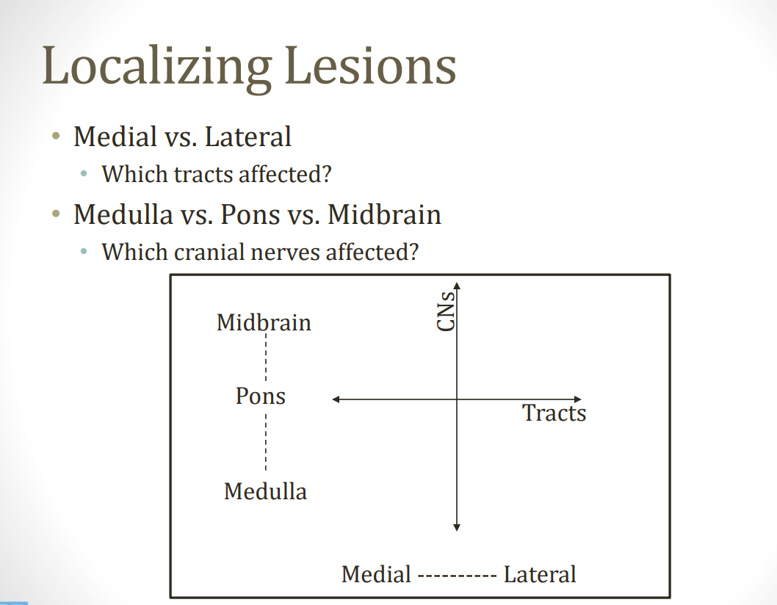

Slide 60
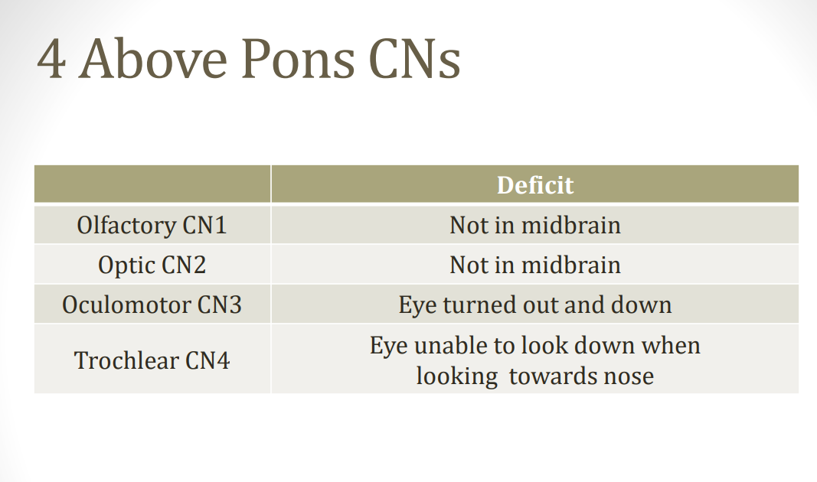

Slide 61
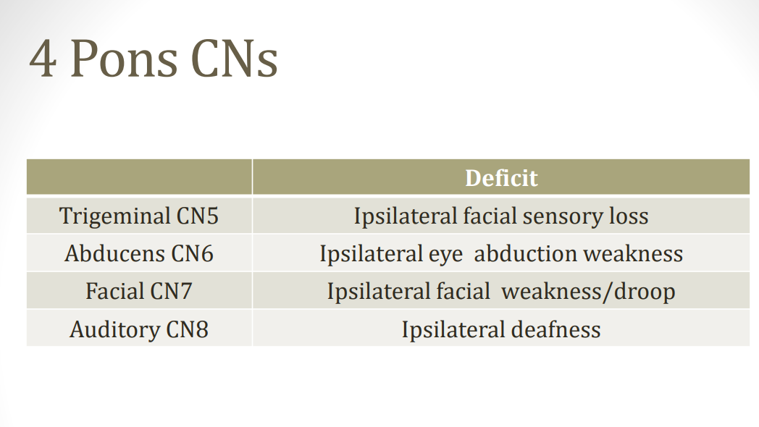

Slide 62
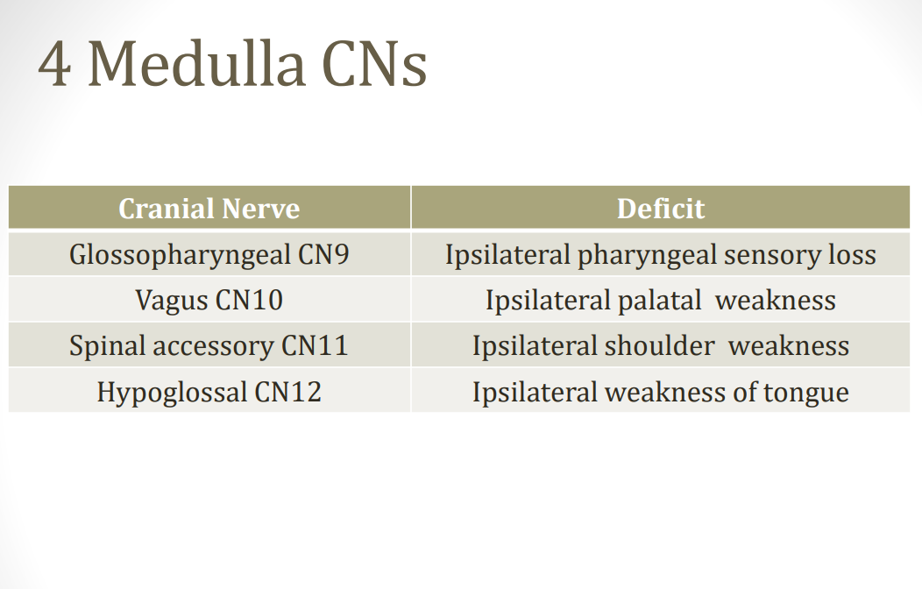

Slide 63


Slide 64


Slide 65


Slide 66


Slide 67


Slide 68


Slide 69


Slide 70


Slide 71


Slide 72


Slide 73


Slide 74


Slide 75


Slide 76


Slide 77
Thank You

